Slide 1
LINEAR PROGRAMMING · LESSONS 1 TO 7
Optimization Methods
Linear programming, from formulation to duality
7 lessons · 193 slides
Definitions · fundamentals · solved problems · applications
with an intuitive explanation of every idea
Nikhil Rajput

Slide 2
OPTIMIZATION METHODS · LESSON 01
Operations Research and the Modelling Approach
Linear Programming - Lesson 1
Nikhil Rajput
Notes:
Operations research is the use of scientific and mathematical method to study how a system actually operates, so that whoever runs it can be given an optimal or near-optimal course of action. That is the whole subject in one sentence, and this opening part unpacks it: what the discipline is and where it came from, the six phases through which a real study runs from problem to implementation, the families a model can belong to, and the translation that turns a paragraph of words into decision variables, an objective function and constraints. The mechanism throughout is the same. You strip a situation down to the quantities somebody can actually choose, the single number they want made as large or as small as possible, and the limits they cannot break; an algorithm then searches that written-down world instead of the real one. It matters because every method later assumes a model already exists and is correct. The caveat: the commonest failure in practice is not a wrong calculation but a well-solved wrong problem.

Slide 3
Learning Outcomes
by the end of this lesson you will be able to
• Define operations research and recount its origins.
• List and explain the phases of an OR study.
• Classify mathematical models by type and choose an appropriate class.
• Identify decision variables, the objective function and constraints in a verbal problem.
• Formulate a simple real-world problem as a mathematical programme.
OM-L01 · Operations Research and the Modelling Approach
Nikhil Rajput
3
Notes:
These five outcomes divide into knowing and doing. The first three are descriptive: define operations research and its origins, list the six phases through which a study proceeds, and place a model in a class — symbolic or physical, deterministic or random, linear or not. The last two are the skill itself: reading a verbal problem, naming its decision variables, its objective function and its constraints, then writing them as algebra. The mechanism behind that second pair is a fixed routine. Ask who decides and what they can change; that gives the variables. Ask what single quantity they want largest or smallest; that gives the objective. Ask what stops them; those are the constraints. The second half carries the weight, because a classification can be recited while a formulation cannot be faked. The caveat: the third outcome tempts you to memorise a taxonomy for its own sake. The taxonomy earns its place only because it picks the algorithm, so learn it by classifying models rather than by reciting names.

Slide 4
The big picture, in simple terms
Deciding what a factory should build this week is like packing one suitcase for a trip: the bag has a fixed size, everything you pack has a value, and you want the most useful bag you can still close.
• Every operating decision has three parts: what you may change, what you are trying to get, and what you cannot exceed.
• Write those three parts down as numbers and the decision stops being a contest of opinions.
• OR is not one formula. It is the discipline of writing a problem down honestly before solving it.
• The hard step is rarely the algebra; it is deciding what the problem actually is.
• This lesson is about that translation, from a paragraph of English into a model.
OM-L01 · Operations Research and the Modelling Approach
Nikhil Rajput
4
Notes:
A decision problem has three parts and no more, which is what the suitcase makes visible. What you may change is the set of items you choose to pack; those become the decision variables. What you are trying to get is the total usefulness of the packed bag, one number to be made as large as possible; that is the objective function. What you cannot exceed is the fixed size of the bag; that is a constraint. Finding the best bag means searching only over packings that fit and comparing them by that single number, which is exactly what an optimisation algorithm does. Once the three parts are written as numbers the decision stops being a contest of opinions and can be checked by anyone. The caveat is where the analogy stops. A real firm faces many limits at once — machine time, labour, material, policy — and they interact, so no amount of eyeballing finds the best plan. The hard step is still deciding what the problem is, not the algebra that follows.

Slide 5
What is Operations Research?
the working definition, and two worth knowing
• OR is the application of scientific and mathematical methods to the study of the operations of a system.
  – Its aim is to give decision-makers an optimal or near-optimal course of action.
  – Churchman, Ackoff and Arnoff: scientific methods, techniques and tools applied to problems involving the operations of systems,
  – so as to provide those in control of the system with optimum solutions to the problems.
  – Operational Research Society, UK: the attack of modern science on complex problems arising in the direction and management
  – of large systems of men, machines, materials and money.
OM-L01 · Operations Research and the Modelling Approach
Nikhil Rajput
5
Notes:
The working definition has three load-bearing parts: scientific method, applied to the operations of a system, in order to recommend a course of action. Each phrase restricts. Scientific method means observation, a stated model and testing against evidence, not judgement. Operations of a system means the running of an existing arrangement of people and machines, not a laboratory. A course of action means the output is a decision somebody can carry out. The word near-optimal is deliberate: a decision that must be taken this week and is provably close beats an exact answer arriving late. The two quoted definitions stress opposite halves. Churchman, Ackoff and Arnoff emphasise method and the person in control of the system, so the customer of the work is explicit. The Operational Research Society emphasises scale — the direction and management of large systems of men, machines, materials and money. The caveat: neither treats the subject as a bag of formulas, and a study with no identified decision-maker is not operations research at all.

Slide 6
The three defining characteristics
what separates OR from ordinary calculation
• A systems orientation - OR examines the whole system, not an isolated part.
  – Optimising one department may harm the organisation: this is sub-optimisation.
• An interdisciplinary team.
  – Mathematicians, statisticians, engineers, economists and domain experts working together.
• A scientific method.
  – Observe, formulate a hypothesis (the model), test, validate, implement.
OM-L01 · Operations Research and the Modelling Approach
Nikhil Rajput
6
Notes:
Three commitments, not the difficulty of the arithmetic, are what make a study operations research. A systems orientation means the boundary you draw around the problem includes everything the decision touches. Optimising one department may leave the organisation worse off; that failure has a name, sub-optimisation, and Problem 5 shows the idea producing a famous formula. An interdisciplinary team of mathematicians, statisticians, engineers, economists and domain experts exists because formulation needs two kinds of knowledge at once: the analyst does not know which constraints are real, and the manager does not know which could be relaxed cheaply. The scientific method here means treating the model as a hypothesis — observe, write it down, test it against behaviour already recorded, validate, only then implement. These matter because they are what a disputed answer can be checked against. The caveat: a model never tested against past behaviour is a conjecture however elegant, and the systems boundary is a judgement, so drawing it too wide produces a study that never finishes.

Slide 7
Historical origins
Period | Development
1937-1945 | Bawdsey 1937; radar and convoy work
1940s | Blackett's Circus, the first OR team
1947 | Dantzig invents the simplex method
1950s | Into industry: transport, inventory
1950s-60s | Dynamic programming; PERT/CPM 1958
1979 | Khachiyan's ellipsoid: LP is in P
1984 | Karmarkar's interior-point method
1990s-now | CPLEX, Gurobi; OR meets data science
1990-2020: 10⁶× from algorithms × 10⁶× from hardware = 10¹²×; a 1990 year-long solve now takes ~30 ms.
OM-L01 · Operations Research and the Modelling Approach
Nikhil Rajput
7
Notes:
The rows fall into two eras, and reading them that way explains why the subject looks as it does. The first block is wartime invention: the term operational research dates from Bawdsey Research Station in 1937, Blackett's Circus of the 1940s was the first interdisciplinary team, and Dantzig's simplex method of 1947 is the single most consequential event in the field because it made linear models solvable at all. Everything below that line widens what can be solved rather than what can be written: Khachiyan's ellipsoid method proved in 1979 that linear programming lies in P, Karmarkar's interior-point method of 1984 was polynomial and practical at once, and commercial solvers followed. The footnote is where the arithmetic surprises. Between 1990 and 2020 solvers gained roughly 10⁶× from algorithms and 10⁶× from hardware, and the two factors multiply to 10¹²×, so a solve that took a year in 1990 now takes about 30 milliseconds. The caveat: algorithms bought as much as hardware, which is easy to forget.

Slide 8
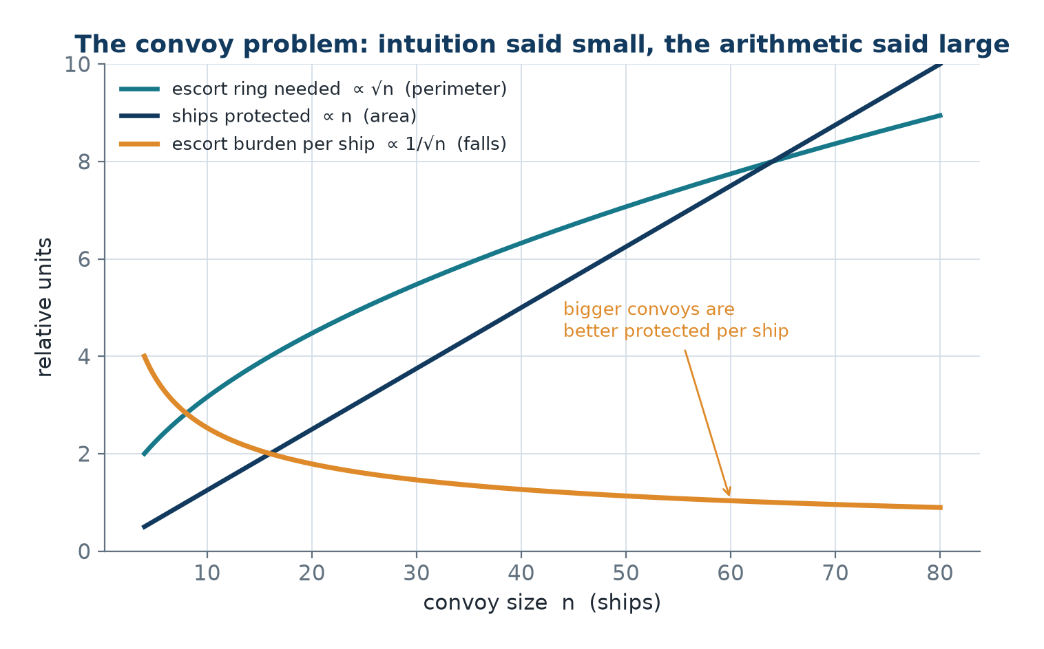
The convoy problem - OR against intuition
• Should merchant ships cross the Atlantic in small frequent convoys or large infrequent ones?
• The intuition, which is wrong: small convoys are less conspicuous.
• The escort ring scales with the perimeter, proportional to √n for n ships; the ships protected scale with n.
• U-boat detection depends on convoy frequency, not size, so the answer is large convoys.
Escort strength per ship rises with convoy size, so large convoys won.
OM-L01 · Operations Research and the Modelling Approach
Nikhil Rajput
8
Notes:
Look at how the two quantities in the picture grow, because the whole argument is a comparison of growth rates. Escorts have to ring the outside of a formation, so the escort strength needed is set by the perimeter, and for n ships in a compact formation the perimeter grows like √n while the ships protected inside grow like n. Divide one by the other and the escorts needed per ship fall like 1 ÷ √n. With the same escort fleet, every ship in a large convoy is therefore better defended than it would be in a small one. The second half disposes of the intuition that small convoys are less conspicuous: a submarine's chance of finding a convoy depends on how often convoys sail, not on how big each one is, so fewer and larger is also harder to find. The conclusion is large convoys, reached with no new data collected. The caveat: the perimeter law assumes a compact formation, and a long thin one loses much of the advantage.

Slide 9
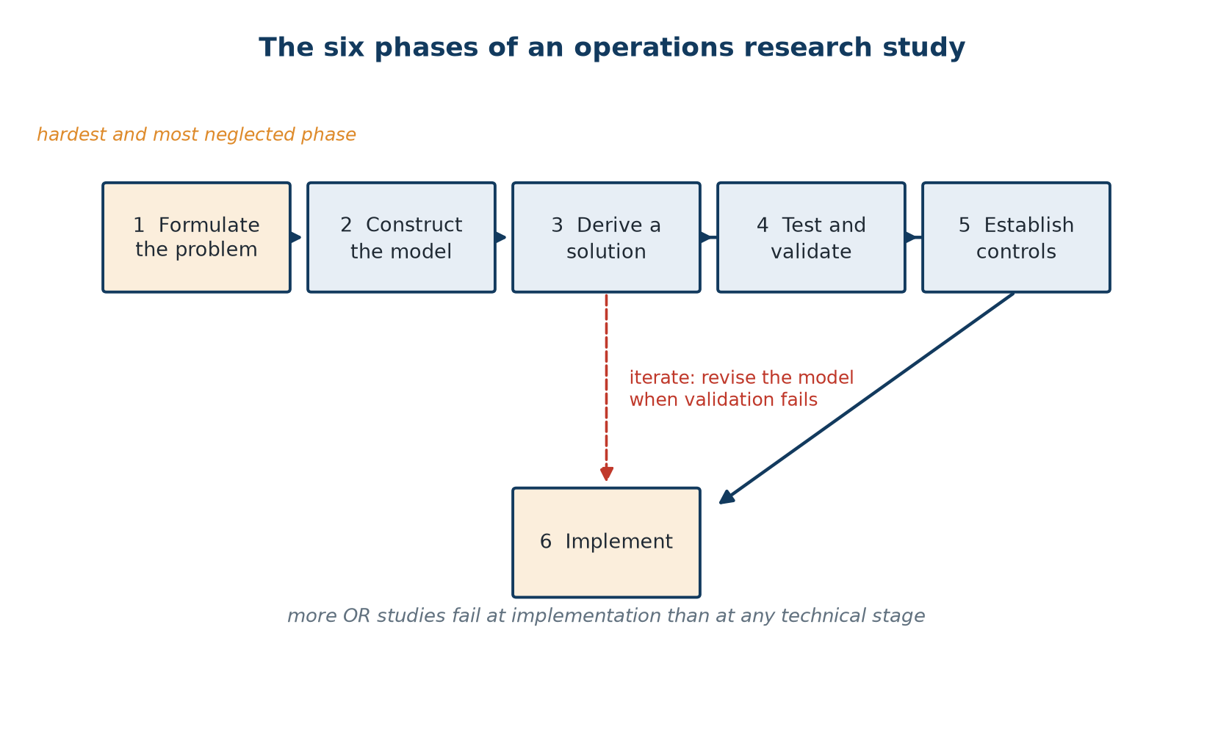
The six phases of an OR study
• Phases 3 to 5 iterate until the model survives testing.
• Formulation is typically the hardest and most neglected phase.
• A precisely solved wrong problem is worthless.
• More OR studies fail at implementation than at any technical stage.
Formulate → model → solve → validate → control → implement, with the iterate-back loop.
OM-L01 · Operations Research and the Modelling Approach
Nikhil Rajput
9
Notes:
The six phases are the standard life of a study: formulate the problem, construct the model, derive a solution, test and validate, establish controls, implement. Follow the solid arrows once, then follow the dashed return from controls back to deriving a solution. That loop is the mechanism — phases 3 to 5 repeat until the model survives testing, because a model that fails validation must be re-solved and is often rebuilt from the modelling phase upward. Knowing the sequence matters for a diagnostic reason rather than a memorising one: when a real study goes wrong, the sequence tells you which phase to return to instead of which formula to try next, since an answer that survives validation but looks absurd is a formulation fault, not an arithmetic one. Note where failures actually sit. Formulation and implementation, the first phase and the last, are where studies collapse, while deriving the solution — the phase drilled hardest in what follows — is the most reliable of the six. A precisely solved wrong problem is worthless.

Slide 10
The six phases in detail
• Phase 1 Formulate - identify the decision-maker, the objectives, the alternatives and the constraints.
• Phase 2 Model - translate the words into decision variables, an objective function and constraints.
  – Decide what to simplify; a model is a deliberate reduction, not a photograph.
• Phase 3 Solve - apply an algorithm: simplex, branch and bound, a queueing formula, simulation.
• Phase 4 Validate - does the model reproduce known past behaviour? Retrospective testing is standard.
• Phase 5 Controls - sensitivity analysis says which parameters matter and how far they may drift.
• Phase 6 Implement - turn the solution into procedures people will actually follow.
OM-L01 · Operations Research and the Modelling Approach
Nikhil Rajput
10
Notes:
Each phase has a definite output. Formulation names the decision-maker, the objectives, the alternatives and the constraints. Modelling turns those words into decision variables, an objective function and constraints. Solving applies an algorithm — simplex, branch and bound, a queueing formula, simulation. Two phases deserve more than the single line they get. Validation means retrospective testing: feed the model the parameters of a period already past and check that it would have recommended roughly what actually happened, or explain convincingly why it would have done better. Controls means sensitivity analysis, which asks which parameters matter and how far each may drift before the recommended plan stops being best. Implementation turns that plan into procedures people will actually follow. This matters because it converts a vague sense that a model is good into two concrete tests you can run. The caveat is hidden in the modelling phase: a model is a deliberate reduction, not a photograph, so every simplification is a decision you should be able to defend aloud.

Slide 11
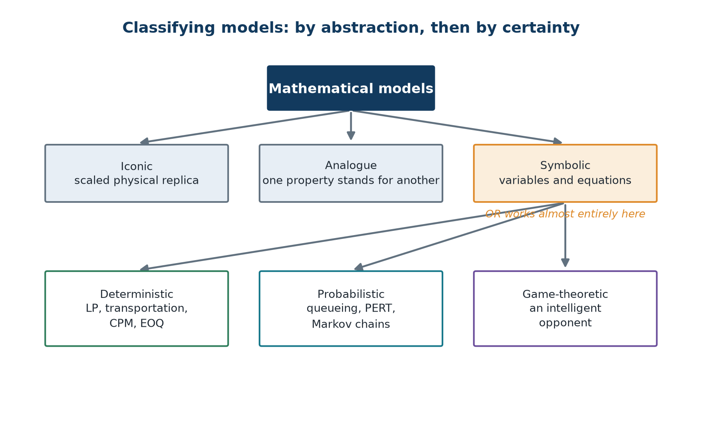
Types of model
• By abstraction: iconic, analogue, symbolic.
• By certainty: deterministic, probabilistic, game-theoretic.
• OR works almost entirely with symbolic (mathematical) models.
• A third axis, mathematical structure, gives the six model classes this course covers.
Two independent axes: how abstract the model is, and how certain its data is.
OM-L01 · Operations Research and the Modelling Approach
Nikhil Rajput
11
Notes:
A model is a stand-in for a system, and the figure sorts stand-ins by two questions asked at once. The first is how abstract the model is: iconic means a scaled physical replica, analogue means one property standing in for another, symbolic means variables and equations. The second is how certain its data is: deterministic when every parameter is known, probabilistic when some are random, game-theoretic when an intelligent opponent chooses. The axes are independent, so you answer both about the same model — a linear programme is symbolic and deterministic together, not one or the other. Follow the first split down to the symbolic branch, where operations research almost entirely lives. The reason is not snobbery about physical models but arithmetic: only a symbolic model can be optimised. You can measure a wind-tunnel replica, but you cannot differentiate it or hand it to a solver. The caveat: these two axes narrow the technique without choosing it. A third axis, mathematical structure, is what finally names the algorithm.

Slide 12
Models by abstraction and by certainty
Axis | Type | What it means | Example
Abstraction | Iconic | a scaled physical replica | wind-tunnel aircraft model
Abstraction | Analogue | one property represents another | contour map; circuit analogy
Abstraction | Symbolic | variables and equations | max 3x₁ + 5x₂ s.t. constraints
Certainty | Deterministic | all parameters known exactly | LP, transportation, CPM, EOQ
Certainty | Probabilistic | some parameters are random | queueing, PERT, Markov chains
Certainty | Game-theoretic | an intelligent opponent chooses | game theory
OR works almost entirely with symbolic models.
OM-L01 · Operations Research and the Modelling Approach
Nikhil Rajput
12
Notes:
The rows are two separate questions stacked in one table, with the axis column saying which is being asked. Abstraction runs from a wind-tunnel aircraft model, a scaled replica, through a contour map or a circuit standing in for a mechanical system, to the highlighted symbolic row where the model is nothing but variables and equations, such as max 3x₁ + 5x₂ subject to constraints. The certainty block asks instead where the numbers come from. Notice that its third class differs in kind rather than merely in difficulty. Randomness is indifferent to you, so averaging over it is meaningful and expected values are a legitimate objective, whereas an intelligent opponent reacts to whatever you choose, which is why game theory needs a solution concept of its own rather than a harder integral. Treat the last column as a checklist: linear programming, transportation, CPM and the economic order quantity are deterministic; queueing, PERT and Markov chains are not. The caveat: a deterministic model of a random world is a choice you must justify.

Slide 13
Models by mathematical structure
Model | Objective | Constraints | Variables
Linear programming | linear | linear | continuous
Integer programming | linear | linear | integer
Mixed integer | linear | linear | both
Non-linear programming | non-linear | any | continuous
Quadratic programming | quadratic | linear | continuous
Dynamic programming | any | staged | any
This course covers all six.
OM-L01 · Operations Research and the Modelling Approach
Nikhil Rajput
13
Notes:
This is the classification that chooses the algorithm, and the columns are the three questions to ask of any new problem: is the objective linear, are the constraints linear, must the variables come out whole? Linear programming answers linear, linear, continuous. Integer programming changes only the last answer, mixed integer allows both kinds of variable in one model, non-linear and quadratic programming relax the objective, and dynamic programming replaces a constraint set with stages. The rows are arranged to show how little changes on paper before the difficulty changes enormously. Compare the first two: the only difference is that the variables must be whole numbers, yet a problem solvable in milliseconds becomes one that can be NP-hard, where the work grows explosively with size, because you can no longer follow a continuous path of small improvements to the answer. Insisting on whole tables and chairs is not harmless tidying-up. The caveat: round a continuous solution afterwards and the result may be infeasible, not merely slightly worse.

Slide 14
Anatomy of a mathematical programme
Optimise Z = f(x₁, x₂, ..., xₙ) objective function
subject to gᵢ(x₁, ..., xₙ) {≤, =, ≥} bᵢ, i = 1, ..., m
constraints
xⱼ ≥ 0, j = 1, ..., n non-negativity
Every optimisation model has exactly these three components.
OM-L01 · Operations Research and the Modelling Approach
Nikhil Rajput
14
Notes:
Read this notation slowly the first time, because everything later is written in it. There are n decision variables, x₁ through xₙ, indexed by j, and one decision is one choice of values for all of them. Z is the single number you care about and f is whatever rule turns a choice of variables into that number, so Z = f(x₁, ..., xₙ) is the objective function. There are m constraints, indexed by i: constraint i combines the variables into one quantity gᵢ and compares it with a limit bᵢ. The braces {≤, =, ≥} mean choose the appropriate sign for that row; it is not a set you must satisfy all of, and different rows may carry different signs. The last line, xⱼ ≥ 0, is non-negativity, written separately only because almost every model needs it. The three lines matter because they are exhaustive. The caveat: f and gᵢ are arbitrary functions here, and only when both are linear does the simplex method apply.

Slide 15
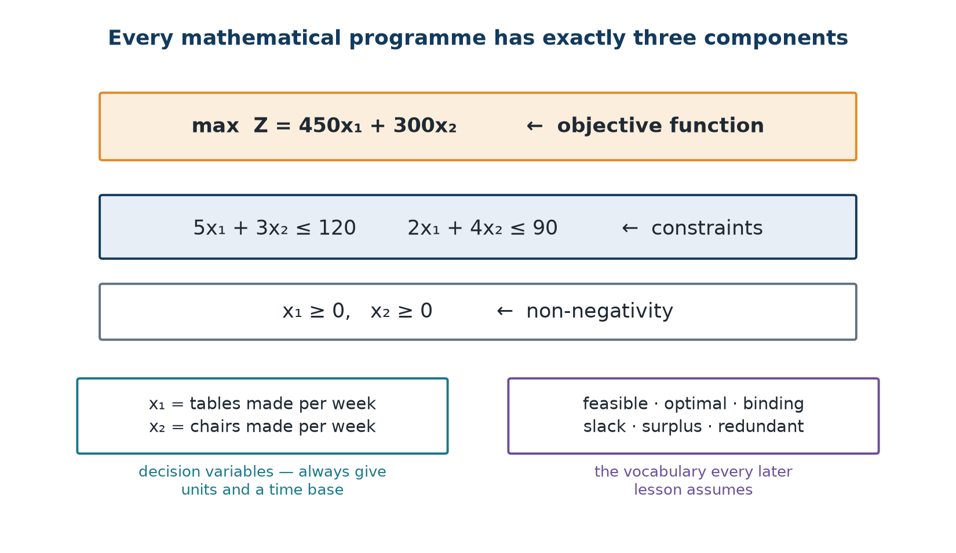
The three components, labelled
• Decision variables are the quantities under the decision-maker's control.
• Always define them with units and a time base: x₁ = tonnes of product A per week.
• The objective is the single quantity to maximise (profit, throughput) or minimise (cost, time).
• Constraints cover resources, requirements, capacity, policy rules and non-negativity.
Decision variables, one objective function, and the constraint set.
OM-L01 · Operations Research and the Modelling Approach
Nikhil Rajput
15
Notes:
These three boxes are the entire inventory of parts; there is no fourth. Decision variables are the quantities genuinely under the decision-maker's control — not measurements, not outcomes, but numbers somebody sets. The objective is the single quantity to maximise, such as profit or throughput, or to minimise, such as cost or time. Constraints are everything limiting the choice: resource availability, demand requirements, capacity, policy rules and non-negativity. Name all three for a verbal problem and you have formulated it; miss one and you have an essay. The units-and-time-base rule is the mechanism that keeps this honest. Write x₁ = tonnes of product A per week, not x₁ = product A, because every coefficient multiplying x₁ must then agree with those units, so a mismatch becomes visible instead of silent. A large share of formulation errors trace back to a variable whose units were never fixed. The caveat: single means single. Given two objectives, one is really a constraint, or they need explicit weights somebody owns.

Slide 16
Terminology you will use all term
Solutions and regions
Constraints and their status
• Feasible solution - any point satisfying all constraints.
• Feasible region - the set of all feasible solutions.
• Optimal solution - a feasible solution giving the best objective value.
• Infeasible - no solution satisfies all constraints.
• Unbounded - the objective can be improved without limit.
• Redundant constraint - removing it does not change the feasible region.
• Binding (active) constraint - holds with equality at the optimum.
• Slack - the unused amount of a ≤ resource.
• Surplus - the excess over a ≥ requirement.
OM-L01 · Operations Research and the Modelling Approach
Nikhil Rajput
16
Notes:
The two columns describe different things, which is why they are separated: the left names properties of solutions, the right names properties of constraints. A feasible solution is any point satisfying every constraint, the feasible region is the set of all of them, and an optimal solution is a feasible point with the best objective value. Infeasible means no point satisfies all constraints at once; unbounded means the objective can be improved without limit. On the right, a redundant constraint can be deleted without changing the region, a binding constraint holds with equality at the optimum, slack is the unused amount of a ≤ resource and surplus the excess over a ≥ requirement. Make them concrete on the furniture problem that follows. At the plan making 24 tables and no chairs, all 120 carpentry hours are consumed, so that constraint is binding, while finishing has 42 hours of slack. The caveat: infeasible and unbounded are findings about your model, not solver failures — a constraint nobody imposes, or one you forgot.

Slide 17
Solved Problem 1 - Product-mix formulation
A furniture firm makes tables and chairs. A table needs 5 hours of carpentry and 2 hours of finishing; a chair needs 3 hours of carpentry and 4 hours of finishing. Weekly capacity is 120 hours of carpentry and 90 hours of finishing. Profit is ₹450 per table and ₹300 per chair. Formulate an LP to maximise weekly profit.
Step 1 - Decision variables
x₁ = number of tables produced per week
x₂ = number of chairs produced per week
Step 2 - Objective function, weekly profit in ₹
max Z = 450x₁ + 300x₂
Step 3 - Constraints and the complete model
5x₁ + 3x₂ ≤ 120 (carpentry, 5 h and 3 h against 120 h)
2x₁ + 4x₂ ≤ 90 (finishing, 2 h and 4 h against 90 h)
x₁, x₂ ≥ 0 (non-negativity)
max Z = 450x₁ + 300x₂ subject to those three lines
Step 4 - Tabulate first, then read the model off
Carpentry (h): table 5, chair 3, available 120
Finishing (h): table 2, chair 4, available 90
Profit (₹): table 450, chair 300 - maximise
Each row is a constraint; the bottom row is the objective.
x₁ = 15, x₂ = 15, Z = ₹11,250
Solved graphically in L03 and by simplex in L05. Students who build the data table first make far fewer formulation errors.
OM-L01 · Operations Research and the Modelling Approach
Nikhil Rajput
17
Notes:
The technique here is the data table, and it is the step to take first because the statement hides eight numbers inside three sentences. Build one column per thing you can decide and one row per thing that limits you: carpentry 5 and 3 against 120 hours, finishing 2 and 4 against 90, profit ₹450 and ₹300 to be maximised. Each resource row then reads off directly as a constraint, 5x₁ + 3x₂ ≤ 120 and 2x₁ + 4x₂ ≤ 90, and the bottom row becomes the objective, max Z = 450x₁ + 300x₂. It works because every coefficient is a rate — 5 hours per table — so multiplying by x₁, the number of tables per week, converts a decision into a resource usage measured in the same units as the 120 hours available. Students who tabulate first make far fewer formulation errors. The caveat: non-negativity is absent from the table because it comes from common sense, and omitting x₁, x₂ ≥ 0 is a standard route to an absurd answer.

Slide 18
Solved Problem 2 - Diet problem formulation
A nutritionist must design a minimum-cost daily diet from two foods. Food A costs ₹12 per unit and provides 4 units of protein, 2 of fat and 8 of carbohydrate. Food B costs ₹20 per unit and provides 9 units of protein, 5 of fat and 3 of carbohydrate. The diet must supply at least 36 units of protein and 20 of fat, and at most 40 units of carbohydrate. Formulate.
Step 1 - Decision variables
x₁ = units of Food A per day
x₂ = units of Food B per day
Step 2 - Objective, minimise cost in ₹
min Z = 12x₁ + 20x₂
Step 3 - Constraints
4x₁ + 9x₂ ≥ 36 (protein - at least)
2x₁ + 5x₂ ≥ 20 (fat - at least)
8x₁ + 3x₂ ≤ 40 (carbohydrate - at most)
x₁, x₂ ≥ 0
Step 4 - Getting the inequality directions right
Nutritional requirements give ≥; limits give ≤.
Ask: would more of this be a problem or a benefit?
Benefit ⟹ ≥ ; problem ⟹ ≤ .
Confusing them is the commonest error in diet problems.
Posed by the US Army in 1945 and solved heuristically by George Stigler (77 foods, 9 nutrients); Dantzig solved it exactly by simplex in 1947.
OM-L01 · Operations Research and the Modelling Approach
Nikhil Rajput
18
Notes:
Structurally this is the product-mix problem run backwards: minimise rather than maximise, requirements rather than capacities. The variables are units of Food A and Food B per day, the objective is min Z = 12x₁ + 20x₂, and each nutrient becomes one row: 4x₁ + 9x₂ ≥ 36 for protein, 2x₁ + 5x₂ ≥ 20 for fat, 8x₁ + 3x₂ ≤ 40 for carbohydrate. Requirements give ≥ and limits give ≤, so one model carries inequalities in both directions. Step 4 is the part to internalise, because the reliable check is a question rather than a rule: would more of this be a benefit or a problem? Benefit gives ≥, problem gives ≤. It matters because a reversed sign does not produce a slightly wrong answer, it produces a confident answer to a different question. Write the protein requirement as ≤ 36 and eating nothing satisfies it, so the cheapest diet costs ₹0; write carbohydrate as ≥ 40 and the model recommends pure sugar. The caveat: this is the commonest error in diet problems.

Slide 19
Solved Problem 3 - Blending with a ratio constraint
A refinery blends two crude oils into petrol. Crude 1 costs ₹60 per barrel and is 40 % octane; Crude 2 costs ₹85 per barrel and is 70 % octane. At least 8000 barrels of blend are needed, with an octane content of at least 55 %. Supply of Crude 2 is limited to 5000 barrels. Formulate.
Step 1 - Variables and objective
x₁ = barrels of Crude 1, x₂ = barrels of Crude 2
min Z = 60x₁ + 85x₂
Step 2 - Volume and supply
x₁ + x₂ ≥ 8000 (total blend required)
x₂ ≤ 5000 (supply limit on Crude 2)
Step 3 - Octane: non-linear as written, then linearised
(0.40x₁ + 0.70x₂) / (x₁ + x₂) ≥ 0.55
Multiply by (x₁ + x₂) > 0: 0.40x₁ + 0.70x₂ ≥ 0.55x₁ + 0.55x₂
−0.15x₁ + 0.15x₂ ≥ 0 ⟹ x₂ ≥ x₁
At least as much high-octane crude as low-octane crude.
Step 4 - Complete model and a feasibility check
min Z = 60x₁ + 85x₂
s.t. x₁ + x₂ ≥ 8000, x₂ − x₁ ≥ 0, x₂ ≤ 5000
x₁, x₂ ≥ 0
The three force x₁ ≥ 3000 and x₁ ≤ x₂ ≤ 5000, so the region is non-empty.
Ratio and percentage requirements are always linearisable by cross-multiplying, provided the denominator is guaranteed positive.
OM-L01 · Operations Research and the Modelling Approach
Nikhil Rajput
19
Notes:
Octane is a property of the mixture rather than a quantity you can add up, so the requirement arrives as a fraction: the octane carried by the blend, 0.40x₁ + 0.70x₂, divided by the total barrels, x₁ + x₂, must be at least 0.55. A fraction with variables in its denominator is not a linear constraint, so no linear programming algorithm can touch it as written. Cross-multiplying is the fix. Multiply both sides by (x₁ + x₂) to get 0.40x₁ + 0.70x₂ ≥ 0.55x₁ + 0.55x₂, collect terms into −0.15x₁ + 0.15x₂ ≥ 0, and divide by 0.15 to reach x₂ ≥ x₁. The step is legitimate only because the requirement of at least 8000 barrels guarantees x₁ + x₂ is strictly positive, so the ≥ keeps its direction. Then check the result in words: 55 % sits exactly halfway between 40 % and 70 %, so an equal split is the weakest passing mix, which is precisely x₂ ≥ x₁. The caveat: multiplying by something that could be zero destroys the constraint.

Slide 20
Solved Problem 4 - Multi-period production planning (1 of 2)
A firm faces demand of 100, 150 and 120 units in months 1, 2 and 3. Production capacity is 130 units per month. Production costs ₹50 per unit; holding inventory costs ₹8 per unit per month. Initial inventory is zero. Formulate an LP minimising total cost.
Step 1 - Two families of decision variables
pⱼ = units produced in month j, j = 1, 2, 3
Iⱼ = inventory carried from month j to month j+1, j = 1, 2, 3
Step 2 - Objective
min Z = 50(p₁ + p₂ + p₃) + 8(I₁ + I₂ + I₃)
Step 3 - Inventory balance, the key structural idea
opening inventory + production = demand + closing inventory
Month 1: 0 + p₁ = 100 + I₁ ⟹ p₁ − I₁ = 100
Month 2: I₁ + p₂ = 150 + I₂ ⟹ I₁ + p₂ − I₂ = 150
Month 3: I₂ + p₃ = 120 + I₃ ⟹ I₂ + p₃ − I₃ = 120
Step 4 - Capacity and non-negativity
pⱼ ≤ 130, j = 1, 2, 3
pⱼ, Iⱼ ≥ 0
Requiring Iⱼ ≥ 0 is what forbids backordering.
Letting Iⱼ go negative would model backorders instead.
OM-L01 · Operations Research and the Modelling Approach
Nikhil Rajput
20
Notes:
Two families of variables are needed, and the second is what makes this one model rather than three unrelated monthly ones. pⱼ is the units produced in month j and Iⱼ the inventory carried from month j into month j+1; the Iⱼ are the only channel through which a month can use something made earlier. The balance equation is pure accounting rather than an optimisation trick — opening inventory plus production equals demand plus closing inventory — and written once per month from an opening stock of zero it gives p₁ − I₁ = 100, I₁ + p₂ − I₂ = 150 and I₂ + p₃ − I₃ = 120, which is conservation of stuff and nothing more. The same identity returns in transportation, network flow and dynamic programming. Capacity adds pⱼ ≤ 130 for every month. The caveat is what the sign restriction encodes: Iⱼ ≥ 0 is the modelling statement that backorders are forbidden, and nothing else in the model says so.

Slide 21
Solved Problem 4 - Multi-period production planning (2 of 2)
Step 5 - Why production must be smoothed
Total demand = 100 + 150 + 120 = 370 units
Total capacity = 3 × 130 = 390 units, so the plan is feasible overall
But month 2 demand of 150 exceeds the monthly capacity of 130
So the firm must build inventory in month 1.
Step 6 - The obvious feasible plan
p₁ = 120, carrying I₁ = 20
p₂ = 130, carrying I₂ = 0
p₃ = 120, I₃ = 0
Step 7 - Cost of that plan
Z = 50(370) + 8(20 + 0 + 0)
Z = 18,500 + 160
Z = ₹18,660
Step 8 - Why it is optimal
Production cost per unit is constant and total production is fixed at 370.
So minimising total cost means minimising inventory.
Carrying exactly 20 units for one month is the minimum required.
Varying monthly production costs would make this a genuine lot-sizing trade-off.
p₁ = 120, p₂ = 130, p₃ = 120, I₁ = 20, Z = ₹18,660
The standard lot-sizing model; overtime or seasonal labour is what makes the trade-off interesting.
OM-L01 · Operations Research and the Modelling Approach
Nikhil Rajput
21
Notes:
Step 5 derives a bound rather than guessing a plan. Total demand is 100 + 150 + 120 = 370 units against a total capacity of 3 × 130 = 390, so the plan is feasible overall, but month 2 needs 150 against a monthly capacity of 130, so stock must be built earlier. Made precise, month 2's balance rearranges to I₁ = 150 + I₂ − p₂, and with p₂ ≤ 130 and I₂ ≥ 0 that forces I₁ ≥ 20 in every feasible plan, not merely in sensible ones. The bound is what turns Step 8 into a proof rather than an assertion. Production costs ₹50 per unit and total production is fixed at 370 whenever it happens, so ₹18,500 is unavoidable and minimising cost reduces to minimising inventory at ₹8 per unit per month. The plan carries exactly the 20 unit-months the bound demands, giving Z = 18,500 + 160 = ₹18,660. The caveat: let production cost vary by month and a genuine lot-sizing trade-off appears.

Slide 22
Solved Problem 5 - Recognising sub-optimisation
A manufacturer's production department is rewarded for minimising unit cost, and therefore runs very long production batches. The warehouse is separately rewarded for minimising inventory. Sales is rewarded for never missing an order. Explain the conflict in OR terms and state the correct formulation.
Step 1 - The conflict, department by department
Production: minimise unit cost ⟹ very large batches ⟹ huge inventory
Warehouse: minimise inventory ⟹ very small batches ⟹ frequent setups
Sales: never stock out ⟹ large safety stock ⟹ high inventory
Each department is rational on its own metric, and the firm suffers.
Step 2 - Why it happens mathematically
Q = batch size, D = annual demand, Co = setup cost, Ch = holding cost per unit-year
Production: min (D × Co)/Q ⟹ Q → ∞
Warehouse: min (Q × Ch)/2 ⟹ Q → 0
They pull in opposite directions; neither alone has an interior optimum.
Step 3 - The correct, system-wide formulation
min over Q > 0: TC(Q) = (D × Co)/Q + (Q × Ch)/2
dTC/dQ = −(D × Co)/Q² + Ch/2 = 0
Q* = √(2 D Co / Ch), the Economic Order Quantity, derived in full in L31
It sits between the two departmental extremes; neither would propose it.
OM-L01 · Operations Research and the Modelling Approach
Nikhil Rajput
22

Slide 23
Solved Problem 5 - Recognising sub-optimisation (continued)
Step 4 - The organisational fix
Change the incentives, not just the mathematics.
Reward departments on total system cost, or use transfer prices.
This is why implementation (Phase 6) so often requires organisational change.
OR's first principle: optimise the system, not its parts.
Q* = √(2 D Co / Ch)
OM-L01 · Operations Research and the Modelling Approach
Nikhil Rajput
23
Notes:
This problem states the systems orientation as mathematics. Let Q be the batch size, D annual demand, Co the setup cost and Ch the holding cost per unit per year. Production, judged on unit cost, minimises (D × Co)/Q, which falls as Q grows and so drives Q towards infinity. The warehouse, judged on stock, minimises (Q × Ch)/2, which rises with Q and so drives Q towards zero. Each objective is a monotone function of Q, so neither has an interior optimum, and each department answering honestly on its own metric is driven to an absurd extreme. The correct move is to add the two costs that were separately owned and minimise the sum TC(Q), which does turn: dTC/dQ = −(D × Co)/Q² + Ch/2, and setting that to zero gives Q* = √(2 D Co / Ch), the economic order quantity, sitting between the two extremes. The caveat is Step 4 — the mathematics fixes nothing until the incentives themselves are rewritten, by rewarding total system cost or using transfer prices.

Slide 24
Where this modelling approach is used
Airline crew and fleet scheduling
The same three components at a scale of millions of columns; a solve that once took a year now takes minutes.
Refinery and cement blending
The octane cross-multiplication of Problem 3 is exactly how a refiner meets a grade specification at least cost.
Hospital nurse rostering
Demand per shift becomes a constraint row; the objective trades overtime cost against unfilled shifts.
E-commerce inventory planning
The inventory-balance identity of Problem 4 drives replenishment across warehouses, seasons and festival peaks.
Relief and vaccine logistics
Agencies allocate scarce trucks and cold-chain capacity across districts with the same feasible-region reasoning.
OM-L01 · Operations Research and the Modelling Approach
Nikhil Rajput
24
Notes:
Each item is the same three components at industrial scale, and each points back to one idea already seen. Airline crew and fleet scheduling is decision variables, one objective and constraints with millions of columns; such models were out of reach in 1990, which is what the solver speed-up bought. Refinery and cement blending is Problem 3's cross-multiplication, one linear row per percentage clause in the grade specification, which is how a refiner meets a specification at least cost. Nurse rostering turns demand per shift into a constraint row and trades overtime cost against unfilled shifts in the objective. E-commerce inventory planning is Problem 4's balance identity repeated across warehouses, seasons and festival peaks. Relief and vaccine logistics allocates scarce trucks and cold-chain capacity by the same feasible-region reasoning. These matter because the components scale without changing shape. The caveat is where rostering bites: an optimal roster that staff will not accept is worth nothing, which is the implementation phase asserting itself again.

Slide 25
Sub-optimisation, in simple terms
If every player in a cricket team is paid only on their own batting average, nobody takes the risky single that actually wins the match.
• Sub-optimisation is when every department does its own job perfectly and the company still loses money.
• Production wants long runs; the warehouse wants empty shelves. Both are right, and together they are wrong.
• The fix is one objective that adds up the costs each department was allowed to ignore.
• The EOQ Q* = √(2 D Co / Ch) is exactly that compromise, and no single department would have proposed it.
• This is why OR studies fail in meetings more often than in the mathematics.
OM-L01 · Operations Research and the Modelling Approach
Nikhil Rajput
25
Notes:
Sub-optimisation is what happens when every part of an organisation does its own job perfectly and the organisation still loses money. The mechanism is a measurement that is individually fair but collectively wrong, because each player's metric omits the value they create for somebody else. Pay a cricketer only on their own batting average and nobody takes the risky single that wins the match: the run is worth something to the team and nothing to the metric. The same thing happens when production is judged on unit cost, which rewards long runs, and the warehouse on stock held, which rewards empty shelves. Both are right on their own numbers, and together they are wrong. The fix is not to argue about who is right but to write one objective that adds up the costs each was allowed to ignore. The economic order quantity Q* = √(2 D Co / Ch) is that sum's minimum, which is why it sits between the two extremes and neither department would propose it. The caveat: studies fail in meetings more often than in the mathematics.

Slide 26
Common mistakes to avoid
• Defining variables with no units and no time base: write x₁ = tonnes of A per week, not x₁ = product A.
• Reversing inequality directions: requirements give ≥, limits give ≤.
• Leaving a ratio or percentage requirement non-linear instead of cross-multiplying it.
• Cross-multiplying without checking the denominator is strictly positive.
• Dropping the inventory-balance rows, or letting Iⱼ go negative when backorders are not allowed.
• Optimising one department in isolation - the sub-optimisation trap.
• Solving precisely the wrong problem: formulation is the phase most often skipped.
OM-L01 · Operations Research and the Modelling Approach
Nikhil Rajput
26
Notes:
These are ordered roughly by how quietly they fail, and quiet failure is what makes them dangerous. A variable with no units and no time base still solves, but nothing then checks that a weekly capacity is not constraining a daily quantity, so write x₁ = tonnes of A per week. A reversed inequality still solves too, and the rule is that requirements give ≥ while limits give ≤. Cross-multiplication appears twice on purpose: once for leaving a percentage requirement non-linear, which no algorithm can accept, and once for cross-multiplying without checking the denominator is strictly positive, since the step is invalid if the blend could be empty. Dropping an inventory-balance row disconnects the periods, and letting Iⱼ go negative silently permits backorders. All of these return confident answers to questions nobody asked. The caveat: the last two entries are not technical at all, which matches the profession's own experience that studies fail at the human ends rather than in the algebra.

Slide 27
Summary
• OR applies scientific method to system-level decisions: systems orientation, interdisciplinary team, scientific method.
• Born in WWII Britain; transformed by Dantzig's simplex method in 1947; LP solvers roughly 10¹²× faster since 1990.
• Six phases: formulate → model → solve → validate → control → implement; failures cluster at the first and the last.
• Models are iconic / analogue / symbolic, and deterministic / stochastic / game-theoretic.
• Every programme has decision variables, an objective function and constraints; define variables with units and a time base.
• Ratio and percentage requirements linearise by cross-multiplication when the denominator is positive.
• Multi-period models rest on opening + production = demand + closing; sub-optimisation is OR's central warning.
OM-L01 · Operations Research and the Modelling Approach
Nikhil Rajput
27
Notes:
Three things carry forward. First, the components are universal: every model ahead, however elaborate, is decision variables, one objective function and a constraint set, with variables defined by units and a time base, and every study runs formulate, model, solve, validate, control, implement. Second, two structural devices recur far beyond where they first appeared — cross-multiplying a ratio requirement into a linear row when the denominator is guaranteed positive, and the balance identity opening plus production equals demand plus closing, which is conservation applied one period at a time. Third, the classifications exist to pick an algorithm: iconic, analogue or symbolic, then deterministic, stochastic or game-theoretic, then mathematical structure. Behind all of it sits the history, from Dantzig's simplex method of 1947 to solvers roughly 10¹²× faster since 1990. The caveat is the warning worth keeping: a technically perfect answer to a departmental question is still the wrong answer, and formulation and implementation are where studies actually fail.

Slide 28
Practice problems
next lesson: L02 - introduction to linear programming and formulation
• 1. Two products need 2 and 3 hours of machine time with 60 hours available; profits are ₹40 and ₹50. Formulate.
• 2. Formulate a diet problem with three foods and two nutrients, choosing your own data.
• 3. A blend must be at most 30 % impurity from two sources with 20 % and 45 % impurity. Write the linear constraint.
  – Answer: −0.10x₁ + 0.15x₂ ≤ 0, that is 3x₂ ≤ 2x₁.
• 4. Extend the multi-period problem to four months with your own demand figures.
• 5. Classify each as deterministic or stochastic: EOQ, PERT, simplex, M/M/1, CPM.
• 6. State the six phases of an OR study and which is most often the cause of failure.
OM-L01 · Operations Research and the Modelling Approach
Nikhil Rajput
28
Notes:
Attempt these before moving on, because each rehearses one device rather than testing recall. Question 1 is the product-mix problem with one resource instead of two: the variables are units of each product, the objective is max 40x₁ + 50x₂, and the data table has a single row, 2x₁ + 3x₂ ≤ 60. Question 3 is the blending cross-multiplication with the inequality pointing the other way, because impurity is a problem rather than a benefit: write (0.20x₁ + 0.45x₂) / (x₁ + x₂) ≤ 0.30, multiply through by the positive total and collect terms to reach −0.10x₁ + 0.15x₂ ≤ 0, that is 3x₂ ≤ 2x₁, which is why the quoted answer carries ≤. Question 5 is a classification drill on the certainty axis: any model with a random parameter is stochastic, so PERT and M/M/1 go one way and EOQ, simplex and CPM the other. The caveat: Question 6 has a specific expected answer — formulation and implementation, not the solving step.

Slide 29
OPTIMIZATION METHODS · LESSON 02
Introduction to Linear Programming and Formulation
Linear Programming - Lesson 2
Nikhil Rajput
Notes:
A linear programme is an optimisation model in which one linear quantity is pushed as high or as low as possible while a set of linear equalities and inequalities is respected. Linear means every expression is a sum of constants times variables, c₁x₁ + c₂x₂ + ... + cₙxₙ, with no variable multiplied by another, raised to a power, or fed into a function. That restriction is what makes the whole subject work: flat constraints bound a convex region with corners, and a linear objective improves in one fixed direction, so a search over corners suffices. Two tasks follow, and this part covers both. Formulation is writing a real situation down in that restricted arithmetic, which is where nearly all modelling failures happen. Conversion is rewriting any such model mechanically into the one fixed shape an algorithm accepts. The asymmetry to keep in mind is that conversion is safe and formulation is not: the rewriting never changes the problem, but a careless formulation answers a different question entirely.

Slide 30
Learning Outcomes
by the end of this lesson you will be able to
• State the four assumptions of linear programming and recognise when they fail.
• Write an LP in general, canonical and standard form and convert between them.
• Convert inequalities to equations using slack, surplus and artificial variables.
• Handle unrestricted variables and ≥ constraints correctly.
• Formulate a range of applied problems as LPs.
OM-L02 · Introduction to Linear Programming and Formulation
Nikhil Rajput
30
Notes:
These five outcomes divide into judgement and mechanism. The four assumptions — proportionality, additivity, divisibility and certainty — are the conditions under which a situation may honestly be written as an LP, and naming which one has broken tells you what the model becomes instead. The three forms are notations for the same problem: general form is what a modeller writes down, canonical form has every constraint ≤ with the objective maximised, and standard form has every constraint an equation with non-negative right-hand sides. Converting between them uses a fixed set of moves — negate a minimised objective, add a slack to a ≤ row, subtract a surplus from a ≥ row, add an artificial where no starting variable exists, split a free variable into a difference of two non-negative ones. Those become automatic with practice. Formulation is listed last but takes longest to acquire, because choosing the decision variables well is what makes the constraints come out linear at all.

Slide 31
The big picture, in simple terms
You have a fixed number of machine hours, workers and rupees. Linear programming is the arithmetic of getting the most out of exactly what you have, and no more.
• A linear model says: doubling the work doubles the cost, and separate jobs simply add up.
• Those two habits of arithmetic are what make millions of possibilities searchable in seconds.
• This lesson is about writing a business situation down in that arithmetic, correctly.
• It is also about rewriting it into one fixed shape, so one algorithm can solve any of them.
• Most real modelling errors happen here, at the writing-down stage, not in the algebra later.
OM-L02 · Introduction to Linear Programming and Formulation
Nikhil Rajput
31
Notes:
The analogy fixes what an LP is for. You hold a fixed stock of machine hours, workers and rupees; linear programming arranges what you already have so that none of it is wasted, and it cannot conjure more. The two arithmetic habits named on the slide are the formal content. Proportionality says each variable's contribution scales with its value: doubling the work doubles the cost, and zero work costs nothing. Additivity says the total is the sum of the separate contributions, with no interaction term. Together they force every expression into the shape c₁x₁ + ... + cₙxₙ, and it is that flatness which lets an algorithm sweep millions of plans in seconds instead of testing them one by one. So the restriction is the price of admission, and what it buys is speed. The warning at the end is the serious one: the algebra later is reliable, but a badly written model returns a confident answer to a question nobody asked.

Slide 32
What Makes a Programme Linear?
the two definitions everything else rests on
• Definition. A linear programming problem optimises a linear objective function subject to linear equality and inequality constraints.
  – Variables are restricted to non-negative values in the standard treatment.
• Definition (linear function). f(x₁, ..., xₙ) = c₁x₁ + c₂x₂ + ... + cₙxₙ.
  – Each variable appears to the first power, multiplied by a constant.
  – No products of variables and no transcendental functions.
• Not linear: x₁x₂, x₁², √x₁, log x₁, max(x₁, x₂), |x₁|.
OM-L02 · Introduction to Linear Programming and Formulation
Nikhil Rajput
32
Notes:
Two definitions and a test you can apply by sight. A linear programming problem optimises a linear objective function subject to linear equality and inequality constraints, with the variables restricted to non-negative values in the standard treatment. A linear function is f(x₁, ..., xₙ) = c₁x₁ + c₂x₂ + ... + cₙxₙ: each variable appears to the first power, multiplied by a constant, with no products of variables and no transcendental functions. The test is therefore to strike out any expression in which a variable multiplies another variable, carries a power, or sits inside a function — x₁x₂, x₁², √x₁, log x₁, max(x₁, x₂) and |x₁| all fail it. The narrowness buys the prize: each linear constraint cuts space with a flat wall, so the feasible region is a flat-sided convex body, and a linear objective improves in one fixed direction across it, which is why an optimum can always be found at a corner. The catch is that illegal forms hide in ordinary words: a share of a total is a ratio, and however far we miss is an absolute value.

Slide 33
Anatomy of a Mathematical Programme
• Decision variables: the quantities you control, written xⱼ.
• Objective function: the single linear quantity Z you push up or down.
• Constraints: linear equalities and inequalities on the resources.
• Non-negativity, xⱼ ≥ 0, is the constraint every standard model carries.
Every LP has the same three components, whatever the application.
OM-L02 · Introduction to Linear Programming and Formulation
Nikhil Rajput
33
Notes:
Every LP, whatever the application, has the same three components. The decision variables xⱼ are the quantities you control — units made, units shipped, staff started. The objective function is one linear quantity Z = ∑ⱼ cⱼxⱼ that you push up or down, where cⱼ is the contribution of a single unit of xⱼ. The constraints are linear equalities and inequalities recording what the resources permit, one row per limit; non-negativity, xⱼ ≥ 0, is one of them, the row that closes the model off below. Build them in that order when you formulate, because everything else is written in terms of the variables and a poor choice makes the constraints come out non-linear — the staffing problem later turns entirely on this. Two cautions. The objective must be a single quantity, since an LP cannot chase two goals at once, which is why the deviation device of the goal-programming problem exists. And non-negativity is a constraint like any other, not a formality; a variable free to go negative must be rewritten before the model is usable.

Slide 34
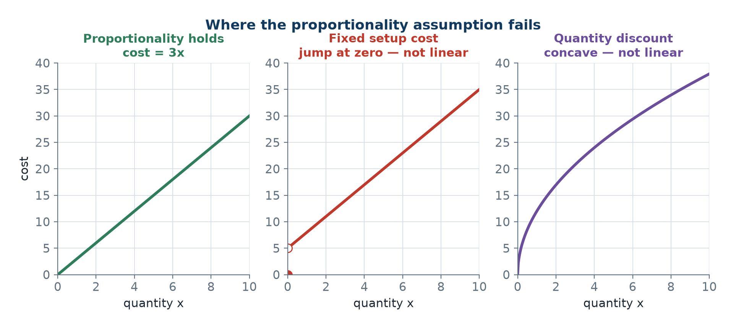
Linear and Non-Linear Shapes
• A linear cost is a straight line: double the output, double the cost.
• A fixed setup cost jumps at zero, so proportionality fails and LP cannot express it.
• Economies of scale bend the curve; the fix is a mixed-integer or non-linear model.
• Not linear: x₁x₂, x₁², √x₁, log x₁, max(x₁, x₂), |x₁|.
Proportionality holds only for the straight line through the origin.
OM-L02 · Introduction to Linear Programming and Formulation
Nikhil Rajput
34
Notes:
The picture separates cost functions LP can express from ones it cannot. A linear cost is a straight line through the origin: x units cost cx, so doubling the output doubles the cost and zero output costs nothing. That is proportionality, and only the straight line through the origin has it. A fixed setup cost has a jump — nothing at x = 0 and ₹5000 the instant production starts — and no straight line through the origin can imitate a jump. Economies of scale bend the curve gradually instead, so the cost per unit changes with the quantity and no single coefficient c describes the row. Why this matters: the shape of your cost curve decides whether you are allowed to use LP at all, before any algebra begins. Both failures are repairable, but only by leaving LP — a setup cost needs a mixed-integer model with a binary variable, and a bending curve needs a non-linear or piecewise-linear one.

Slide 35
The Four Assumptions of Linear Programming
Assumption | Meaning | Fails when
1. Proportionality | contribution scales with value | setup costs, quantity discounts
2. Additivity | total = sum of contributions | activities interact, joint setup
3. Divisibility | fractional values allowed | aircraft, people ⟹ IP (L16-L18)
4. Certainty | coefficients are known constants | random data ⟹ stochastic prog.
All four must hold before the simplex machinery of L04-L05 may be applied.
OM-L02 · Introduction to Linear Programming and Formulation
Nikhil Rajput
35
Notes:
The four assumptions are the conditions under which a situation may be written as an LP. Proportionality: a variable's contribution scales with its value, so a coefficient does not change with the quantity. Additivity: the total equals the sum of individual contributions, with no cross terms. Divisibility: variables may take fractional values. Certainty: every coefficient is a known constant, not a random draw. Read the third column as a diagnostic checklist rather than a list of curiosities. Each row names a way a real situation refuses to be an LP, and each has its own escape route: setup costs and quantity discounts break proportionality; two products sharing a joint setup break additivity; aircraft and people break divisibility and lead to integer programming; random data breaks certainty and leads to stochastic programming. The note beneath says why you must check. The simplex machinery rests on all four, so a model that violates one silently will still return a number, and the number will be wrong.

Slide 36
Why the Assumptions Matter in Practice
how proportionality and divisibility break, and what to do
• Proportionality fails most often through fixed setup costs.
  – Producing any quantity of product A incurs a ₹5000 setup: the cost function jumps at zero.
  – Fix: a binary y ∈ {0, 1} with the big-M linking constraint x ≤ My, giving a mixed-integer programme.
• Divisibility fails whenever the answer must be a whole number.
  – If the LP optimum is x₁ = 12.857 aircraft, rounding is not safe.
  – The rounded point may be infeasible, or feasible but far from the integer optimum.
• Engineering judgement: round 12,857.3 bottles; never round 12.857 aircraft.
OM-L02 · Introduction to Linear Programming and Formulation
Nikhil Rajput
36
Notes:
The two failures shown are the ones you meet most often, and each has a standard repair. A fixed setup cost breaks proportionality: producing any quantity of product A incurs ₹5000, so the cost function jumps at zero rather than passing through it. The repair introduces a yes-or-no variable y ∈ {0, 1}, charged the ₹5000 in the objective and linked to production by x ≤ My, with M any number larger than the largest x the other constraints allow. Then y = 0 forces x ≤ 0 and hence x = 0, while producing anything forces y = 1 and pays the setup. The result is a mixed-integer programme, not an LP. Divisibility fails whenever the answer must be whole. If the optimum is x₁ = 12.857 aircraft, rounding is not safe: the rounded point may fall outside the feasible region, or inside it but far from the best whole-number plan, which need not be near the fractional one. Round 12,857.3 bottles; never round 12.857 aircraft.

Slide 37
General Form
Optimise Z = c₁x₁ + c₂x₂ + ... + cₙxₙ = ∑ⱼ cⱼxⱼ
subject to ∑ⱼ aᵢⱼxⱼ {≤, =, ≥} bᵢ, i = 1, ..., m
xⱼ ≥ 0, j = 1, ..., n
Mixed relations, either sense of optimisation - the form a modeller writes down first.
OM-L02 · Introduction to Linear Programming and Formulation
Nikhil Rajput
37
Notes:
General form is the notation a modeller writes down first, before any tidying. Read the symbols. There are n decision variables and m constraints; xⱼ is the jth decision variable; cⱼ is its objective coefficient, the contribution one unit of xⱼ makes to Z; aᵢⱼ is its coefficient in constraint i, the amount of resource i that one unit of xⱼ consumes; and bᵢ is the number on the right of constraint i, the amount available or required. So Z = ∑ⱼ cⱼxⱼ totals the contributions, and ∑ⱼ aᵢⱼxⱼ {≤, =, ≥} bᵢ records one limit per row. The form is deliberately permissive: either direction of optimisation, any mixture of ≤, = and ≥ across the rows, and any sign on bᵢ. That faithfulness to the story is exactly what makes it useless to an algorithm, which needs one fixed shape. Converting changes only the writing, never the situation. Note that the line xⱼ ≥ 0 is an assumption, and a variable that may go negative has to be handled separately.

Slide 38
Canonical Form versus Standard Form
Canonical form - for duality (L07)
Standard form - for simplex (L04-L05)
• max Z = cᵀx
• subject to Ax ≤ b
• x ≥ 0
• All constraints ≤, objective maximised, all variables non-negative.
  – This is the shape the primal-dual transposition of L07 assumes.
• max Z = cᵀx
• subject to Ax = b, b ≥ 0
• x ≥ 0
• All constraints are equations and every right-hand side is non-negative.
  – Equations supply a basis; b ≥ 0 makes the starting solution feasible.
OM-L02 · Introduction to Linear Programming and Formulation
Nikhil Rajput
38
Notes:
Two target shapes, and you choose by what you are about to do. Canonical form is max Z = cᵀx subject to Ax ≤ b and x ≥ 0: every row points the same way and the objective is maximised. That symmetry is what duality needs, because the dual can then be read straight off by transposing the coefficient matrix, with no sign traps. Standard form is max Z = cᵀx subject to Ax = b with b ≥ 0 and x ≥ 0: every row is an equation and every right-hand side is non-negative. That is what simplex needs. Once the m rows are equations you may pick m variables to solve for, set the rest to zero and read a solution off, and that is cheap only when each row already contains a variable carrying coefficient 1 in it and 0 in every other row. Requiring b ≥ 0 is what makes that free starting solution feasible rather than negative. Neither form is more correct; both describe the same problem.

Slide 39
The Conversion Rules
min Z = ∑ cⱼxⱼ ⟺ max Z′ = −Z = ∑ (−cⱼ)xⱼ, Z(min) = −Z′(max)
∑ⱼ aᵢⱼxⱼ ≤ bᵢ ⟹ ∑ⱼ aᵢⱼxⱼ + sᵢ = bᵢ, sᵢ ≥ 0 (slack)
∑ⱼ aᵢⱼxⱼ ≥ bᵢ ⟹ ∑ⱼ aᵢⱼxⱼ − sᵢ = bᵢ, sᵢ ≥ 0 (surplus)
a ≥ row ⟹ ∑ⱼ aᵢⱼxⱼ − sᵢ + Aᵢ = bᵢ, Aᵢ ≥ 0 (surplus + artificial)
an = row ⟹ ∑ⱼ aᵢⱼxⱼ + Aᵢ = bᵢ (artificial alone, no surplus)
3x₁ − 2x₂ ≥ −6 ⟹ −3x₁ + 2x₂ ≤ 6 (bᵢ < 0: multiply by −1)
xⱼ free ⟹ xⱼ = xⱼ′ − xⱼ″, xⱼ′ ≥ 0, xⱼ″ ≥ 0
Artificials have no physical meaning and must be driven to zero, by Big-M or two-phase (L06).
OM-L02 · Introduction to Linear Programming and Formulation
Nikhil Rajput
39
Notes:
These rules convert any linear programme to standard form, and the order matters. First, turn a minimisation into a maximisation by negating every objective coefficient: min Z = ∑ cⱼxⱼ becomes max Z′ = ∑ (−cⱼ)xⱼ, and the answer is reported as Z(min) = −Z′(max). Second, fix any negative right-hand side by multiplying that whole row by −1, which negates every term and reverses the relation, so 3x₁ − 2x₂ ≥ −6 becomes −3x₁ + 2x₂ ≤ 6. Do this before adding any variables, because it changes which variable the row needs. Third, split every free variable as xⱼ = xⱼ′ − xⱼ″ with both parts non-negative, substituting in the objective and in every constraint. Only then go row by row: a ≤ row takes + sᵢ, a ≥ row takes − sᵢ and + Aᵢ, an = row takes + Aᵢ alone, every new variable non-negative. The caveat is that artificials mean nothing physically and must be driven to zero, by Big-M or by two phases.

Slide 40
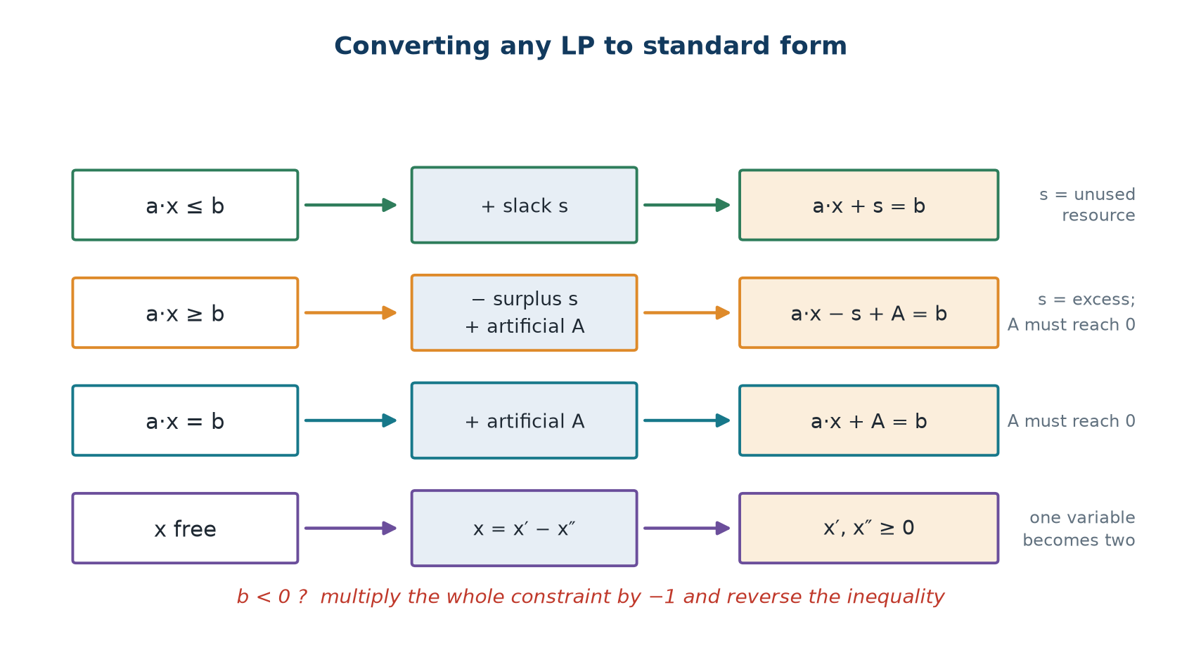
The Conversion Map
• ≤ constraint: add a slack sᵢ ≥ 0, the unused resource.
• ≥ constraint: subtract a surplus sᵢ ≥ 0, the excess over the requirement, then add an artificial.
• A surplus enters with coefficient −1, so it cannot be basic at the origin - hence artificials.
• Free variable: split it as xⱼ = xⱼ′ − xⱼ″ with both parts non-negative.
Every simplex problem begins with these four moves.
OM-L02 · Introduction to Linear Programming and Formulation
Nikhil Rajput
40
Notes:
The map shows three rules applied once to the whole problem, then a fork taken separately by each row according to its relation. A slack sᵢ ≥ 0 added to a ≤ row is the unused resource, the amount by which the limit bᵢ exceeds what is actually consumed. A surplus sᵢ ≥ 0 subtracted from a ≥ row is the excess over the requirement. A free variable splits as xⱼ = xⱼ′ − xⱼ″, positive when xⱼ′ exceeds xⱼ″ and negative when it does not. The third bullet is the mechanism behind the whole picture. A slack enters its own row with coefficient +1 and appears in no other row, so setting the original variables to zero gives sᵢ = bᵢ ≥ 0, a starting solution for free. A surplus enters with −1, so the same move gives sᵢ = −bᵢ, which is negative and therefore not allowed. That single sign is the entire reason artificial variables, Big-M and the two-phase method exist.

Slide 41
Worked Conversion - A Free Variable and Three Relations
Convert to standard form: min Z = 3x₁ − 2x₂ + 4x₃ subject to 2x₁ + x₂ − x₃ ≤ 10, x₁ − 3x₂ + 2x₃ ≥ 4, x₁ + x₂ + x₃ = 8, with x₁, x₂ ≥ 0 and x₃ unrestricted.
Step 1 - Objective to maximisation
max Z′ = −3x₁ + 2x₂ − 4x₃
with Z(min) = −Z′(max)
Step 2 - The free variable
Put x₃ = x₃′ − x₃″ with x₃′, x₃″ ≥ 0.
One free variable becomes two non-negative ones.
Step 3 - The constraints
2x₁ + x₂ − x₃′ + x₃″ + s₁ = 10 (slack)
x₁ − 3x₂ + 2x₃′ − 2x₃″ − s₂ + A₁ = 4 (surplus + artificial)
x₁ + x₂ + x₃′ − x₃″ + A₂ = 8 (artificial)
Step 4 - The Big-M objective
max Z′ = −3x₁ + 2x₂ − 4x₃′ + 4x₃″ + 0s₁ + 0s₂ − MA₁ − MA₂
Final tally: 8 variables (x₁, x₂, x₃′, x₃″, s₁, s₂, A₁, A₂) in 3 equations.
The original 3 variables became 8. This expansion is normal and is the price of a uniform algorithm.
OM-L02 · Introduction to Linear Programming and Formulation
Nikhil Rajput
41
Notes:
Every rule fires in this example, which is why it repays following line by line. The objective is minimised, so Step 1 negates it: max Z′ = −3x₁ + 2x₂ − 4x₃, with Z(min) = −Z′(max). Step 2 handles x₃, which is unrestricted, by writing x₃ = x₃′ − x₃″ with both parts non-negative. Notice what that does to the coefficients: a coefficient a on x₃ becomes +a on x₃′ and −a on x₃″ in every row, not only in the objective, which is why the ≥ row reads +2x₃′ − 2x₃″. Step 3 then takes the fork one row at a time, decided purely by the relation: the ≤ row gains s₁, the ≥ row gains −s₂ and +A₁, the = row gains A₂ alone. The check to run before moving on is that s₁, A₁ and A₂ each appear with coefficient +1 in exactly one row, so the starting solution reads off with no algebra: s₁ = 10, A₁ = 4, A₂ = 8.

Slide 42
Solved Problem 1 - Conversion to Standard Form (1 of 2)
Convert to standard form: min Z = 5x₁ + 8x₂ subject to 3x₁ + 2x₂ ≥ 12, x₁ + 4x₂ ≤ 20, x₁ − x₂ = 2, x₁, x₂ ≥ 0.
Step 1 - Objective
max Z′ = −5x₁ − 8x₂, with Z(min) = −Z′(max)
Step 2 - Constraint 1 is ≥
Subtract surplus s₁, add artificial A₁:
3x₁ + 2x₂ − s₁ + A₁ = 12
Step 3 - Constraint 2 is ≤
Add slack s₂:
x₁ + 4x₂ + s₂ = 20
Step 4 - Constraint 3 is =
Add artificial A₂:
x₁ − x₂ + A₂ = 2
OM-L02 · Introduction to Linear Programming and Formulation
Nikhil Rajput
42
Notes:
The same fixed sequence, now on a problem carrying one row of each kind, which makes it the cleanest drill available. Two rules fire silently and should still be checked aloud. The right-hand sides 12, 20 and 2 are all non-negative, so no row is multiplied by −1. Both variables are already declared non-negative, so there is no free variable to split. That leaves the objective and the fork. Negating min Z = 5x₁ + 8x₂ gives max Z′ = −5x₁ − 8x₂. Then each row takes its branch by relation alone: the ≥ row 3x₁ + 2x₂ ≥ 12 loses a surplus s₁ and gains an artificial A₁, the ≤ row gains a slack s₂, and the = row gains an artificial A₂. The common error is stopping at the surplus. Subtracting s₁ does turn that row into an equation, but leaves it with no variable owning a +1 column, so there is nothing for the algorithm to start from.

Slide 43
Solved Problem 1 - Conversion to Standard Form (2 of 2)
Step 5 - The complete standard form
max Z′ = −5x₁ − 8x₂ + 0s₁ + 0s₂ − MA₁ − MA₂
3x₁ + 2x₂ − s₁ + A₁ = 12
x₁ + 4x₂ + s₂ = 20
x₁ − x₂ + A₂ = 2
Step 6 - Sign restrictions
x₁, x₂, s₁, s₂, A₁, A₂ ≥ 0
Step 7 - Initial basic feasible solution
Set the non-basic variables x₁ = x₂ = s₁ = 0; the basis is {A₁, s₂, A₂}.
A₁ = 12, s₂ = 20, A₂ = 2
Z′ = −M(12) − M(2) = −14M
Step 8 - Why that starting value helps
The hugely negative objective is exactly what drives the artificials out of the basis.
For reference, this LP's optimum is x₁ = 3.2, x₂ = 1.2, Z(min) = 25.6.
Check: 3(3.2) + 2(1.2) = 12 ≥ 12 (binding); 3.2 + 4.8 = 8 ≤ 20; 3.2 − 1.2 = 2.
OM-L02 · Introduction to Linear Programming and Formulation
Nikhil Rajput
43
Notes:
Steps 7 and 8 are the point of this problem. Three equations in six unknowns leave three degrees of freedom, so simplex solves for three variables — the basis — and sets the other three to zero. Choose exactly those variables that own a +1 column, meaning coefficient 1 in their own row and 0 in every other row; here that is A₁, s₂ and A₂. Each then equals its row's right-hand side with no algebra at all: A₁ = 12, s₂ = 20, A₂ = 2. Evaluating the objective there gives Z′ = −M(12) − M(2) = −14M, since only the two artificials carry a non-zero cost. That enormous negative number is the mechanism rather than an accident: because M stands for something huge, any move that shrinks an artificial improves Z′ far more than any trade among the real variables, so the artificials are driven out first. For reference the optimum is x₁ = 3.2, x₂ = 1.2, Z(min) = 25.6.

Slide 44
Solved Problem 2 - Transportation Formulation as an LP
Warehouses in Delhi (200 units) and Mumbai (300) supply Kolkata (150), Chennai (200) and Bengaluru (150). Unit shipping costs (₹) are Delhi 16, 22, 18 and Mumbai 14, 12, 20. Formulate as an LP.
Step 1 - Decision variables
x(ij) = units shipped from warehouse i to city j
i ∈ {D, M} and j ∈ {K, C, B} - 6 variables
Step 2 - Objective
min Z = 16x(DK) + 22x(DC) + 18x(DB)
+ 14x(MK) + 12x(MC) + 20x(MB)
Step 3 - Supply constraints
x(DK) + x(DC) + x(DB) ≤ 200
x(MK) + x(MC) + x(MB) ≤ 300
Step 4 - Demand constraints and non-negativity
x(DK) + x(MK) ≥ 150
x(DC) + x(MC) ≥ 200
x(DB) + x(MB) ≥ 150
all x(ij) ≥ 0
Total supply 200 + 300 = 500 equals total demand 150 + 200 + 150 = 500, so the problem is balanced.
Balanced ⟹ every constraint holds with equality, so ≤ and ≥ may be replaced by =. The optimum is Z = ₹7,300, found in L09.
OM-L02 · Introduction to Linear Programming and Formulation
Nikhil Rajput
44
Notes:
A transportation problem ships a commodity from sources of limited supply to destinations with stated demand, at a known cost per unit on each route, and asks for the cheapest plan. The formulation turns on Step 1. The decision is not how much Delhi sends altogether but how much travels along each individual route, so there is one variable per warehouse-city pair — two warehouses times three cities gives six. The objective sums cost times quantity over those six routes. Grouping the same six variables by warehouse gives the two supply rows, each ≤ what that warehouse holds; grouping them by city gives the three demand rows, each ≥ what that city needs. The balance check then does real work. Supply 200 + 300 = 500 equals demand 150 + 200 + 150 = 500, so the total shipped is at most 500 by the supply rows and at least 500 by the demand rows, hence exactly 500. No slack survives, and every relation may be rewritten as an equation.

Slide 45
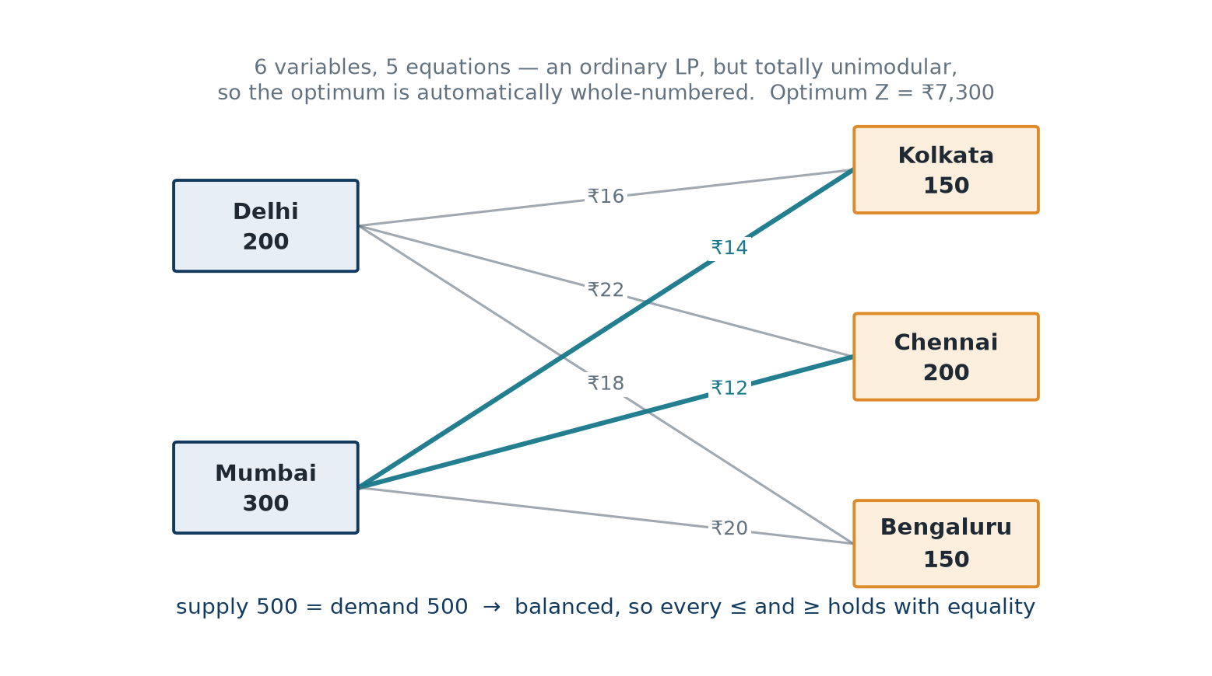
Why Transportation Problems Get Their Own Algorithm
• Each variable appears in exactly two constraints, with coefficient +1.
• That structure makes the constraint matrix totally unimodular.
• The optimum is automatically integral whenever supplies and demands are integers.
• MODI (L09) exploits this with a tableau, not a full basis inverse, and beats simplex.
Two warehouses to three cities: an ordinary LP with 6 variables and 5 equations.
OM-L02 · Introduction to Linear Programming and Formulation
Nikhil Rajput
45
Notes:
Look at the pattern of coefficients rather than at the numbers. Each of the six variables appears in exactly two rows — the supply row of its warehouse and the demand row of its city — always with coefficient +1, and nowhere else. A matrix built that way is totally unimodular, meaning every square piece of it has determinant 0, +1 or −1. That property hands you something for nothing. Solving for a basis divides by such a determinant, and dividing whole numbers by ±1 leaves whole numbers, so the optimal shipments come out integral whenever supplies and demands are integers and no integer programming is needed. The same regularity lets MODI work from a small tableau instead of a full basis inverse, which is why a problem that is an ordinary LP with 6 variables and 5 equations still gets its own algorithm. The caveat: unimodularity belongs to this structure, not to LPs generally — add a fixed charge per route and integrality stops being free.

Slide 46
Solved Problem 3 - Goal Programming with Deviations
A firm wants production of x₁ and x₂ to hit a target revenue of ₹50,000, where unit revenues are ₹200 and ₹350. Shortfall costs ₹5 per rupee and excess ₹2 per rupee. Machine hours available: 4x₁ + 6x₂ ≤ 900. Formulate.
Step 1 - The difficulty
Deviation in either direction is |200x₁ + 350x₂ − 50000|, which is not linear.
Step 2 - Split the deviation into two non-negative parts
d⁻ = shortfall below target ≥ 0
d⁺ = excess above target ≥ 0
Goal constraint: 200x₁ + 350x₂ + d⁻ − d⁺ = 50,000
Step 3 - The complete model
min Z = 5d⁻ + 2d⁺
200x₁ + 350x₂ + d⁻ − d⁺ = 50,000
4x₁ + 6x₂ ≤ 900
x₁, x₂, d⁻, d⁺ ≥ 0
Step 4 - Why d⁻ and d⁺ are never both positive
Suppose d⁻ = a > 0 and d⁺ = b > 0; reduce both by min(a, b).
They appear with opposite signs, so the goal constraint still holds.
Both cost coefficients are positive, so Z strictly falls.
Hence at least one of them is zero at any optimum.
Per machine-hour product 1 yields 200/4 = ₹50 and product 2 yields 350/6 = ₹58.3.
All hours to product 2 gives x₂ = 150 and revenue ₹52,500 > ₹50,000, so the target is attainable with d⁻ = 0. This is the standard trick for absolute values and goal programming.
OM-L02 · Introduction to Linear Programming and Formulation
Nikhil Rajput
46
Notes:
Goal programming reverses the usual question. Instead of pushing one quantity as far as it will go, you name a target and pay for missing it, at possibly different rates on each side — here ₹5 for every rupee of shortfall against ₹2 for every rupee of excess, on a ₹50,000 revenue target. The obstacle is that the miss is |200x₁ + 350x₂ − 50000|, a V rather than a straight line, so it is not linear. The repair in Step 2 is the standard one: define d⁻ ≥ 0 as the shortfall and d⁺ ≥ 0 as the excess, write the goal as the equation 200x₁ + 350x₂ + d⁻ − d⁺ = 50,000, and price the two separately in min Z = 5d⁻ + 2d⁺. Step 4 is the argument that makes this legitimate. Were both positive, reducing each by min(a, b) leaves the goal constraint true, since they enter with opposite signs, and strictly lowers a cost with two positive coefficients. So one is always zero and d⁻ + d⁺ equals the miss exactly.

Slide 47
Solved Problem 4 - Recognising and Repairing Non-Linearities
Which of these are linear? Repair those that can be linearised. (a) max 3x₁ + 5x₂ s.t. x₁x₂ ≤ 10. (b) min √x₁ + x₂. (c) max 4x₁ + 7x₂ s.t. x₁/(x₁ + x₂) ≥ 0.4. (d) min |x₁ − 5| + x₂. (e) max 2x₁ s.t. x₁ ≤ 100 if y = 1, x₁ = 0 if y = 0, y binary.
Step 1 - (a) and (b) are not repairable within LP
(a) The product x₁x₂ makes the feasible region non-convex - needs non-linear programming.
(b) √x₁ is concave and it is being minimised, which is genuinely hard.
A piecewise-linear approximation is the practical route for both.
Step 2 - (c) a ratio, repairable
Cross-multiply, valid since x₁ + x₂ > 0:
x₁ ≥ 0.4(x₁ + x₂) ⟹ 0.6x₁ − 0.4x₂ ≥ 0 ⟹ 3x₁ ≥ 2x₂
Now linear.
Step 3 - (d) a minimised absolute value, repairable
Introduce d⁺, d⁻ ≥ 0 with x₁ − 5 = d⁺ − d⁻ and min d⁺ + d⁻ + x₂.
At an optimum at most one is positive, so d⁺ + d⁻ = |x₁ − 5| exactly.
Maximising |x₁ − 5| is not linearisable - that is NP-hard in general.
Step 4 - (e) a logical condition, repairable as an MILP
Big-M linking constraint: x₁ ≤ 100y with y ∈ {0, 1}.
y = 0 ⟹ x₁ ≤ 0, forcing x₁ = 0; y = 1 ⟹ x₁ ≤ 100.
Linear constraints, but with an integer variable - an MILP, not an LP (L16-L18).
Repairable: (c) cross-multiply, (d) split into d⁺ and d⁻, (e) big-M with a binary. Not repairable: (a) bilinear, (b) concave minimisation.
Technique (c) is the ratio trick of L01, Problem 3; technique (d) is Problem 3 of this lesson.
OM-L02 · Introduction to Linear Programming and Formulation
Nikhil Rajput
47
Notes:
This problem sorts non-linearities by whether the repair keeps you inside LP. A ratio such as x₁/(x₁ + x₂) ≥ 0.4 is repairable by cross-multiplying: x₁ ≥ 0.4(x₁ + x₂) gives 0.6x₁ − 0.4x₂ ≥ 0, that is 3x₁ ≥ 2x₂. It is valid only because x₁ + x₂ > 0, since multiplying an inequality by a positive number preserves its direction while a denominator that could go negative would flip it. A minimised absolute value splits into d⁺ and d⁻ by the argument of the previous problem, and the split is exact only for minimisation; maximising |x₁ − 5| maximises a convex function and is not linearisable. A logical condition becomes the linear row x₁ ≤ 100y, but y is binary, so the model has left LP for a mixed-integer programme. A product x₁x₂ makes the region non-convex and cannot be saved, and minimising the concave √x₁ is genuinely hard; both need a non-linear or piecewise-linear treatment.

Slide 48
Solved Problem 5 - Cyclic Nurse Staffing (1 of 2)
A hospital needs nurses on six 4-hour shifts per day, with minimum requirements 7, 15, 12, 16, 9, 5. Each nurse works two consecutive shifts. Formulate an LP minimising the number of nurses.
Step 1 - Decision variables
xⱼ = nurses starting at the beginning of shift j, j = 1, ..., 6
Each such nurse covers shifts j and j+1, with shift 7 wrapping to shift 1.
Step 2 - Objective
min Z = x₁ + x₂ + x₃ + x₄ + x₅ + x₆
Step 3 - Coverage constraints
Shift 1: x₆ + x₁ ≥ 7 Shift 2: x₁ + x₂ ≥ 15
Shift 3: x₂ + x₃ ≥ 12 Shift 4: x₃ + x₄ ≥ 16
Shift 5: x₄ + x₅ ≥ 9 Shift 6: x₅ + x₆ ≥ 5
All xⱼ ≥ 0 and, strictly, integral - nurses are indivisible.
Step 4 - A lower bound by inspection
Every nurse covers exactly 2 shifts, so 2Z ≥ 7+15+12+16+9+5 = 64.
Hence Z ≥ 32; the bound is usually not attained because demand is uneven.
Shift 1's constraint involves x₆, closing the cycle - forgetting it is the classic error.
OM-L02 · Introduction to Linear Programming and Formulation
Nikhil Rajput
48
Notes:
A set-covering model asks how few resources will cover every requirement, and Step 1 is where this one is won or lost. Counting nurses on duty during each shift fails, because those counts are not independent: one nurse works two consecutive shifts and so appears in two of them, and no constraint written on the counts alone records which. Counting start times instead makes every nurse appear exactly once, so the objective min Z = x₁ + x₂ + x₃ + x₄ + x₅ + x₆ is a plain sum. A nurse starting at shift j covers shifts j and j+1, so shift j is staffed by those who started at j together with those who started at j−1, giving rows such as x₂ + x₃ ≥ 12. Shift 1's row involves x₆ because shift 7 wraps to shift 1, and forgetting that link is the classic error. Adding all six rows, each xⱼ appears in exactly two, so the left sides total 2Z and the right sides total 64, giving Z ≥ 32.

Slide 49
Solved Problem 5 - Cyclic Nurse Staffing (2 of 2)
Step 5 - A first attempt
Take x₁ = 15, x₃ = 16, x₅ = 5, the others 0.
Shift 1: 0 + 15 = 15 ≥ 7; Shift 2: 15 + 0 = 15, binding
Shift 3: 0 + 16 = 16 ≥ 12; Shift 4: 16 + 0 = 16, binding
Shift 5: 0 + 5 = 5 against 9 - short by 4, so this plan is infeasible.
Step 6 - Repairing the attempt
Raising x₅ to 9 repairs it and gives Z = 15 + 16 + 9 = 40.
Feasible, but not optimal.
Step 7 - The true optimum
Exhaustive search gives x = (2, 13, 0, 16, 0, 5).
Binding: 5+2 = 7, 2+13 = 15, 0+16 = 16, 0+5 = 5 on shifts 1, 2, 4, 6.
Slack: shift 3 has 13+0 = 13 ≥ 12; shift 5 has 16+0 = 16 ≥ 9.
Z = 2 + 13 + 0 + 16 + 0 + 5 = 36 nurses
Step 8 - What the model is worth
Against the lower bound of 32, the excess of 4 is the cost of uneven demand.
The naive plan needed 40 - 11 % more staff than necessary.
At nursing salaries that gap is a substantial annual sum.
Z = 36 nurses, with x = (2, 13, 0, 16, 0, 5).
Set-covering formulations of exactly this shape schedule airline crews, call-centre agents, bus drivers and police patrols.
OM-L02 · Introduction to Linear Programming and Formulation
Nikhil Rajput
49
Notes:
These steps show why the bound of 32 is not reached. The first attempt covers the busiest shifts head-on with x₁ = 15, x₃ = 16 and x₅ = 5, and fails: shift 5 requires 9 but receives x₄ + x₅ = 0 + 5 = 5, short by 4, so the plan is infeasible rather than merely expensive. Raising x₅ to 9 repairs it at Z = 40. The true optimum x = (2, 13, 0, 16, 0, 5) needs 36, spreading the starts so that shifts 1, 2, 4 and 6 bind exactly while only shifts 3 and 5 carry surplus coverage, 13 against a requirement of 12 and 16 against 9. That excess of 4 over the bound is the unavoidable cost of uneven demand: a nurse hired for a busy shift cannot be sent home part-way through the quiet one beside it. Against the optimum, the naive repair at 40 uses 11 % more staff than necessary, which at nursing salaries is a substantial annual sum.

Slide 50
Where These Formulations Are Used
Airline and railway crew rostering
Set-covering LPs of Problem 5's exact shape assign crews to duties; the wrap-around is the overnight link nobody may forget.
Hospital nurse scheduling
The six-shift model scales to a full week; a 10 % staffing saving at nursing salaries is a large annual sum for one ward.
Freight and e-commerce distribution
Problem 2's warehouse-to-city model runs nightly over hundreds of depots, and integrality of the answer comes free.
Refinery and animal-feed blending
Limits stated as ratios - octane, protein per kilogram - are made linear by cross-multiplying, exactly as in Problem 4(c).
Budget and revenue target planning
Goal programming with d⁺ and d⁻ lets a firm price a shortfall differently from an overshoot and still stay linear.
OM-L02 · Introduction to Linear Programming and Formulation
Nikhil Rajput
50
Notes:
These are not illustrations chosen for variety; each reuses one device from this material unchanged. Airline and railway crew rostering is the cyclic set-covering model with rotations in place of shifts, and the wrap-around becomes the overnight link nobody may forget. Nurse scheduling scales the six-shift model to a full week. Freight and e-commerce distribution is the warehouse-to-city transportation model run nightly across hundreds of depots, where total unimodularity delivers whole pallets with no integer machinery attached. Refinery and animal-feed blending states its limits as ratios — octane, protein per kilogram — which become linear rows by cross-multiplying. Budget and revenue planning uses the deviation pair d⁺ and d⁻ so that a firm may price a shortfall differently from an overshoot and still stay linear. What makes these economically significant is repetition: each model runs again and again, so a few per cent saved on one run compounds across a year. The four assumptions do not stop applying at scale.

Slide 51
Artificial variables, in simple terms
An artificial variable is scaffolding. You put it up only so the builders have somewhere to stand on day one, and the building is not finished until every last pole has come down.
• A ≥ constraint has no obvious starting point: at zero production you are already below the requirement.
• So we invent a variable that fakes a feasible start, then charge a ruinous penalty M for using it.
• The algorithm removes it because keeping it is expensive, not because we asked it politely.
• If one is still positive when the algorithm stops, no honest solution exists: the model is infeasible.
• Slack and surplus are real quantities - unused resource, excess. Artificials mean nothing at all.
OM-L02 · Introduction to Linear Programming and Formulation
Nikhil Rajput
51
Notes:
An artificial variable Aᵢ ≥ 0 is a term added to a ≥ or = row purely so that the row owns a variable with a +1 column to start from; it stands for nothing in the world. The scaffolding image is exact and worth taking literally. Adding an artificial genuinely enlarges the feasible set, because any row can be satisfied by making its artificial large enough, so a solution counts as a solution of the original problem only when every artificial has reached zero. Two devices force that: Big-M charges each one a penalty of −M in a maximised objective, with M enormous, so keeping it is ruinous; the two-phase method first minimises the sum of the artificials and proceeds only if that minimum is zero. The fourth point is why this matters. If one is still positive when the method stops, the only way to satisfy that row was to cheat, so the real constraints have no common solution. A positive artificial is a verdict, never a quantity.

Slide 52
Common Mistakes to Avoid
the traps this lesson warns about
• Forgetting the wrap-around constraint in a cyclic staffing model; it under-staffs the night shift.
• Rounding an LP answer for an indivisible item: the rounded point may be infeasible or far from optimal.
• Trying to use a surplus variable as an initial basic variable - it enters with coefficient −1.
• Multiplying a constraint by −1 and forgetting to reverse the inequality.
• Reading physical meaning into an artificial variable; it has none and must be driven to zero.
• Trying to linearise a maximised absolute value - only the minimised one splits into d⁺ and d⁻.
• Losing the sign when reporting the answer: Z(min) = −Z′(max).
OM-L02 · Introduction to Linear Programming and Formulation
Nikhil Rajput
52
Notes:
Most of these traps share one cause: a rule applied without its reason. The surplus trap is about the sign, not the name — a ≥ row needs − sᵢ, and writing + sᵢ instead quietly states the opposite requirement, so the answer will be feasible for a problem nobody asked about. A surplus also cannot start in the basis, because its column is −1, and that is what the artificial is for. The ordering trap is that multiplying a row by −1 to fix a negative right-hand side reverses the relation, which can turn a ≥ into a ≤ and so change which variables that row needs; it must therefore come before any are added. Rounding a fractional answer for an indivisible item can land outside the feasible region. Only a minimised absolute value splits into d⁺ and d⁻. An artificial has no physical reading. And the sign slip at the end costs nothing to avoid: after maximising Z′, report Z(min) = −Z′.

Slide 53
Summary
• LP optimises a linear objective over linear constraints.
  – The four assumptions are proportionality, additivity, divisibility and certainty.
• Canonical form (all ≤, max) is used for duality; standard form (all =, b ≥ 0) for simplex.
• Conversions: min → max by negation; ≤ adds a slack; ≥ subtracts a surplus and adds an artificial.
  – bᵢ < 0 ⟹ multiply by −1; a free variable becomes x = x′ − x″.
• Artificials must reach zero; any positive at optimality means the problem is infeasible.
• Repairable: ratios, minimised absolute values, logical conditions. Not: products, concave minimisation.
OM-L02 · Introduction to Linear Programming and Formulation
Nikhil Rajput
53
Notes:
Two things should be automatic by now. First, the test for whether a model is an LP at all: every expression a sum of constants times variables, and all four assumptions — proportionality, additivity, divisibility, certainty — holding. If one breaks, name it and name what the model becomes instead: mixed-integer for setup costs and logical conditions, integer for indivisible items, non-linear for products and concave minimisation, stochastic for random coefficients. Second, the conversion sequence in its fixed order — negate a minimised objective, multiply any row with bᵢ < 0 by −1, split each free variable as x = x′ − x″, then give each row its slack, its surplus with an artificial, or its artificial alone — together with the reason behind each step. The slack's +1 column supplies a free starting solution, the surplus's −1 column does not, and the artificial puts a +1 back at the price of having to reach zero. Everything after this treats standard form as the starting point rather than as something to derive.

Slide 54
Practice Problems
answers where the source gives them
• 1. Convert to standard form: max 2x₁ + 3x₂ s.t. x₁ + x₂ ≥ 5, 2x₁ − x₂ ≤ 8, x₁ ≥ 0, x₂ free.
• 2. How many variables after that conversion? Answer: x₁, x₂′, x₂″, s₁, s₂, A₁ = 6.
• 3. Linearise (2x₁ + 3x₂)/(x₁ + x₂) ≤ 2.5. Answer: 0.5x₂ ≤ 0.5x₁, that is x₂ ≤ x₁.
• 4. Which LP assumption fails for quantity discounts? Answer: proportionality.
• 5. Formulate a 7-day staffing problem where each worker works 5 consecutive days.
• 6. Convert min Z with b₂ = −15 on a ≥ constraint into standard form.
• 7. Explain why an artificial variable positive at optimality signals infeasibility.
OM-L02 · Introduction to Linear Programming and Formulation
Nikhil Rajput
54
Notes:
Work these before moving on, since what follows assumes the conversion is automatic. Question 1 exercises the whole sequence and question 2 checks the count it produces: x₁, x₂′, x₂″, s₁, s₂ and A₁ make 6, because the free x₂ becomes two columns rather than one and the ≥ row needs both a surplus and an artificial. Question 3 is the ratio trick again — cross-multiply by the positive denominator, then collect terms, so 2x₁ + 3x₂ ≤ 2.5(x₁ + x₂) reduces to x₂ ≤ x₁. Question 4 tests the assumption names: a quantity discount changes the cost per unit as the quantity changes, so proportionality fails. Question 6 is the one worth care — fix the negative right-hand side first, because multiplying that row by −1 turns the ≥ into a ≤, after which it takes only a slack and needs no artificial at all. Question 7 asks for the argument behind the rule, not the rule.

Slide 55
OPTIMIZATION METHODS · LESSON 03
The Graphical Method
Linear Programming - Lesson 3
Nikhil Rajput
Notes:
A linear programme with exactly two decision variables can be drawn on paper. Each constraint is an inequality in x₁ and x₂, so its boundary is a straight line and the inequality itself allows everything on one side of that line - a half-plane. Overlaying all of them leaves a shaded polygon: the plans that break no rule. The objective Z = c₁x₁ + c₂x₂ becomes a family of parallel lines whose value climbs steadily in one fixed direction, so solving means pushing that family as far across the polygon as the boundary permits. What follows builds in that order: how to draw the region, why its shape is convex, why the best plan must sit at a corner, the two ways of finding that corner, the four things a linear programme can do instead of having one neat answer, and how far a profit figure may move before the plan itself has to change. The drawing stops at two variables; the geometry behind it does not.

Slide 56
Learning Outcomes
by the end of this lesson you will be able to
• Plot a feasible region for a two-variable LP.
• State and use the Corner-Point (Extreme-Point) Theorem.
• Solve LPs by corner-point enumeration and by the iso-profit line method.
• Recognise and diagnose the four special cases: multiple optima, unbounded, infeasible, degenerate.
• Identify binding constraints and compute slack and surplus graphically.
  – The method itself handles only two variables - its value is entirely conceptual.
OM-L03 · The Graphical Method
Nikhil Rajput
56
Notes:
The feasible region named in the first outcome is the set of points satisfying every constraint simultaneously; an extreme point, or corner, is a point of that region lying on no segment joining two other feasible points. The Corner-Point Theorem ties the two together: if an optimum exists, at least one occurs at such a corner. That is what makes the next outcome possible, because both methods then finish in finitely many steps. Corner-point enumeration lists the corners, checks each is genuinely feasible, and evaluates Z at each; the iso-profit method draws a line of constant Z and slides it parallel until it is about to leave the region. The four special cases are what the picture shows when that story is disturbed - a tie, an escape to infinity, an empty overlap, a crowded corner. Slack and surplus measure how far a constraint sits from holding with equality, which is how the answer is reported to someone who must act on it. The last line is the honest limit: two variables is the ceiling.

Slide 57
The big picture, in simple terms
Every constraint is a fence. The fences cut a plot out of an open field, and the most profitable spot in that plot is always at a corner post - never somewhere in the middle.
• With two decisions you can literally draw the problem and see where the answer sits.
• The rules of the problem carve out a region; only points inside it are allowed plans.
• Profit rises in one fixed direction, so you push as far that way as the fences let you.
• You always stop at a corner. That single fact is why linear programming is fast.
• Real problems have no picture, but the geometry is identical - simplex walks the same corners.
OM-L03 · The Graphical Method
Nikhil Rajput
57
Notes:
The analogy carries real content, and the content is linearity. Because Z = c₁x₁ + c₂x₂ is linear, moving one unit in a given direction changes profit by the same amount wherever you start; the rate of gain never falls off, so there is no hilltop in the middle of the plot to settle on. From any interior point some direction still raises Z, so you are always pushed onto a fence - a constraint holding with equality. Once on a fence, sliding along it still changes Z at a constant rate, so you keep sliding until the fence ends at a corner post where two fences meet. That is why an infinite set of allowed plans collapses to a short list of corners you can check by hand, and why the simplex method, which draws nothing, is doing exactly this walk in higher dimensions. The one exception: if profit happens to change at zero rate along a fence, every point of that fence ties.

Slide 58
The Feasible Region
definition and the plotting procedure
• Definition. The feasible region is the set of points satisfying all constraints simultaneously.
  – 1. Treat each constraint as an equation and draw the line.
  – For a₁x₁ + a₂x₂ = b the intercepts are (b/a₁, 0) and (0, b/a₂) - the fastest way to plot.
  – 2. Test the origin (0, 0): if it satisfies the inequality shade its side, otherwise shade the other.
  – If the line passes through the origin, test any other convenient point.
  – 3. Non-negativity x₁, x₂ ≥ 0 restricts everything to the first quadrant.
  – 4. The feasible region is the intersection of all the shaded half-planes.
OM-L03 · The Graphical Method
Nikhil Rajput
58
Notes:
The feasible region is the set of points satisfying every constraint at once, and the procedure builds it one constraint at a time. Replace ≤ by = and you have that constraint's exact boundary, a straight line. Setting x₂ = 0 in a₁x₁ + a₂x₂ = b gives x₁ = b/a₁, and setting x₁ = 0 gives x₂ = b/a₂, so the two intercepts (b/a₁, 0) and (0, b/a₂) fix the line without any table of points. The line splits the plane in two and the inequality keeps exactly one side; substituting (0, 0) into the original inequality tells you which, since the origin lies on the allowed side precisely when the statement comes out true. Shade that side, repeat, and the region is the overlap of all the shaded half-planes. Two traps: the origin test says nothing when the line passes through the origin, so test another point, and x₁, x₂ ≥ 0 is a constraint like any other rather than scenery.

Slide 59
Convexity - Why LP Is Tractable
theorem and proof sketch
• Theorem. The feasible region of an LP is a convex set - a possibly unbounded polygon, a polyhedron.
  – Proof sketch. Each constraint defines a half-plane, which is convex.
  – An intersection of convex sets is convex. ∎
  – Convexity guarantees that a local optimum is a global optimum.
  – That is exactly what makes LP tractable, and what non-linear programmes lose.
  – The picture works for two variables, three at a stretch; it is useless for real sizes.
• Every idea in the simplex method is visible in a two-variable picture. Learn the picture first.
OM-L03 · The Graphical Method
Nikhil Rajput
59
Notes:
A set is convex when the straight segment joining any two of its points lies wholly inside it - no dents, no gaps. Each constraint a₁x₁ + a₂x₂ ≤ b defines a half-plane, and that half-plane is convex because the left-hand side is linear: along a segment between two feasible points its value is the weighted average of the two endpoint values, so it never exceeds the larger of them and therefore never exceeds b. Intersecting convex sets keeps the property, since a segment lying inside each set lies inside the overlap. The feasible region is therefore a convex polygon, possibly unbounded, called a polyhedron. The payoff is that any local optimum is automatically global: one hill, no lesser peaks to be trapped on, so a method that only ever improves cannot stop at the wrong answer. Lose convexity and that guarantee goes with it, which is exactly why non-linear programming is a far harder subject.

Slide 60
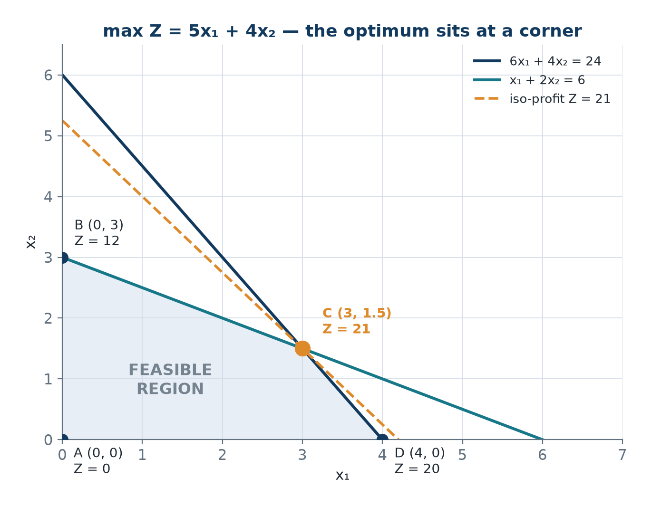
A Feasible Region and Its Corners
• The origin satisfies both constraints, so both are shaded towards the origin.
• Corners: A (0, 0), B (0, 3), C (3, 1.5), D (4, 0).
• Every edge is one constraint; every corner solves two constraint equations.
• For max Z = 5x₁ + 4x₂ the optimum is C = (3, 1.5) with Z* = 21.
Region of 6x₁ + 4x₂ ≤ 24 and x₁ + 2x₂ ≤ 6 in the first quadrant.
OM-L03 · The Graphical Method
Nikhil Rajput
60
Notes:
Look first at the shaded quadrilateral. It is the overlap of the half-planes 6x₁ + 4x₂ ≤ 24 and x₁ + 2x₂ ≤ 6 with the first quadrant; the origin satisfies both inequalities, so both are shaded towards it. Every edge is one constraint holding with equality, and every corner is where two of those equations hold at once: A (0, 0) is the two axes, B (0, 3) is the x₂-axis meeting line 2, D (4, 0) is the x₁-axis meeting line 1, and C (3, 1.5) is where the two constraint lines cross. Now read the values of Z = 5x₁ + 4x₂ at those corners: 0 at A, 12 at B, 21 at C and 20 at D. The dashed line drawn for Z = 21 grazes the region at C and touches nowhere else, which is what an optimum looks like. Conclude that the best plan sits at a corner, never inside - and note that D at 20 is close enough that a careless sketch could pick it.

Slide 61
The Corner-Point Theorem
the Fundamental Theorem of Linear Programming
• Theorem. If an LP has an optimal solution, at least one optimal solution occurs at an extreme point of the feasible region.
  – Proof sketch. Suppose the optimum x* is not an extreme point.
  – Then x* = λu + (1 − λ)v for feasible u, v with 0 < λ < 1.
  – By linearity, Z(x*) = λZ(u) + (1 − λ)Z(v).
  – If Z(u) ≠ Z(v) then one of them exceeds Z(x*), contradicting optimality.
  – So Z(u) = Z(v) = Z(x*); move along the segment to an endpoint and repeat until a corner is reached. ∎
• You need only check the corners - finitely many points instead of infinitely many.
OM-L03 · The Graphical Method
Nikhil Rajput
61
Notes:
Extreme point is the precise word for corner: a feasible point that does not lie strictly inside any segment joining two other feasible points. The theorem says that if an optimum exists at all, at least one optimum is such a point, and the argument is short. Suppose the optimum x* were not a corner. Then x* = λu + (1 − λ)v for feasible u and v with 0 < λ < 1, and because Z is linear, Z(x*) = λZ(u) + (1 − λ)Z(v) - a weighted average of the two endpoint values. An average of two different numbers is beaten by the larger of them, so one endpoint would score better than the supposed optimum, which is impossible. Hence Z(u) = Z(v) = Z(x*), and you can walk to an endpoint losing nothing, repeating until a corner is reached. That is what makes linear programming solvable: finitely many candidates. Read the wording exactly - at least one optimum is a corner, not every optimum.

Slide 62
Two Solution Methods
Corner-point enumeration
The iso-profit (iso-cost) line
• 1. Plot the feasible region.
• 2. Identify every corner by solving pairs of constraint equations.
• 3. Check each candidate is actually FEASIBLE.
• 4. Evaluate Z at every feasible corner.
• 5. Pick the best.
• Step 3 is the one students skip: two lines can meet outside a third constraint.
• 1. Plot the feasible region.
• 2. Draw Z = k for an arbitrary convenient k - an iso-profit line.
• 3. Slide it parallel, in the direction of increasing Z for a maximum.
• 4. The last point of contact with the region is optimal.
• The gradient ∇Z = (c₁, c₂) points the way: along it to maximise, against it to minimise.
• It reveals why a corner wins and makes multiple optima instantly recognisable.
OM-L03 · The Graphical Method
Nikhil Rajput
62
Notes:
These are two ways of using the same theorem. Enumeration is arithmetic: solve every pair of constraint equations for a candidate corner, discard the candidates that violate some other constraint, evaluate Z at the survivors, take the best. Step 3 is genuinely necessary rather than a formality - two lines always cross somewhere, but the crossing may sit outside a third constraint, and an infeasible point that scores well will win a table it should never have entered. The iso-profit method is geometry: fix a convenient k and draw Z = k, the set of plans all earning the same amount. Every other value of k gives a parallel line, since only the intercept changes, and the gradient ∇Z = (c₁, c₂) points the way k increases. Slide along it and the last point still touching the region is optimal. Enumeration gives the number; the sliding line explains why a corner wins and makes a tie along a whole edge obvious.

Slide 63
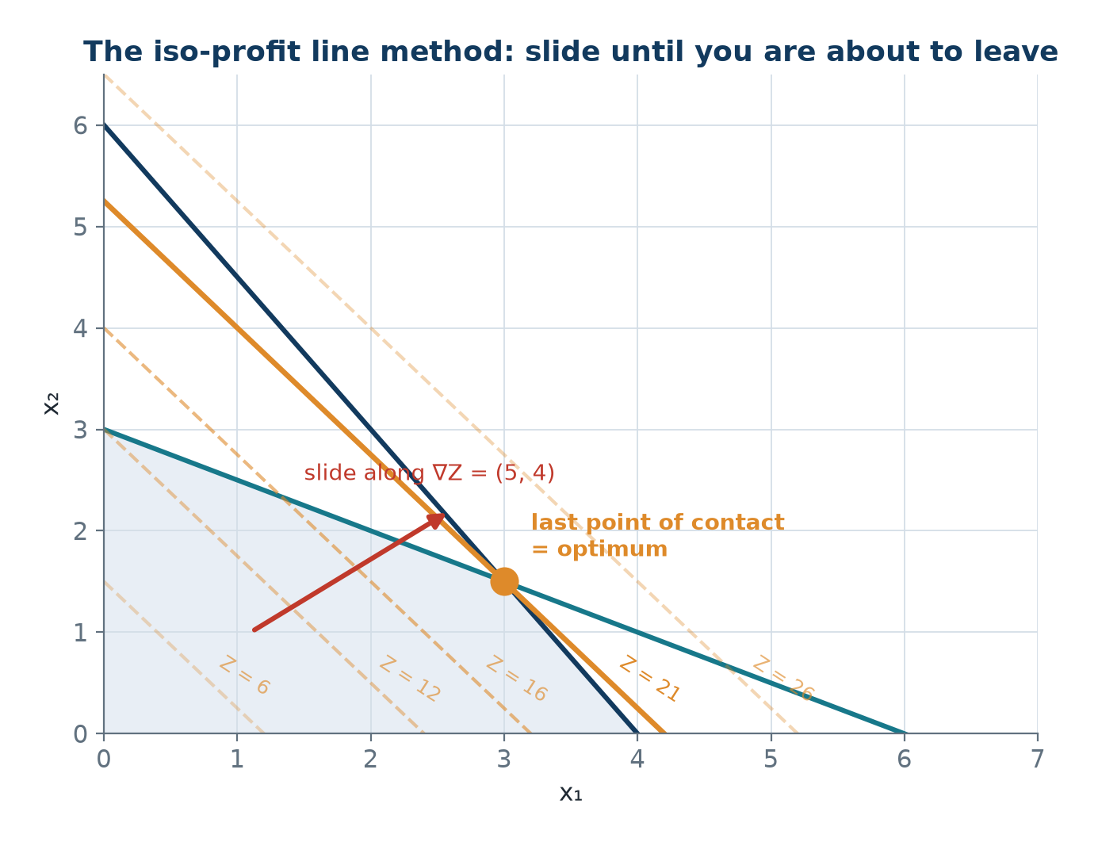
Sliding the Iso-Profit Line
• Every line of the family has the same slope, −c₁/c₂ = −5/4 = −1.25.
• Sliding along ∇Z = (5, 4) raises k; the last contact point is optimal.
• Line 1 has slope −6/4 = −1.5; line 2 has slope −1/2 = −0.5.
• Since −1.5 < −1.25 < −0.5, the optimum is the unique corner (3, 1.5).
A family of parallel lines 5x₁ + 4x₂ = k pushed across the same region.
OM-L03 · The Graphical Method
Nikhil Rajput
63
Notes:
An iso-profit line is the set of plans that earn the same amount. Rewriting 5x₁ + 4x₂ = k as x₂ = (k − 5x₁)/4 shows its slope is −c₁/c₂ = −5/4 = −1.25 whatever k may be, which is why every dashed line in the figure is parallel; only the intercept moves. Follow the red arrow, which points along the gradient ∇Z = (5, 4), the direction in which k grows fastest. Now watch what happens as k rises: the line for k = 26 has already left the shaded region entirely, k = 21 is the last one still in contact, and it meets the region at the single point (3, 1.5). The two edges meeting there have slopes −6/4 = −1.5 and −1/2 = −0.5, and since −1.5 < −1.25 < −0.5 the profit line is steeper than one edge and flatter than the other, so it can only pivot on their crossing. Conclude that the optimum is that corner and that it is unique.

Slide 64
The Special Cases and Their Signatures
Case | Graphical signature | Algebraic signature (L06)
Unique optimum | line touches one corner | all reduced costs favourable
Multiple optima | line parallel to an edge | a non-basic reduced cost is zero
Unbounded | region open in improving dir. | no positive entry in pivot column
Infeasible | no common shaded region | an artificial stays positive
Degenerate | 3+ lines through one corner | a basic variable equals zero
Degeneracy is the fifth case: it can, in principle, make the simplex method cycle.
OM-L03 · The Graphical Method
Nikhil Rajput
64
Notes:
Each row is one thing a linear programme can do, paired with how it looks in the picture and how the same event appears in the algebra of the simplex method. A unique optimum: the sliding line's last contact is a single corner. Multiple optima: the line is parallel to a binding edge, so its last contact is the whole edge and every point on it scores the same. Unbounded: the region has no boundary in the improving direction, so there is no last contact at all. Infeasible: no point satisfies everything, so there is nothing to slide across. The pairing is the point - a line parallel to an edge and a zero reduced cost on a non-basic variable are one fact seen twice, which matters because real problems have no picture and only the algebraic signature is available. Degeneracy is listed apart because it is not a different answer but a crowded corner, and it can in principle make the simplex method cycle.

Slide 65
Binding Constraints, Slack, Surplus and Degeneracy
• A constraint is binding at a point when it holds there with equality.
  – For a ≤ constraint the slack sᵢ = bᵢ − (left side at x); sᵢ = 0 means binding.
  – For a ≥ constraint the surplus = (left side at x) − bᵢ; surplus = 0 means binding.
• At a non-degenerate optimum the number of binding constraints equals the number of variables.
  – In two variables that means exactly two lines crossing at the optimal corner.
• Degeneracy: more than two constraints pass through the same corner in 2-D.
  – This forces a basic variable to zero and can, in principle, cause the simplex method to cycle.
OM-L03 · The Graphical Method
Nikhil Rajput
65
Notes:
A constraint is binding at a point when it holds there with equality, so a resource is exactly exhausted or a requirement exactly met. Slack and surplus measure the distance from that boundary: for a ≤ constraint the slack is sᵢ = bᵢ − (left side at x), the amount of resource i left unused; for a ≥ constraint the surplus is (left side at x) − bᵢ, the amount by which the requirement is over-met. Both are zero exactly when the constraint binds, which is what makes them a report someone can act on: zero slack marks the limits worth relaxing, positive slack marks capacity going idle. The counting rule follows from the geometry - a corner in two dimensions is where two lines cross, so a non-degenerate optimum has exactly two binding constraints. One means you are on an edge rather than at a corner, and at an optimum that is the signature of alternate optima along that edge; three or more means degeneracy, which forces a basic variable to zero and can stall the simplex method.

Slide 66
Solved Problem 1 - The complete graphical solution (1 of 2)
Solve: max Z = 5x₁ + 4x₂ subject to 6x₁ + 4x₂ ≤ 24, x₁ + 2x₂ ≤ 6, x₁, x₂ ≥ 0.
Step 1 - Plot the constraint lines
Line 1: 6x₁ + 4x₂ = 24, intercepts (4, 0) and (0, 6).
Line 2: x₁ + 2x₂ = 6, intercepts (6, 0) and (0, 3).
Step 2 - Determine the shaded side
Test (0, 0) in constraint 1: 6(0) + 4(0) = 0 ≤ 24 ✓.
Test (0, 0) in constraint 2: 0 + 0 = 0 ≤ 6 ✓.
Both include the origin, so shade towards the origin in each case.
Step 3 - The axis corners
Corner A: the origin (0, 0).
Corner B: x₁ = 0. Line 2 gives x₂ = 3, line 1 gives x₂ = 6; the tighter applies.
B = (0, 3). Check: 6(0) + 4(3) = 12 ≤ 24 ✓.
Corner D: x₂ = 0. Line 1 gives x₁ = 4, line 2 gives 6, so D = (4, 0); 4 ≤ 6 ✓.
Step 4 - Corner C, the intersection
Solve 6x₁ + 4x₂ = 24 together with x₁ + 2x₂ = 6.
Multiply the second by 2: 2x₁ + 4x₂ = 12. Subtract from the first.
(6 − 2)x₁ = 24 − 12 ⟹ 4x₁ = 12 ⟹ x₁ = 3.
3 + 2x₂ = 6 ⟹ x₂ = 1.5. Corner C = (3, 1.5).
OM-L03 · The Graphical Method
Nikhil Rajput
66
Notes:
This applies the plotting procedure verbatim, and the order matters. Step 1 draws each boundary from its intercepts: 6x₁ + 4x₂ = 24 passes through (4, 0) and (0, 6), and x₁ + 2x₂ = 6 through (6, 0) and (0, 3). Step 2 substitutes (0, 0) into each original inequality; both come out true, so each half-plane is shaded towards the origin and the region is their overlap. Step 3 finds the corners on the axes, and the reasoning matters more than the arithmetic - on the x₂-axis one constraint permits 3 and the other permits 6, so the tighter of the two sets the corner at (0, 3) and the looser is then checked rather than used. Step 4 finds the one corner where both constraints bind, by elimination: doubling x₁ + 2x₂ = 6 gives 2x₁ + 4x₂ = 12, whose x₂ term now matches, so subtracting removes x₂ and leaves 4x₁ = 12, giving x₁ = 3 and then x₂ = 1.5.

Slide 67
Solved Problem 1 - The complete graphical solution (2 of 2)
Step 5 - Evaluate Z = 5x₁ + 4x₂ at every corner
A (0, 0): Z = 0.
B (0, 3): Z = 12.
C (3, 1.5): Z = 21 <- best.
D (4, 0): Z = 20.
Step 6 - Slack analysis
Constraint 1: 6(3) + 4(1.5) = 18 + 6 = 24 = 24 ⟹ s₁ = 0 (binding).
Constraint 2: 3 + 2(1.5) = 3 + 3 = 6 = 6 ⟹ s₂ = 0 (binding).
Both resources are fully used, as expected at the intersection of both lines.
Two binding constraints for two variables - a non-degenerate optimum.
Step 7 - Iso-profit check
Objective slope = −c₁/c₂ = −5/4 = −1.25.
Line 1 slope = −6/4 = −1.5; line 2 slope = −1/2 = −0.5.
Since −1.5 < −1.25 < −0.5 the objective slope lies strictly between them.
That confirms a unique optimum at their intersection.
x₁* = 3, x₂* = 1.5, Z* = 21
The same corner is reached algebraically by the simplex method in L04 and L05.
OM-L03 · The Graphical Method
Nikhil Rajput
67
Notes:
Step 5 is the Corner-Point Theorem in use: because at least one optimum must be a corner, evaluating Z at all four corners and taking the largest is a complete search rather than a sample. Z = 21 at C (3, 1.5) beats 20, 12 and 0. Step 6 turns that into something a manager can act on. Substituting C into the two constraints gives 24 = 24 and 6 = 6, so both slacks are zero: nothing sits idle, and more of either resource would raise profit. Two binding constraints for two variables also confirms the corner is non-degenerate. Step 7 is an independent check that does not rest on the corner arithmetic at all - the objective slope −5/4 = −1.25 lies strictly between the edge slopes −6/4 = −1.5 and −1/2 = −0.5, so the sliding line can only touch at their crossing. That makes the optimum unique rather than a tied edge.

Slide 68
Solved Problem 2 - Minimisation with ≥ constraints
Solve: min Z = 3x₁ + 2x₂ subject to x₁ + x₂ ≥ 8, 3x₁ + 5x₂ ≥ 30, x₁ ≤ 10, x₂ ≤ 10, x₁, x₂ ≥ 0.
Step 1 - Plot
Line 1: x₁ + x₂ = 8, intercepts (8, 0) and (0, 8).
Line 2: 3x₁ + 5x₂ = 30, intercepts (10, 0) and (0, 6).
Testing (0, 0) gives 0 ≥ 8, which is false.
So for the ≥ constraints shade away from the origin.
Step 2 - Corner points
On x₁ = 0: need x₂ ≥ 8 and 5x₂ ≥ 30 ⟹ x₂ ≥ 6; x₂ ≥ 8 binds. Corners (0, 8) and (0, 10).
Lines 1 and 2 cross: x₁ = 8 − x₂, so 3(8 − x₂) + 5x₂ = 30.
24 + 2x₂ = 30 ⟹ x₂ = 3, x₁ = 5. Corner (5, 3); check 5 ≤ 10 ✓, 3 ≤ 10 ✓.
On x₁ = 10 both ≥ constraints hold always, giving (10, 0) and (10, 10).
Step 3 - Evaluate Z = 3x₁ + 2x₂
(0, 8): Z = 16 <- best.
(0, 10): Z = 20. (5, 3): Z = 21.
(10, 0): Z = 30. (10, 10): Z = 50.
OM-L03 · The Graphical Method
Nikhil Rajput
68

Slide 69
Solved Problem 2 - Minimisation with ≥ constraints (continued)
Step 4 - Surplus analysis
Constraint 1: 0 + 8 = 8 = 8 ⟹ surplus = 0 (binding).
Constraint 2: 3(0) + 5(8) = 40 > 30 ⟹ surplus = 10.
x₂ costs 2 per unit against 3, and contributes the same 1 per unit to constraint 1.
So x₂ dominates x₁ there and the optimum uses only x₂.
x₁* = 0, x₂* = 8, Z*min = 16
A common error is to assume (5, 3) must win because two constraints meet there. Always evaluate all corners.
OM-L03 · The Graphical Method
Nikhil Rajput
69
Notes:
Two things change when the constraints are ≥ and the objective is minimised. Testing (0, 0) in x₁ + x₂ ≥ 8 gives 0 ≥ 8, which is false, so shading runs away from the origin; a region built only from ≥ constraints would then run off to infinity, and here it is closed off by the extra limits x₁ ≤ 10 and x₂ ≤ 10. Minimising also means sliding the cost line against the gradient rather than along it. The optimum lands on an axis, at (0, 8) with Z = 16, and Step 4 says why: x₂ costs 2 per unit against 3 for x₁ while contributing the same 1 per unit to the binding constraint x₁ + x₂ ≥ 8, so it dominates and the plan uses only x₂. The closing comment is the real lesson. The crossing (5, 3) is where two constraints meet and scores 21, worse than 16. Meeting is not winning, so evaluate every corner.

Slide 70
Solved Problem 3 - Multiple optimal solutions
Solve: max Z = 4x₁ + 3x₂ subject to 4x₁ + 3x₂ ≤ 24, x₁ ≤ 5, x₂ ≤ 6, x₁, x₂ ≥ 0.
Step 1 - Immediate observation
The objective 4x₁ + 3x₂ is identical to the left side of constraint 1.
So Z ≤ 24 always, and Z = 24 whenever constraint 1 is binding.
Step 2 - Corner points and their values
(0, 0): Z = 0. (0, 6): Z = 18.
(1.5, 6): x₂ = 6 with 4x₁ + 18 = 24 ⟹ Z = 24.
(5, 1.333): x₁ = 5 with 20 + 3x₂ = 24 ⟹ Z = 24.
(5, 0): Z = 20. Two corners tie at Z = 24.
Step 3 - The whole edge is optimal
x(λ) = λ(1.5, 6) + (1 − λ)(5, 4/3) = (5 − 3.5λ, 4/3 + (14/3)λ), λ ∈ [0, 1].
At λ = 0.5: x = (3.25, 3.667).
Z = 4(3.25) + 3(3.667) = 13 + 11 = 24 ✓.
Feasible: 4(3.25) + 3(3.667) = 24 ≤ 24 ✓, 3.25 ≤ 5 ✓, 3.667 ≤ 6 ✓.
Step 4 - The graphical signature
The iso-profit line 4x₁ + 3x₂ = 24 has slope −4/3, exactly constraint 1's slope.
A line parallel to a binding constraint touches an entire edge, not one corner.
Alternate optima give the decision-maker free choice on secondary criteria.
Always check for and report alternate optima.
Infinitely many optimal solutions, all with Z* = 24
OM-L03 · The Graphical Method
Nikhil Rajput
70
Notes:
This problem shows what happens when the objective is not merely similar to a constraint but identical to its left-hand side. Step 1 exploits that: since the constraint reads 4x₁ + 3x₂ ≤ 24 and the objective is 4x₁ + 3x₂, Z can never exceed 24, and Z equals 24 at every point where that constraint binds. Step 2 confirms it numerically - the corners (1.5, 6) and (5, 1.333) both score 24. Step 3 draws the consequence instead of stopping at a corner: convexity puts the whole segment joining those two corners inside the region, and linearity makes Z along it the weighted average of two equal numbers, so every point of the segment scores 24 as well. Parametrising by λ and testing the midpoint (3.25, 3.667) verifies both the value and feasibility. Step 4 names the signature to watch for: an objective slope of −4/3 identical to the binding constraint's. Report the segment, not one endpoint of it.

Slide 71
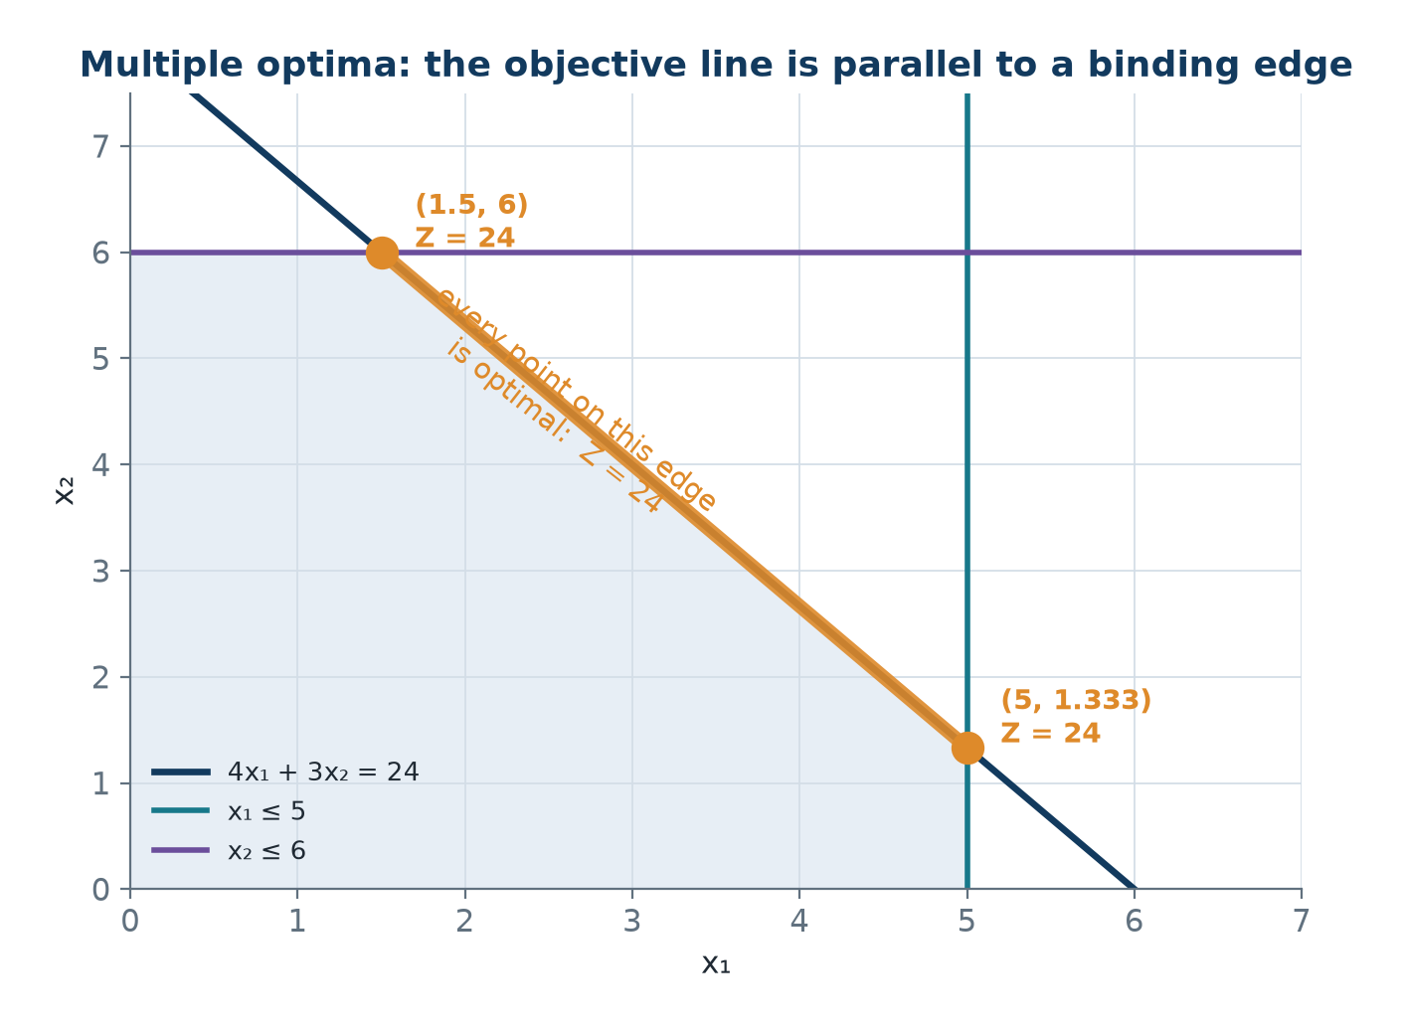
Multiple Optima - A Whole Optimal Edge
• Objective slope −4/3 equals the slope of 4x₁ + 3x₂ = 24.
• The tied corners are (1.5, 6) and (5, 1.333), both with Z = 24.
• The last contact of the sliding line is a segment, not a point.
• Algebraically (L06): a non-basic variable has zero reduced cost at optimality.
The objective line lies flat along a binding edge instead of touching one corner.
OM-L03 · The Graphical Method
Nikhil Rajput
71
Notes:
Look at the thick highlighted segment running from (1.5, 6) down to (5, 1.333). It is not an extra line drawn on top of the diagram - it lies exactly along the constraint boundary 4x₁ + 3x₂ = 24, because the objective 4x₁ + 3x₂ has the same slope, −4/3, as that constraint. That is the whole mechanism: when the sliding line and the edge are parallel, the line does not pivot on a corner as it leaves the region, it lies flat against the edge. Both marked endpoints carry Z = 24, and so does every point between them, since Z along the segment is a weighted average of two equal values. Conclude that the last contact between the profit line and the region can be a whole edge rather than a single point, and that naming just one of the two corners hides a genuinely free choice - every plan on that segment earns the same, so the choice can be settled on grounds the model never captured.

Slide 72
Solved Problem 4 - Unbounded and infeasible problems
Diagnose (a) max Z = 2x₁ + 3x₂ s.t. x₁ − x₂ ≤ 2, x₁ + x₂ ≥ 4, x₁, x₂ ≥ 0; (b) max Z = x₁ + x₂ s.t. x₁ + x₂ ≤ 3, x₁ + x₂ ≥ 8, x₁, x₂ ≥ 0.
(a) Test the ray x₁ = t, x₂ = t for t ≥ 2
x₁ − x₂ = 0 ≤ 2 ✓ for every t.
x₁ + x₂ = 2t ≥ 4 for t ≥ 2 ✓.
Z = 2t + 3t = 5t ⟶ ∞ as t → ∞.
Unbounded - no finite optimum exists.
(a) What that means in practice
The region extends infinitely to the upper right and Z improves in that direction.
An unbounded LP almost always signals a modelling error.
Real profit is never infinite - look for the constraint you forgot.
(b) The contradiction
Constraint 1 requires x₁ + x₂ ≤ 3; constraint 2 requires x₁ + x₂ ≥ 8.
Together 8 ≤ x₁ + x₂ ≤ 3, so 8 ≤ 3, a contradiction.
Infeasible - the feasible region is empty.
Graphically the two shaded half-planes never overlap.
Detection in the simplex method
Unbounded: the entering column has no positive entry, so the ratio test fails.
Infeasible: an artificial variable is positive at optimality.
The practical response is to find the Irreducible Infeasible Subsystem.
Commercial solvers report it automatically; then relax one of its constraints.
(a) unbounded; (b) infeasible
OM-L03 · The Graphical Method
Nikhil Rajput
72
Notes:
Unbounded and infeasible are the two ways a linear programme can fail to have a finite answer, and both are settled by proof rather than by eye. Unbounded means feasible points exist along which Z grows without limit; to establish it, exhibit one explicit ray. Here x₁ = x₂ = t satisfies x₁ − x₂ = 0 ≤ 2 and x₁ + x₂ = 2t ≥ 4 for every t ≥ 2, while Z = 5t rises without limit, so no finite optimum can exist. Infeasible means no point satisfies everything at once; here chaining the two constraints gives 8 ≤ x₁ + x₂ ≤ 3, hence 8 ≤ 3, a contradiction that needs no drawing. Neither outcome is a failure of the method - both are verdicts on the model. Unbounded almost always means a capacity limit was left out, since real profit is never infinite; infeasible means the requirements conflict, so find the smallest conflicting set and relax one constraint in it.

Slide 73
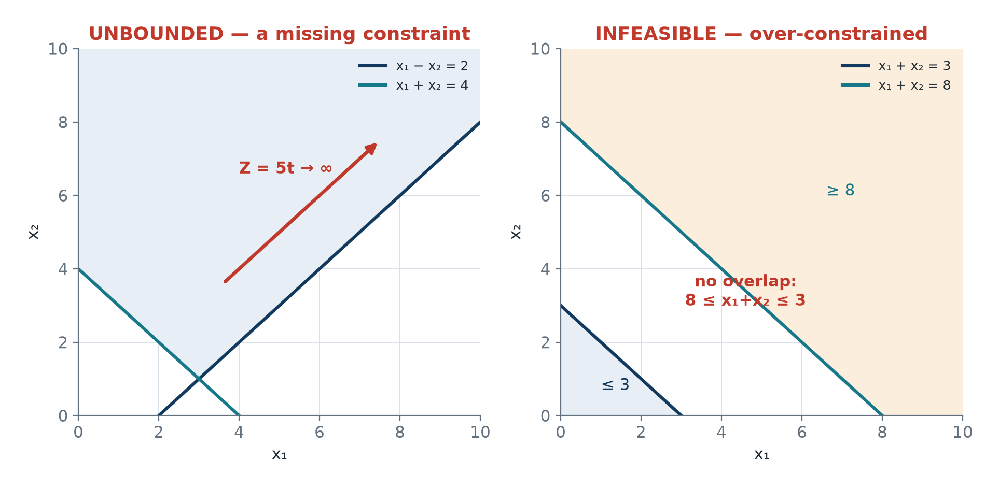
Unbounded and Infeasible, Side by Side
• Unbounded: feasible points run to infinity along a ray on which Z keeps growing.
• In (a) the ray x₁ = x₂ = t, t ≥ 2, gives Z = 5t without limit.
• Infeasible: x₁ + x₂ ≤ 3 and x₁ + x₂ ≥ 8 share no point at all.
• Both are verdicts on the model, not failures of the method.
Left: a region open in the improving direction. Right: half-planes with no overlap.
OM-L03 · The Graphical Method
Nikhil Rajput
73
Notes:
In the left panel, notice that the shaded region has no boundary at all towards the upper right: it simply runs off the top of the axes, because x₁ − x₂ ≤ 2 and x₁ + x₂ ≥ 4 together limit nothing in that direction. Follow the red arrow along the ray x₁ = x₂ = t. Every point on it stays feasible however large t grows, while Z = 2t + 3t = 5t rises with it, so the sliding profit line never has a last point of contact and no finite optimum exists. In the right panel two wedges are shaded separately, one below x₁ + x₂ = 3 and one above x₁ + x₂ = 8, with a visible gap between the two boundaries. No point lies in both, so the feasible region is empty and there is nothing to optimise over. Look at the gap itself: it is the picture of 8 ≤ 3, the contradiction the two constraints produce algebraically.

Slide 74
Solved Problem 5 - Sensitivity from the graph (1 of 2)
Furniture problem: max Z = 450x₁ + 300x₂ s.t. 5x₁ + 3x₂ ≤ 120 (carpentry), 2x₁ + 4x₂ ≤ 90 (finishing), x₁, x₂ ≥ 0. Find the optimum and the binding constraints.
Step 1 - The intersection corner
From 2x₁ + 4x₂ = 90: x₁ = 45 − 2x₂.
Substitute: 5(45 − 2x₂) + 3x₂ = 120 ⟹ 225 − 7x₂ = 120.
So x₂ = 15 and x₁ = 15.
Step 2 - Evaluate Z = 450x₁ + 300x₂
(0, 0), origin: Z = 0.
(0, 22.5), finishing binding: Z = 6,750.
(15, 15), both binding: Z = 11,250 <- best.
(24, 0), carpentry binding: Z = 10,800.
Step 3 - Binding constraints
5(15) + 3(15) = 120 = 120 ⟹ carpentry binding, s₁ = 0.
2(15) + 4(15) = 90 = 90 ⟹ finishing binding, s₂ = 0.
Both resources are fully used - no idle capacity anywhere.
x₁* = 15, x₂* = 15, Z* = ₹11,250
OM-L03 · The Graphical Method
Nikhil Rajput
74
Notes:
This reuses the furniture problem from the formulation work - profit 450 and 300 per unit, a carpentry limit of 120 and a finishing limit of 90 - so the modelling is already settled and only the geometry is new. Step 1 finds the corner where both resources are exhausted, by substitution rather than elimination: 2x₁ + 4x₂ = 90 rearranges to x₁ = 45 − 2x₂, and putting that into 5x₁ + 3x₂ = 120 gives 225 − 7x₂ = 120, so x₂ = 15 and x₁ = 15. Step 2 evaluates Z at all four corners, and the near miss is worth noticing: (24, 0) earns ₹10,800 against ₹11,250 at (15, 15), so a sketch that picks the wrong corner costs real money and eyeballing is not enough. Step 3 checks the slacks: 5(15) + 3(15) = 120 and 2(15) + 4(15) = 90, both zero, so carpentry and finishing are exhausted together.

Slide 75
Solved Problem 5 - Sensitivity from the graph (2 of 2)
Step 4 - When does the corner stay optimal?
The corner (15, 15) stays optimal while the iso-profit slope lies between the two binding slopes.
Slope of carpentry: −5/3 = −1.667.
Slope of finishing: −2/4 = −0.5.
Slope of the objective: −c₁/c₂ = −c₁/300.
Step 5 - Solve the condition
−5/3 ≤ −c₁/300 ≤ −1/2.
Multiply by −1, reversing the inequalities: 1/2 ≤ c₁/300 ≤ 5/3.
Hence 150 ≤ c₁ ≤ 500.
Table profit may fall to ₹150 or rise to ₹500 and the plan is still 15 and 15.
Step 6 - Verify at the boundaries
At c₁ = 500: slope −500/300 = −1.667, the carpentry slope ⟹ multiple optima.
Z(24, 0) = 500(24) = 12,000 and Z(15, 15) = 7500 + 4500 = 12,000 ✓ - they tie.
At c₁ = 150: slope −0.5, the finishing slope ⟹ multiple optima.
Z(0, 22.5) = 300(22.5) = 6750 and Z(15, 15) = 2250 + 4500 = 6750 ✓.
Step 7 - Why sensitivity matters
Cost and price estimates are never exact.
Table profit may fall by two thirds, to ₹150, or rise to ₹500, and the plan holds.
That is far more useful than the point estimate ₹11,250 alone.
Sensitivity analysis is developed algebraically in L07.
150 ≤ c₁ ≤ 500 keeps the optimal corner at (15, 15); only Z changes, not the plan
OM-L03 · The Graphical Method
Nikhil Rajput
75
Notes:
Sensitivity analysis asks how far a coefficient may move before the answer changes; here the coefficient is c₁, the profit on the first product. The technique is a slope sandwich. The corner (15, 15) is where the carpentry and finishing edges meet, and it stays the last point the sliding line touches for exactly as long as that line is steeper than one of those edges and flatter than the other. Writing the condition with the objective slope −c₁/300 gives −5/3 ≤ −c₁/300 ≤ −1/2; multiplying by −1 reverses both inequalities to 1/2 ≤ c₁/300 ≤ 5/3, hence 150 ≤ c₁ ≤ 500. Step 6 is the check that makes the range believable: at each endpoint the corner ties exactly with a neighbour, 12,000 with (24, 0) at c₁ = 500 and 6,750 with (0, 22.5) at c₁ = 150. Report the range, and note that inside it only Z changes, never the plan.

Slide 76
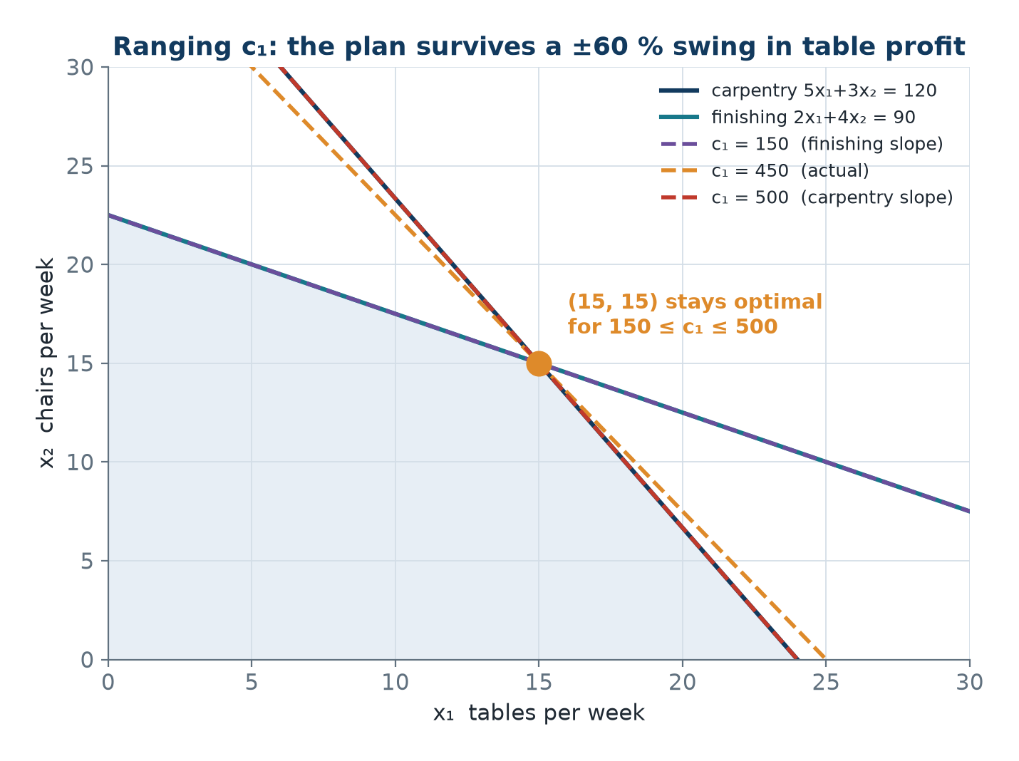
The Objective Line Rotating Over Its Range
• Inside the range the last contact is still the single corner (15, 15).
• At c₁ = 500 the line lies along the carpentry edge, tying with (24, 0).
• At c₁ = 150 it lies along the finishing edge, tying with (0, 22.5).
• Outside the range the optimum jumps to a different corner.
The furniture region with the iso-profit line swept over 150 ≤ c₁ ≤ 500.
OM-L03 · The Graphical Method
Nikhil Rajput
76
Notes:
All three dashed lines pass through the same point, (15, 15); what differs is their tilt, because changing c₁ changes the objective slope −c₁/300 while leaving the region untouched. The middle line is the actual profit, c₁ = 450, with slope −1.5. Now watch the two extremes. At c₁ = 500 the slope is −500/300 = −1.667, exactly the carpentry edge's slope, so the line lies flat along that edge and (24, 0) ties with (15, 15). At c₁ = 150 the slope is −0.5, the finishing edge's slope, and (0, 22.5) ties instead. Between those two tilts the corner remains the unique last contact, which is what 150 ≤ c₁ ≤ 500 records. Push past either end and the line rolls over onto the neighbouring edge and the optimum jumps to a different corner - so the ends of a sensitivity range are precisely the tilts at which multiple optima appear.

Slide 77
Where this geometry is used
Blending and formulation reviews
Planners plot two free ratios to see which quality limit is actually binding before trusting the full model.
Two-crop farm planning
Land-and-water problems are still solved this way by extension services; the optimal corner gives the acreage split.
Pricing and contract negotiation
A range such as 150 ≤ c₁ ≤ 500 says how far a price can move before the production plan must change.
Diagnosing a failed solver run
Solvers return unbounded or infeasible; the picture tells you which limit is missing or which pair of rules conflicts.
Learning the simplex method
Basis, pivot, ratio test and degeneracy are first met here as a corner, an edge and a crossing of lines.
OM-L03 · The Graphical Method
Nikhil Rajput
77
Notes:
These uses share a shape: the picture is not doing the solving, it is doing the diagnosing. Nobody plots a model with thousands of variables, but people routinely hold everything else fixed and plot two free quantities, because the resulting sketch shows immediately which limit is actually binding - which one holds with equality at the answer and therefore controls it - and which has slack to spare. The same sketch explains a solver that returned unbounded or infeasible instead of a plan: unbounded points to a missing limit, infeasible to a pair of rules that cannot both hold. The pricing entry is where a range such as 150 ≤ c₁ ≤ 500 earns its keep, since in a negotiation it says exactly how far a price may move before the production plan has to be renegotiated, not merely the profit figure. The caveat: each of these is a two-dimensional slice of a larger model, so it shows a cross-section, not the whole truth.

Slide 78
The intuition - why the answer is always at a corner
Stand in a sloping field and walk uphill. You never stop in the middle; you stop when a fence blocks you, and then you slide along that fence until you reach a corner post.
• Profit has a constant slope, so there is no hilltop in the middle of the region to settle at.
• The best point is therefore pushed onto the boundary, and along the boundary to a corner.
• That turns an infinite search into checking a handful of corner points.
• If the ground slopes exactly along a fence, the whole fence is best - that is multiple optima.
• Sensitivity asks how far you can tilt the ground before a different corner post wins.
OM-L03 · The Graphical Method
Nikhil Rajput
78
Notes:
This is the Corner-Point Theorem told as a walk, and the load-bearing phrase is constant slope. Because the objective is linear, profit rises at the same rate however far you go in a given direction; the ground has a uniform tilt with no summit anywhere inside the field, so wherever you stand in the middle there is always a direction that pays more. The boundary therefore always beats the interior. Once a fence stops you, sliding along it still pays at a constant rate, so you keep going until the fence ends - which is why a corner post, where two fences meet, is where you stop rather than the middle of a fence. That converts an infinite search into checking a handful of points. Both exceptions are already in the story: ground sloping exactly along a fence makes every point of that fence equally good, which is multiple optima, and asking how far the ground may tilt before a different post wins is sensitivity analysis.

Slide 79
Common Mistakes to Avoid
• Intersecting two constraint lines and never checking the third - the point may not be feasible.
• Assuming the optimum must sit where two constraints cross; in Problem 2 the crossing (5, 3) gives 21, worse than 16.
• Shading the wrong side: always test the origin, and test another point if the line passes through it.
• Forgetting x₁, x₂ ≥ 0, which confines the whole picture to the first quadrant.
• Reporting one optimum when the objective line is parallel to a binding edge - report the whole edge.
• Treating an unbounded answer as a solver bug; it almost always means a missing capacity constraint.
• Quoting sensitivity as a single number instead of a range such as 150 ≤ c₁ ≤ 500.
OM-L03 · The Graphical Method
Nikhil Rajput
79
Notes:
Most of these are one error wearing different clothes: trusting a feature of the drawing instead of checking it against the constraints. An intersection of two constraint lines is only a candidate corner until every other constraint has been tested at it, since two lines cross whether or not the crossing is allowed; and a candidate is only optimal once all corners have been compared. Problem 2 is the counterexample that settles the second point - the crossing (5, 3) scores 21 while the axis corner (0, 8) scores 16, so on a minimisation the meeting point loses. The shading mistakes are the same failure earlier in the process: the origin test decides the side, and it says nothing when the line runs through the origin. The last two are reporting failures rather than arithmetic ones. An unbounded answer is information about the model, and sensitivity is a range such as 150 ≤ c₁ ≤ 500, so a single number throws away the useful part.

Slide 80
Summary
• The feasible region is a convex polyhedron; draw each constraint as a line and use the origin test for the side.
• Corner-Point Theorem: if an optimum exists, one occurs at an extreme point, so finitely many corners suffice.
• That theorem is the theoretical basis of the simplex method - an intelligent walk from corner to corner.
• Two equivalent methods: corner enumeration, verifying feasibility, and the iso-profit line slid along ∇Z.
• Multiple optima ⟺ the objective line is parallel to a binding constraint ⟺ tied corner values; report them.
• Unbounded ⟹ almost always a missing constraint. Infeasible ⟹ over-constrained requirements.
• Sensitivity: the optimal corner is unchanged while −c₁/c₂ lies between the slopes of the binding constraints.
OM-L03 · The Graphical Method
Nikhil Rajput
80
Notes:
The summary is a chain, and it runs in one direction. Each constraint gives a half-plane; the half-planes intersect in a convex region, meaning the segment between any two feasible plans is itself feasible; convexity together with a linear objective forces at least one optimum onto an extreme point; and because the region has finitely many extreme points, the problem is solved by inspecting a list. The simplex method adds nothing to that geometry - it is a clever route between the same corners, chosen so that Z improves at every step. Everything else here is the same geometry in a special position: an objective line parallel to a binding edge means a tied edge and infinitely many optima, a region open in the improving direction means unbounded, an empty overlap means infeasible, and a slope trapped between the two binding edge slopes gives the sensitivity range. The caveat is that only the drawing is limited to two variables.

Slide 81
Practice Problems
answers where the source gives them
• 1. max 3x₁ + 2x₂ s.t. x₁ + x₂ ≤ 4, x₁ + 3x₂ ≤ 6, x₁ ≤ 3. [Ans: (3, 1), Z = 11]
• 2. min 2x₁ + 3x₂ s.t. x₁ + x₂ ≥ 6, 2x₁ + x₂ ≥ 8, x₁, x₂ ≥ 0. [Ans: (6, 0), Z = 12]
  – The corner (2, 4) gives 16 - check all corners.
• 3. Show that max 2x₁ + 2x₂ s.t. x₁ + x₂ ≤ 5 has multiple optima and describe them.
• 4. Diagnose: max x₁ s.t. x₁ − x₂ ≤ 1, x₁, x₂ ≥ 0. [Ans: unbounded]
• 5. Diagnose: x₁ ≥ 5, x₁ ≤ 3. [Ans: infeasible]
• 6. For Practice 1, find the range of c₁ that keeps the optimum unchanged.
OM-L03 · The Graphical Method
Nikhil Rajput
81
Notes:
Work these on paper rather than by inspection, because each carries a specific trap and inspection is what the traps are built to catch. Problem 1 is straight enumeration with three constraints, so it also exercises the feasibility check on candidate corners. Problem 2 states its own warning: the crossing (2, 4) scores 16 against 12 at (6, 0), so an answer chosen because two constraints meet there will be wrong. Problem 3 has a single constraint whose left-hand side is proportional to the objective, so its whole boundary segment is optimal and the answer has to describe that segment rather than name a point. Problems 4 and 5 are diagnoses rather than solutions, and each should finish with a sentence saying which limit is missing or which pair of rules conflicts. Problem 6 asks for a range, so the answer is two numbers with the corner they protect named alongside them.

Slide 82
OPTIMIZATION METHODS · LESSON 04
The Simplex Method I: Theory
Linear Programming - Lesson 4
Nikhil Rajput
Notes:
The simplex method is an algorithm for solving a linear programme: maximise Z = cᵀx subject to linear constraints and x ≥ 0. The earlier graphical work established that when an optimum exists it sits at a corner of the feasible region — true, but not yet usable, because in thirty dimensions there is no picture and no obvious way to list the corners. What follows supplies the missing translation. A corner will be described purely in algebra, as a choice of which m variables are allowed to be non-zero; moving to a neighbouring corner will become a single swap in that choice; and two arithmetic tests will decide which swap to make and when to stop. That translation is what turns a geometric observation into something a machine can execute, and it is why problems with tens of thousands of constraints are routine. No tableau is worked here. The theory comes first, deliberately, so the arithmetic that follows is derived rather than remembered.

Slide 83
Learning Outcomes
by the end of this lesson you will be able to
• Define basic solution, basic feasible solution (BFS) and basis.
• State and use the theorem that BFS ⟺ extreme point.
• Count the maximum number of basic solutions.
  – Explain why complete enumeration of them is hopeless.
• Derive the optimality criterion (zⱼ − cⱼ) and the feasibility criterion (minimum ratio).
• State the simplex algorithm and explain why it terminates.
OM-L04 · The Simplex Method I: Theory
Nikhil Rajput
83
Notes:
These outcomes form a chain, and each link rests on the one before. The definitions come first because everything downstream is phrased in them: a basis is a chosen set of m variables, a basic solution is what you get by solving for them with the rest set to zero, and a basic feasible solution is one whose values are all non-negative. The equivalence theorem comes next, because it is what lets an algebraic search answer a geometric question — corners and basic feasible solutions turn out to be the same objects under two descriptions. The counting outcome then shows why that finite search still cannot be done by listing, and the two criteria are the escape. Notice the verb on the fourth outcome: derive, not state. Both criteria follow from one identity in the tableau, and a reader who holds that identity can rebuild them, while a reader who only memorised them will not recognise unboundedness or degeneracy when the arithmetic produces one.

Slide 84
The big picture, in simple terms
Think of a city where every good restaurant sits on a street corner. You never walk the whole city. You hop from corner to corner, always uphill, and stop when no neighbouring corner is better.
• A corner of the feasible region is just a choice of which few activities you run and which you switch off.
• Switch off enough activities and the leftover equations have exactly one solution. That is a corner, written as algebra.
• A 30-constraint plan has about 8.87×10²¹ corners. Simplex looks at roughly 75 of them.
• Each move swaps one activity in and one out, and profit strictly rises, so you can never go round in circles.
• This lesson is the theory of why that shortcut is allowed. The next one runs it on a real tableau.
OM-L04 · The Simplex Method I: Theory
Nikhil Rajput
84
Notes:
A corner of the feasible region is nothing more mysterious than a decision about which activities you run and which you switch off, and in algebra switching an activity off means setting its variable to zero. Switch off enough of them — n − m out of n — and the equations that remain have as many unknowns as equations, so they pin down exactly one point. That point is a corner written as numbers, and every definition that follows formalises this sentence. The analogy is doing real work rather than decorating: restaurants sitting on street corners is the corner theorem, hopping from corner to corner is a pivot, and refusing to walk the whole city is the local stopping test. The walk stays short because each hop swaps one activity in and one out while profit strictly rises, so no corner is ever revisited. The 75-out-of-8.87×10²¹ figure is not rhetoric; it is computed later from a problem with 30 constraints.

Slide 85
From geometry to algebra: standard form
max Z = cᵀx subject to Ax = b, x ≥ 0
A is m×n with m < n and rank(A) = m
Choose m basic variables; set the other n − m to zero
B x_B = b ⟹ x_B = B⁻¹b
Corner point (geometry) ⟺ basic feasible solution (algebra). That equivalence is the whole lesson.
OM-L04 · The Simplex Method I: Theory
Nikhil Rajput
85
Notes:
Standard form is the shape every model is forced into before the algebra starts: maximise Z = cᵀx subject to Ax = b and x ≥ 0, where A holds the constraint coefficients, b the right-hand sides and c the objective coefficients. An inequality becomes an equation by adding a slack variable that absorbs the unused amount, which is why n, the number of variables, exceeds m, the number of equations. That is both the difficulty and the opening: m equations in n unknowns are underdetermined, so there are infinitely many solutions. Simplex supplies the missing n − m conditions in the cheapest way available, by forcing n − m variables to zero. What is left is a square system B x_B = b in the m survivors, and rank(A) = m guarantees that some choice of m columns gives an invertible B, so x_B = B⁻¹b. Setting a variable to zero means standing on that constraint's boundary; choosing which to zero chooses which boundaries meet.

Slide 86
Basic solutions: the definitions
what simplex means by a corner
  – The system Ax = b is underdetermined - m equations, n unknowns, infinitely many solutions.
• Basic solution. Choose m of the n variables to be basic; set the remaining n − m non-basic variables to zero.
  – The m×m submatrix B of the chosen columns is the basis matrix; it must be non-singular.
  – Solve B x_B = b, so x_B = B⁻¹b. The resulting x is a basic solution.
• Basic feasible solution (BFS). A basic solution with x_B ≥ 0.
• Degenerate BFS. A BFS in which at least one basic variable equals zero.
  – Simplex searches only this finite special subset, never the infinite set of all solutions.
OM-L04 · The Simplex Method I: Theory
Nikhil Rajput
86
Notes:
A basis is a chosen set of m variables; the other n − m are non-basic and are set to zero. The m columns of A belonging to the chosen variables form the m×m basis matrix B, and solving B x_B = b gives x_B = B⁻¹b, a basic solution. Read these as one construction with two filters. The construction is: pick m variables, zero the rest, invert B. The first filter is non-singularity — if the chosen columns are linearly dependent then B has no inverse and the choice names no point at all. The second is non-negativity, and it is what separates a basic solution from a basic feasible one, because the algebra happily returns points with a negative slack, meaning a resource used beyond its limit, and those lie outside the region. Degeneracy — a basic variable that comes out exactly zero — is flagged this early because it is the one case that later breaks the termination argument.

Slide 87
How many basic solutions are there?
m | n | C(n, m) = n! / (m! (n−m)!)
2 | 4 | 6
3 | 6 | 20
5 | 10 | 252
10 | 20 | 184 756
20 | 40 | 1.4×10¹¹
50 | 100 | 1.0×10²⁹
At 10⁹ solutions per second the last row takes 3×10¹² years - yet such problems are solved in milliseconds.
OM-L04 · The Simplex Method I: Theory
Nikhil Rajput
87
Notes:
A basis is a selection of m variables out of n, so the number of basic solutions is at most the count of such selections, the binomial coefficient C(n, m) = n! / (m! (n−m)!). The rows are laid out to display a growth rate, not to be memorised. Doubling the size of the problem does not double the count: going from m = 2, n = 4 to m = 5, n = 10 takes 6 to 252, and the last two rows, 1.4×10¹¹ and 1.0×10²⁹, are eighteen orders of magnitude apart. At 10⁹ solutions per second the bottom row needs 3×10¹² years, yet problems of that size are solved in milliseconds. Read the figures as an upper bound rather than an exact corner count: some column choices make B singular and define no point, many define infeasible points, and a single degenerate corner is named by several bases at once. The true number is smaller, and still hopeless.

Slide 88
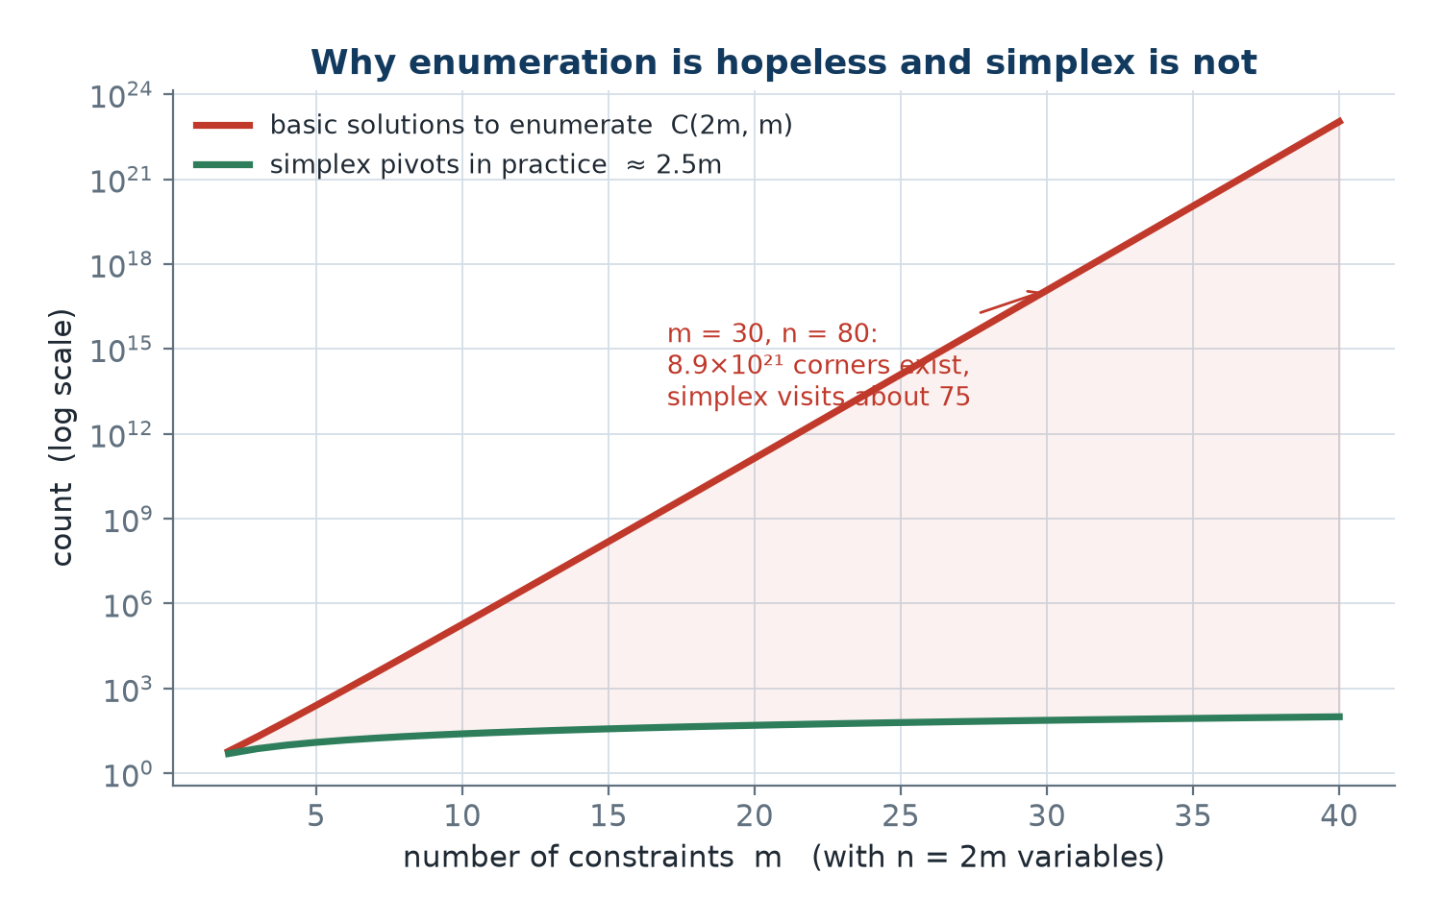
Why enumeration is hopeless
• Total enumeration is hopeless: the count grows faster than any machine ever will.
• Yet m = 50, n = 100 problems are solved in milliseconds.
• The simplex method's genius is visiting only a tiny fraction of the corners - typically O(m) of them.
• The gap is not a faster computer. It is a better search.
C(n, m) basic solutions against the roughly 2.5m pivots simplex actually performs, on a log scale.
OM-L04 · The Simplex Method I: Theory
Nikhil Rajput
88
Notes:
Look at the vertical axis before anything else: it is logarithmic, so equal spacings mean equal multiplications rather than equal additions. On that axis the upper line is the count of basic solutions C(n, m), and it climbs almost straight — straightness on a log axis means multiplying by a fixed factor for each extra constraint, which is exponential growth. The lower curve is simplex's roughly 2.5m pivots, and because linear growth flattens on a log scale it barely rises at all. The gap between the two therefore widens without limit as m increases; at m = 30 and n = 80 it is about 8.9×10²¹ corners against roughly 75 pivots. The conclusion to draw is that no hardware closes a gap of that shape — doubling machine speed shifts the upper curve by a hair and leaves the picture unchanged. What closes it is that simplex never enumerates at all: it uses a purely local test to skip everything it does not visit, and the rest of this material exists to justify that skip.

Slide 89
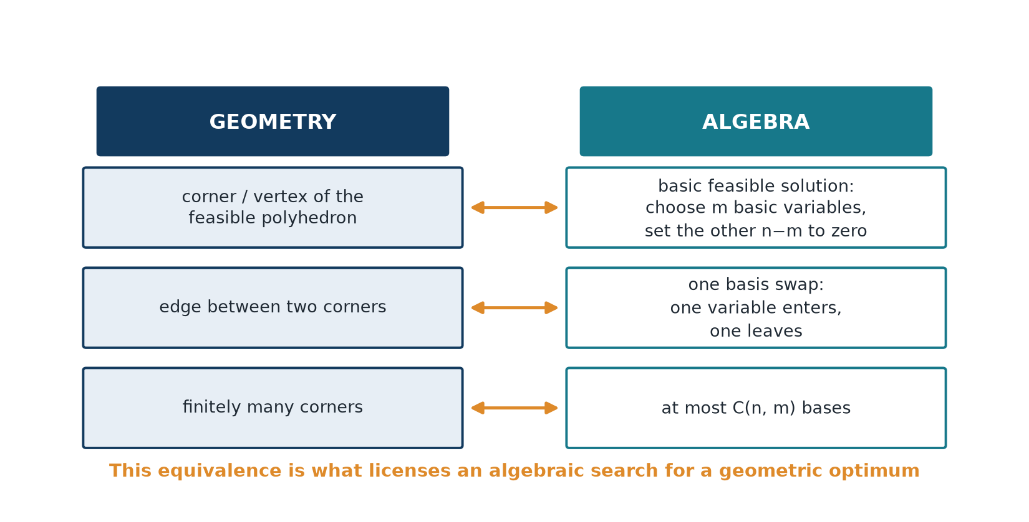
The central theorem: BFS ⟺ extreme point
• Theorem. x is a BFS of Ax = b, x ≥ 0 if and only if x is an extreme point of the feasible region.
• Proof sketch. If the columns of the positive components were dependent, x ± εd would both be feasible.
• Then x would be a midpoint, contradicting extremality - so those columns are independent, k ≤ m, and extend to a basis.
• Corollary. An optimum sits at an extreme point, so it suffices to search the finite set of BFSs.
Every basic feasible solution is a corner, and every corner is a basic feasible solution.
OM-L04 · The Simplex Method I: Theory
Nikhil Rajput
89
Notes:
An extreme point of the feasible region is a feasible point that cannot be written as the midpoint of two other feasible points — a corner, in the sense that it lies partway along no segment inside the region. The theorem says these are exactly the basic feasible solutions, so a geometric object and an algebraic one coincide. The figure pairs them off: corner with basic feasible solution, edge with a single swap of one variable in the basis, and the finiteness of the corners with the at most C(n, m) bases. The middle pairing is the one to dwell on, since it is why a pivot slides along an edge rather than jumping across the region. The proof sketch argues by contradiction: if the columns belonging to the positive components were dependent, some non-zero d has Ad = 0, so x ± εd are both feasible for small ε and x is their midpoint — precisely what an extreme point cannot be.

Slide 90
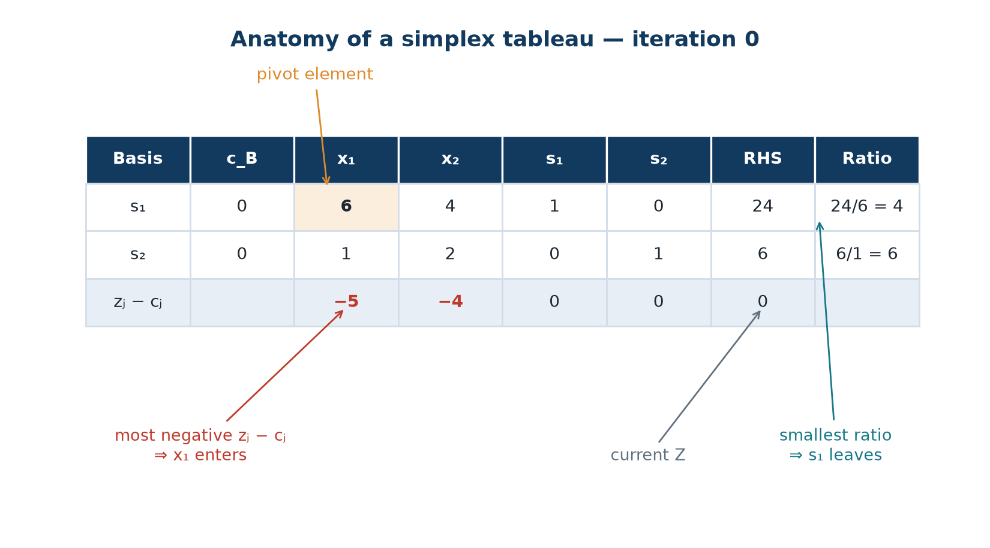
The simplex tableau
• The basis column names which m variables are non-zero; the RHS holds x_B = B⁻¹b.
• The zⱼ row: zⱼ = ∑ᵢ c_Bᵢ aᵢⱼ = c_Bᵀ B⁻¹ aⱼ.
• Reduced cost, also called the net evaluation: Δⱼ = zⱼ − cⱼ.
• The bottom-right cell carries the current objective value Z.
Basis column, c_B column, the constraint columns, the RHS, and the zⱼ − cⱼ row underneath.
OM-L04 · The Simplex Method I: Theory
Nikhil Rajput
90
Notes:
The tableau is a table holding everything the algorithm needs at one basis. Its rows are the constraint equations already multiplied through by B⁻¹, so the columns of the basic variables form an identity and the right-hand column can be read off directly as the current values x_B = B⁻¹b. That is why row i says x_Bᵢ = bᵢ − ∑ⱼ aᵢⱼ xⱼ, and that single line is what the whole array exists to carry: aᵢⱼ is how much of basic variable x_Bᵢ one unit of xⱼ consumes. The basis column names the m variables currently allowed to be non-zero, c_B stores their objective coefficients, zⱼ = ∑ᵢ c_Bᵢ aᵢⱼ = c_Bᵀ B⁻¹ aⱼ prices each column, and the bottom-right cell carries Z. At the iteration shown the slacks are basic with c_B = 0, so every zⱼ is zero and the bottom row is simply −cⱼ: −5, −4, 0, 0, with Z = 0. Both criteria come from that one line.

Slide 91
The economic meaning of zⱼ − cⱼ
what one more unit of a non-basic activity really costs
• Increase a non-basic variable xⱼ by one unit and two things happen.
  – Gain: cⱼ, taken directly from the objective.
  – Cost: zⱼ, because the basic variables are forced to adjust by −aᵢⱼ each.
  – That adjustment changes the objective by −∑ᵢ c_Bᵢ aᵢⱼ = −zⱼ.
• Net change in Z per unit of xⱼ = cⱼ − zⱼ = −Δⱼ.
• So Δⱼ < 0 means bringing xⱼ in improves Z.
  – A positive Δⱼ on a slack column is a shadow price: what one more unit of that resource is worth.
OM-L04 · The Simplex Method I: Theory
Nikhil Rajput
91
Notes:
This is the derivation that makes zⱼ − cⱼ a meaningful quantity rather than a formula to memorise. Push a non-basic variable xⱼ up from zero by one unit. You gain cⱼ, its objective coefficient, directly. You also pay, because the constraint equations force each basic variable x_Bᵢ to fall by aᵢⱼ, and every unit of that basic variable was contributing c_Bᵢ to the objective, so the losses sum to ∑ᵢ c_Bᵢ aᵢⱼ, which is exactly zⱼ. So zⱼ is a replacement cost — what the basis must give up to free the resources for one unit of xⱼ — and not a mysterious inner product. The net rate is cⱼ − zⱼ, and the reduced cost Δⱼ = zⱼ − cⱼ is its negative. Watch the sign convention, which trips everyone once: the tableau stores the rate at which Z worsens, so a negative entry is the good news. A positive Δⱼ on a slack column is that resource's shadow price.

Slide 92
The two criteria
Optimality (max): the BFS is optimal ⟺ zⱼ − cⱼ ≥ 0 for all j
Entering variable (Dantzig): j* = argminⱼ (zⱼ − cⱼ)
Feasibility: x_Bᵢ = bᵢ − a(i, j*) x(j*) must stay ≥ 0
θ = min { bᵢ / a(i, j*) : a(i, j*) > 0 }
For minimisation, convert to maximisation, or reverse: optimal when all zⱼ − cⱼ ≤ 0, and enter the most positive.
OM-L04 · The Simplex Method I: Theory
Nikhil Rajput
92
Notes:
Neither criterion should feel quoted; both fall out of the single line x_Bᵢ = bᵢ − ∑ⱼ aᵢⱼ xⱼ. Optimality: the only moves available from the current corner are to raise one non-basic variable, and each changes Z at rate cⱼ − zⱼ per unit, so if not a single move pays — that is, if zⱼ − cⱼ ≥ 0 for every j — nothing is left to do and the basic feasible solution is optimal. Feasibility: once x(j*) is chosen and raised to a value t, row i reads bᵢ − a(i, j*)t, which must stay non-negative, so each row with a(i, j*) > 0 hands you a ceiling of bᵢ / a(i, j*). Every ceiling must hold at once, so take the smallest, and that is θ. Dantzig's rule enters the most negative Δⱼ, maximising gain per unit — a heuristic, not a guarantee, because the ratio test may permit only a few of those units.

Slide 93
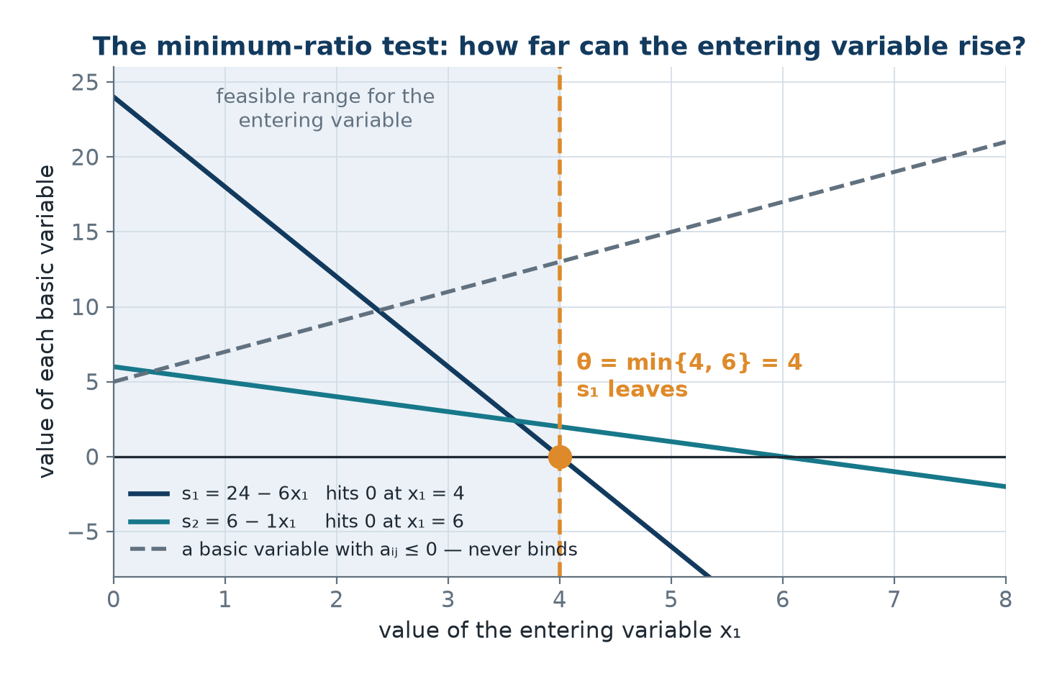
The minimum-ratio test
• The row r achieving θ gives the leaving variable, and a(r, j*) is the pivot element.
• Rows with a(i, j*) ≤ 0 impose no limit: raising x(j*) only raises those basic variables.
• If no a(i, j*) > 0 exists at all, the problem is UNBOUNDED - x(j*) can grow forever.
• A tie in the ratio test means the next BFS is degenerate.
How far the entering variable can rise before the first basic variable would go negative.
OM-L04 · The Simplex Method I: Theory
Nikhil Rajput
93
Notes:
Each line plots one basic variable as a function of how far the entering variable has been raised, following x_Bᵢ = bᵢ − a(i, j*) x(j*). A line's slope is the negative of that row's entry in the entering column, so rows with a positive entry slope downward: s₁ = 24 − 6x₁ reaches zero at x₁ = 4, and s₂ = 6 − x₁ reaches zero at x₁ = 6. The first to touch zero is the binding one, so θ = min{4, 6} = 4, s₁ leaves the basis, and the entry in its row is the pivot element. The dashed rising line belongs to a row with a(i, j*) ≤ 0: it moves away from zero as the entering variable grows and can never bind, which is why such rows are skipped rather than given a ratio. Two consequences follow straight from the picture. If every line rises, nothing stops the entering variable and the problem is unbounded. If two reach zero together, degeneracy arrives.

Slide 94
The simplex algorithm and the pivot
maximisation, standard form
• 1. Find an initial BFS - the slacks form the basis when all constraints are ≤.
• 2. Compute zⱼ − cⱼ for all j. 3. If all zⱼ − cⱼ ≥ 0, stop: optimal.
• 4. Entering column j* = argmin (zⱼ − cⱼ). 5. If no a(i, j*) > 0, stop: unbounded.
• 6. Leaving row r by the minimum-ratio test. 7. Pivot on a(r, j*). 8. Go to step 2.
  – Pivot, first: divide the pivot row by the pivot element, so the pivot becomes 1.
  – Pivot, then: for every other row i, rowᵢ ← rowᵢ − a(i, j*) × (new pivot row).
  – Finally replace the leaving variable by x(j*) in the basis list and recompute the zⱼ − cⱼ row.
OM-L04 · The Simplex Method I: Theory
Nikhil Rajput
94
Notes:
These eight numbered lines are the whole method, and each has now been derived rather than asserted. Step 1 is free only when all constraints are ≤ with non-negative right-hand sides: set the decision variables to zero and each slack takes the value of its own bᵢ, so the origin is a ready-made feasible basis whose basis matrix is already an identity. Steps 2 and 3 apply the optimality test, steps 4 and 5 choose an entering column and check for unboundedness, and steps 6 and 7 apply the ratio test and move. The pivot is Gauss-Jordan elimination on the entering column: divide the pivot row by the pivot element so it becomes 1, then subtract a(i, j*) times that new row from every other row so the rest of the column becomes zero. That is a bookkeeping obligation rather than a new idea — the tableau is readable only while the basic columns form an identity, and x(j*) has just joined them.

Slide 95
Why it terminates - and the degeneracy caveat
• Each iteration moves to an adjacent BFS with a strictly better objective value.
• There are finitely many BFSs and no value repeats, so the algorithm must stop.
  – The caveat: at a degenerate BFS the ratio test can give θ = 0, so Z does not improve.
  – In principle the algorithm can then cycle for ever.
• Bland's rule - among candidates always choose the smallest index. Terminates, but is slow.
• Lexicographic (perturbation) rule - perturb b slightly to break all ties.
• In practice cycling is vanishingly rare; solvers use Bland's rule only after detecting stalling.
OM-L04 · The Simplex Method I: Theory
Nikhil Rajput
95
Notes:
The termination argument has three legs, each easy to check. Every pivot moves to an adjacent basic feasible solution with a strictly better Z; a basis determines its objective value, so a strictly increasing Z means no basis can ever recur; and there are finitely many bases, at most C(n, m) of them. A strictly increasing walk over a finite set must run out of places to go, and the only exit is the optimality test, so the method stops with an answer rather than running for ever. The soft leg is the first. At a degenerate basic feasible solution some bᵢ is already zero, so the ratio test can return θ = 0: the entering variable enters at value zero and the pivot changes the basis without moving the point or changing Z. Values stop increasing, a basis can be revisited, and cycling becomes possible in principle. Bland's rule and lexicographic perturbation restore the guarantee, and both cost something.

Slide 96
Complexity: theory versus practice
Measure | Result | Source
Worst case | exponential: 2ⁿ − 1 iterations | Klee-Minty cube, 1972
Average case | O(m) to O(m log n) pivots | Borgwardt, Smale
Smoothed analysis | polynomial on perturbed data | Spielman-Teng, 2004
Rule of thumb | 2m to 3m iterations | what solvers actually see
Polynomial rivals | ellipsoid, impractical | Khachiyan, 1979
Polynomial rivals | interior point, practical | Karmarkar, 1984
A genuine paradox: simplex is exponential in the worst case yet the algorithm of choice, while the polynomial ellipsoid method is unusable.
OM-L04 · The Simplex Method I: Theory
Nikhil Rajput
96
Notes:
The table separates two questions that sound identical but are not. Worst case asks what an adversary could construct if allowed to design the data: Klee and Minty built a slightly distorted cube in 1972 whose corners force the method through 2ⁿ − 1 iterations, so the worst case is exponential. Average and smoothed analyses ask what typical or slightly perturbed data does, and give O(m) to O(m log n) pivots and a polynomial bound respectively. Practical performance asks what real data does, and the answer is the highlighted row, 2m to 3m iterations — the figure to use when estimating runtime. The paradox in the caption is genuine and worth sitting with. Khachiyan's ellipsoid method of 1979 carries a polynomial guarantee and is unusable; simplex carries an exponential worst case and dominates. A complexity bound describes the worst input someone could hand you, not the input you have, so a guarantee is not a prediction.

Slide 97
Solved Problem 1 - Enumerating all basic solutions (1 of 2)
For the system 6x₁ + 4x₂ + s₁ = 24, x₁ + 2x₂ + s₂ = 6 (from L03), enumerate all basic solutions and identify which are feasible.
Step 1 - How many are there
m = 2, n = 4, so C(4, 2) = 6 basic solutions.
Each basis keeps 2 variables; the other 2 are set to zero.
Step 2 - Bases {s₁, s₂} and {x₁, s₂}
{s₁, s₂}: x₁ = x₂ = 0 ⇒ s₁ = 24, s₂ = 6 ⇒ (0, 0) FEASIBLE
{x₁, s₂}: x₂ = s₁ = 0 ⇒ 6x₁ = 24, x₁ = 4; 4 + s₂ = 6, s₂ = 2
⇒ (4, 0) FEASIBLE
Step 3 - Bases {x₂, s₂} and {x₁, s₁}
{x₂, s₂}: x₁ = s₁ = 0 ⇒ 4x₂ = 24, x₂ = 6; 12 + s₂ = 6, s₂ = −6
⇒ (0, 6) INFEASIBLE (s₂ < 0)
{x₁, s₁}: x₂ = s₂ = 0 ⇒ x₁ = 6; 36 + s₁ = 24, s₁ = −12
⇒ (6, 0) INFEASIBLE
Step 4 - Bases {x₂, s₁} and {x₁, x₂}
{x₂, s₁}: x₁ = s₂ = 0 ⇒ 2x₂ = 6, x₂ = 3; 12 + s₁ = 24, s₁ = 12
⇒ (0, 3) FEASIBLE
{x₁, x₂}: s₁ = s₂ = 0 ⇒ solve 6x₁ + 4x₂ = 24 and x₁ + 2x₂ = 6
⇒ x₁ = 3, x₂ = 1.5 FEASIBLE
OM-L04 · The Simplex Method I: Theory
Nikhil Rajput
97
Notes:
The technique here is exhaustive enumeration, used deliberately on a case small enough to check against a drawing: m = 2 equations and n = 4 variables once the slacks are added, so C(4, 2) = 6 basic solutions, each a choice of which two variables may be non-zero while the other two are set to zero. Because a constraint's boundary line is exactly where its slack equals zero, every basis is really a choice of which two boundary lines to stand on, and each step of the working computes their crossing point. The arithmetic is therefore mechanical: substitute the two zeros, then solve what remains. Watch how infeasibility announces itself. No picture is consulted at any stage; the algebra simply returns s₂ = −6 for the basis {x₂, s₂} and s₁ = −12 for {x₁, s₁}, each meaning a resource consumed past its limit. That negative number is the whole feasibility filter. Enumeration is affordable at this size and never again.

Slide 98
Solved Problem 1 - Enumerating all basic solutions (2 of 2)
Step 5 - The four feasible basic solutions, with Z = 5x₁ + 4x₂
{s₁, s₂} → (0, 0), Z = 0
{x₁, s₂} → (4, 0), Z = 20
{x₂, s₁} → (0, 3), Z = 12
{x₁, x₂} → (3, 1.5), Z = 21 ← best
Step 6 - The two infeasible ones
{x₂, s₂} → (0, 6): rejected because s₂ = −6 < 0
{x₁, s₁} → (6, 0): rejected because s₁ = −12 < 0
Step 7 - What this confirms
Exactly the 4 feasible ones are the 4 corners found graphically in L03.
This confirms the BFS ⟺ extreme-point theorem on a case you can draw.
The 2 infeasible basic solutions are intersections of constraint lines outside the region.
6 basic solutions, 4 feasible; the best is (3, 1.5) with Z = 21.
Algebra found the same four corners the graph did - but algebra keeps working when n > 3.
OM-L04 · The Simplex Method I: Theory
Nikhil Rajput
98
Notes:
Step 7 is the payoff, and the earlier arithmetic exists to reach it. The four feasible basic solutions — (0, 0) with Z = 0, (4, 0) with Z = 20, (0, 3) with Z = 12 and (3, 1.5) with Z = 21 — are exactly the four corners found earlier by drawing the region, and the two rejected ones are honest crossings of constraint lines that happen to fall outside it. That is the equivalence between basic feasible solutions and extreme points verified on a case you can see, which is the only honest way to trust it before relying on it in thirty dimensions where you cannot. Note also what was never needed: the best of the four was identified by comparing four numbers, with nothing plotted at any stage. The caveat is that the method used here does not scale — six bases in this instance but C(n, m) in general — so the value of the exercise is the confirmation, not the technique.

Slide 99
Solved Problem 2 - Computing and interpreting zⱼ − cⱼ
Tableau rows: x₁ with c_B = 5 and entries (1, 2/3, 1/6, 0), RHS 4; s₂ with c_B = 0 and entries (0, 4/3, −1/6, 1), RHS 2. With c = (5, 4, 0, 0), compute the zⱼ − cⱼ row and decide whether the solution is optimal.
Step 1 - The zⱼ row
zⱼ = ∑ᵢ c_Bᵢ aᵢⱼ = 5a₁ⱼ + 0·a₂ⱼ = 5a₁ⱼ
x₁: z = 5(1) = 5, c = 5 ⇒ z − c = 0
x₂: z = 5(2/3) = 10/3, c = 4 ⇒ z − c = 10/3 − 4 = −2/3
s₁: z = 5(1/6) = 5/6, c = 0 ⇒ 5/6. s₂: z = 0, c = 0 ⇒ 0
Step 2 - Objective and optimality test
Z = c_Bᵀ b = 5(4) + 0(2) = 20
z₂ − c₂ = −2/3 < 0 ⇒ NOT optimal
Entering variable: x₂, the most negative Δⱼ
Step 3 - Reading the numbers
One unit of x₂ earns c₂ = 4 directly.
It forces x₁ down by 2/3 (its column entry), losing (2/3)×5 = 10/3.
Net 4 − 10/3 = 2/3 > 0, an improvement, matching −(z₂ − c₂) = +2/3.
z − c = 5/6 on s₁ is the shadow price of resource 1: ₹5/6 per extra unit.
OM-L04 · The Simplex Method I: Theory
Nikhil Rajput
99

Slide 100
Solved Problem 2 - Computing and interpreting zⱼ − cⱼ (continued)
Step 4 - The minimum-ratio test
Entering column of x₂ is (2/3, 4/3).
θ = min { 4 ÷ 2/3, 2 ÷ 4/3 } = min { 6, 1.5 } = 1.5, in row 2
So s₂ leaves, x₂ enters, and x₂ takes the value 1.5.
That matches the graphical optimum (3, 1.5) of L03.
Not optimal: z₂ − c₂ = −2/3. x₂ enters, s₂ leaves at θ = 1.5, Z rises from 20 to 21.
Every entry of the zⱼ − cⱼ row is an economic statement, not just arithmetic.
OM-L04 · The Simplex Method I: Theory
Nikhil Rajput
100
Notes:
This is one full iteration in miniature: price every column, test the prices, choose an entering column, then find how far it can travel. The formula zⱼ = ∑ᵢ c_Bᵢ aᵢⱼ collapses to 5a₁ⱼ only because the second basic variable is a slack with objective coefficient zero, so its row contributes nothing to the weighted sum — worth noticing rather than assuming, since a second non-zero c_B would keep both terms. Step 3 is the point of the exercise: −2/3 is not arithmetic but a statement. One unit of x₂ earns c₂ = 4 directly, but its column entry says it forces x₁ down by 2/3, and each unit of x₁ is worth 5, so 10/3 is handed back, netting 2/3 per unit. The 5/6 on the slack column is the shadow price of the first resource, ₹5/6 per extra unit. Then θ = min{6, 1.5} = 1.5 lands on (3, 1.5) and Z rises from 20 to 21.

Slide 101
Solved Problem 3 - Detecting unboundedness algebraically
A tableau has entering column x₂ with entries (−2, −3) and RHS (5, 8). What happens?
Step 1 - The ratio test has no candidates
No entry in the pivot column is positive.
So the minimum-ratio test has no rows to choose from at all.
Step 2 - Why that means unbounded
x_B₁ = 5 − (−2)x₂ = 5 + 2x₂
x_B₂ = 8 − (−3)x₂ = 8 + 3x₂
Both increase as x₂ grows, so feasibility is never violated.
x₂ → ∞ ⇒ x_B₁, x_B₂ → ∞, all still ≥ 0.
Step 3 - The objective
x₂ was chosen precisely because z₂ − c₂ < 0.
So Z increases without bound along that direction.
UNBOUNDED: no positive entry in the pivot column.
Step 4 - The direction of unboundedness
The ray is x(t) = x₀ + t·d.
d carries 1 in the x₂ slot and 2 and 3 in the two basic slots.
That is: raise x₂ by 1 and the two basic variables rise by 2 and 3.
Unbounded. Report the ray to the modeller rather than just the word 'unbounded'.
The ray shows exactly which activity can grow without limit, which almost always identifies the missing constraint - forget product 2's capacity limit and the model will happily promise infinite profit from product 2.
OM-L04 · The Simplex Method I: Theory
Nikhil Rajput
101
Notes:
An unbounded linear programme is one whose objective can be pushed arbitrarily high while staying feasible, and the point of this problem is that the condition is detected rather than guessed, by a purely local look down one column. Here the entering column of x₂ is (−2, −3) with right-hand sides 5 and 8, and no entry is positive, so the minimum-ratio test has no candidate rows at all. Step 2 says why that suffices. Substituting into x_Bᵢ = bᵢ − aᵢⱼ xⱼ gives 5 + 2x₂ and 8 + 3x₂, so both basic variables rise as x₂ rises, no row ever reaches zero, and feasibility never binds; and since x₂ was chosen precisely because z₂ − c₂ < 0, Z climbs with it without limit. The step worth keeping is the last. Report the ray, not just the word: d carries 1 in the x₂ slot and 2 and 3 in the basic slots, naming the activity the modeller forgot to cap.

Slide 102
Solved Problem 4 - Degeneracy and its consequences
A minimum-ratio test gives ratios {6, 4, 4}. Explain the consequence and the risk.
Step 1 - The tie
A tie at θ = 4 between two rows; either may be chosen to leave.
Suppose row 2 leaves. Row 3 had ratio 4 as well.
After pivoting, its basic variable becomes 4 − 4×1 = 0.
The new BFS has a basic variable equal to zero - it is degenerate.
Step 2 - Geometric meaning
Three or more constraints pass through the same corner.
In 2-D, more lines meet at the point than the two that are needed.
The same geometric corner corresponds to several different bases.
Step 3 - The risk: stalling and cycling
At a degenerate vertex the next minimum ratio may be θ = 0.
The pivot then changes the basis but not the solution or the objective.
If such pivots return to a visited basis, the algorithm cycles for ever.
Beale, 1955: max 3/4 x₁ − 150x₂ + 1/50 x₃ − 6x₄ cycles after 6 pivots under Dantzig's rule.
OM-L04 · The Simplex Method I: Theory
Nikhil Rajput
102

Slide 103
Solved Problem 4 - Degeneracy and its consequences (continued)
Step 4 - Two remedies
Bland's rule: smallest index among eligible entering columns and tied leaving rows.
Lexicographic rule: perturb bᵢ by ε raised to the power i, making all ratios distinct.
Both provably terminate; Bland's often needs many more pivots.
Degeneracy is common, but cycling is essentially never seen on real data.
The next BFS is degenerate; the risk is stalling and, in principle, cycling.
Beale's constraints are (1/4)x₁ − 60x₂ − (1/25)x₃ + 9x₄ ≤ 0, (1/2)x₁ − 90x₂ − (1/50)x₃ + 3x₄ ≤ 0, x₃ ≤ 1. Floating-point noise breaks exact ties, which is why solvers only monitor for stalling.
OM-L04 · The Simplex Method I: Theory
Nikhil Rajput
103
Notes:
A degenerate basic feasible solution is one in which a basic variable — a variable permitted to be non-zero — happens to equal zero, and this problem shows where such solutions come from. The ratios {6, 4, 4} tie at θ = 4, and only one of the tied rows can leave. If row 2 leaves, row 3 stays basic and the same arithmetic drives its variable to 4 − 4×1 = 0, so the new solution is degenerate by construction rather than by accident. Geometrically, more constraints pass through that corner than the number needed to define it, so one point wears several bases and pivots can shuffle between them without moving anywhere. Beale's 1955 four-variable example shows this is not hypothetical: under Dantzig's rule it returns to its starting basis after six pivots. The caveat cuts both ways. Degeneracy is common and usually harmless, and floating-point noise breaks exact ties, which is why solvers hold the remedies in reserve.

Slide 104
Solved Problem 5 - Why simplex beats enumeration
An LP has m = 30 constraints and n = 80 variables after adding slacks. Compare complete enumeration of basic solutions with the expected simplex effort.
Step 1 - Complete enumeration: the count
C(80, 30) = 80! / (30! 50!) ≈ 8.87×10²¹ basic solutions.
Each candidate requires solving a 30×30 system.
That is roughly (2/3)(30)³ ≈ 18,000 floating-point operations.
Step 2 - Complete enumeration: the time
Total: 8.87×10²¹ × 1.8×10⁴ = 1.6×10²⁶ flops.
At 10¹² flops per second on a fast workstation:
t = 1.6×10¹⁴ s ≈ 5 million years.
Step 3 - Simplex
Empirically simplex needs about 2m to 3m pivots: ≈ 2.5×30 = 75 iterations.
Each pivot is a Gauss-Jordan elimination over the tableau.
O(mn) = 30×80 = 2400 operations per pivot.
Total = 75×2400 = 1.8×10⁵ flops ⇒ t ≈ 0.18 µs.
OM-L04 · The Simplex Method I: Theory
Nikhil Rajput
104

Slide 105
Solved Problem 5 - Why simplex beats enumeration (continued)
Step 4 - The comparison, and why it is legitimate
5×10⁶ years ÷ 1.8×10⁻⁷ s ≈ 10²¹× faster.
Simplex visits about 75 of 8.9×10²¹ corners - a fraction of 10⁻²⁰.
It is right because zⱼ − cⱼ ≥ 0 is a local test on adjacent corners only.
Convexity converts a global search into a local one. That is the whole trick.
Enumeration ≈ 5 million years; simplex ≈ 0.18 µs - about 10²¹ times faster.
Lose convexity - integer programming (L16-L18) or non-convex non-linear programming - and local optimality no longer implies global, which is exactly why those problems are hard.
OM-L04 · The Simplex Method I: Theory
Nikhil Rajput
105
Notes:
The arithmetic is a sizing exercise. With m = 30 and n = 80, enumeration means C(80, 30) ≈ 8.87×10²¹ candidate bases, each needing a 30×30 solve at roughly (2/3)(30)³ ≈ 18,000 operations, giving 1.6×10²⁶ operations and about 5 million years at 10¹² per second. Simplex needs about 2.5×30 = 75 pivots at O(mn) = 2400 operations each, so 1.8×10⁵ operations, about 0.18 µs. Step 4 is the real content. The speed-up is not a hardware claim, and not a claim that simplex enumerates faster: it visits about 75 of 8.9×10²¹ corners and never looks at the rest. It is entitled to ignore them because zⱼ − cⱼ ≥ 0 compares the current corner only with its immediate neighbours, and convexity guarantees that a corner beating all its neighbours beats every point in the region. Remove convexity and the guarantee evaporates, which is the honest reason integer and non-convex problems are hard.

Slide 106
Where this theory is used
Airline crew pairing and fleet assignment
Carriers re-solve LPs with tens of thousands of constraints every night; the 2m to 3m pivot rule is why a re-plan finishes in minutes, not weeks.
Refinery and gasoline blending
The zⱼ − cⱼ row prices every crude stream, and the slack columns give the shadow price of each distillation unit's capacity.
Power grid economic dispatch
Grid operators re-solve dispatch LPs every few minutes; ratio-test ties are routine, so solvers fall back to Bland's rule when the objective stalls.
Transportation and assignment plans
Degenerate basic feasible solutions are the norm here: supply exactly matching a demand forces a basic variable to zero.
The solvers you already use
Excel Solver, HiGHS, Gurobi and CPLEX all ship revised simplex; the basis they report is exactly the m-variable set defined here.
OM-L04 · The Simplex Method I: Theory
Nikhil Rajput
106
Notes:
These five are chosen to show that each piece of the theory is load-bearing somewhere real, not merely decorative. The 2m to 3m pivot count is why an airline's overnight re-plan, with tens of thousands of constraints, finishes at all: the effort grows with the number of constraints, not with the number of corners. The zⱼ − cⱼ row is read directly as prices in a refinery — each crude stream's entry is what bringing it in costs net, and the entries on slack columns are exactly the shadow prices a planner quotes for a distillation unit's capacity. Ratio-test ties, easy to dismiss as a curiosity, are routine in grid dispatch and near-universal in transportation problems, where supply matching demand exactly forces a basic variable to zero. And the basis a commercial solver reports is not an analogy for the m-variable set defined here; it is that set.

Slide 107
The intuition - why a local check is enough
You are standing on a smooth hill with no side-peaks and no dips. If not one step from where you stand goes up, you are on the summit. You do not have to walk the rest of the hill to be sure.
• The test zⱼ − cⱼ ≥ 0 only compares the current corner with the corners next door.
• A region cut out by linear constraints is convex: no dents, no separate hills, no hidden second summit.
• On a convex region, a corner better than all its neighbours is better than every corner anywhere.
• That is why simplex can ignore 10²¹ corners and still be certain it has the best one.
• Add integer restrictions or non-linear curves and side-peaks appear; the shortcut dies, and those problems get hard.
OM-L04 · The Simplex Method I: Theory
Nikhil Rajput
107
Notes:
A set is convex when the straight segment joining any two of its points lies entirely inside it — no dents, no separate pieces, no hidden second summit. Linear inequalities always cut out such a set, because each one keeps a half-space and an intersection of half-spaces is convex. That fact answers the objection the whole method invites: how can checking only the corners next door prove anything about corners you never saw? The hill supplies the picture. On a smooth hill with no side-peaks, if not one step from where you stand goes up, you are on the summit, and no further walking is needed to be sure. Convexity is exactly the no-side-peaks condition, so a corner better than all of its neighbours is better than every corner anywhere. That is the licence for ignoring 10²¹ corners. Add integer restrictions or curved constraints and side-peaks appear, a local test certifies nothing, and those problems become genuinely hard.

Slide 108
Common mistakes to avoid
• Including rows with a(i, j*) ≤ 0 in the minimum-ratio test. They impose no limit and must be skipped.
• Calling a problem infeasible when the pivot column has no positive entry. That is unbounded, not infeasible.
• Treating a tie in the ratio test as an error. It is a signal: the next BFS will be degenerate.
• Applying 'all zⱼ − cⱼ ≥ 0' to a minimisation problem without converting it first.
  – For minimisation the test reverses: stop when all zⱼ − cⱼ ≤ 0, and enter the most positive.
• Reading zⱼ − cⱼ as the gain. It is the net rate at which Z worsens; the gain per unit is cⱼ − zⱼ.
• Concluding from 'exponential worst case' that simplex is slow. Worst case is not practical performance.
OM-L04 · The Simplex Method I: Theory
Nikhil Rajput
108
Notes:
Most of these come from applying a rule without its derivation, so each is worth tracing back. Rows with a(i, j*) ≤ 0 are skipped in the ratio test because raising the entering variable raises those basic variables too, so they never approach zero and impose no ceiling — not because someone chose to ignore them. An empty ratio test means unbounded, which is the opposite of infeasible: too many feasible points to have a best one, rather than too few to have any. A tie predicts degeneracy at the next basis rather than signalling a mistake. The sign error is the commonest of all: zⱼ − cⱼ is the rate at which Z worsens per unit, so the gain is cⱼ − zⱼ; and for minimisation the test reverses, stopping when all zⱼ − cⱼ ≤ 0 and entering the most positive. An exponential worst case describes a cube built by an adversary, not the problems you will meet.

Slide 109
Summary
• Standard form has m equations and n > m variables; m basic variables with the rest zero give a basic solution, non-negative gives a BFS.
• BFS ⟺ extreme point. This theorem is what licenses an algebraic search for a geometric optimum.
• There are up to C(n, m) basic solutions - astronomically many, so enumeration is impossible.
• zⱼ − cⱼ is the net rate at which Z worsens per unit of xⱼ; for max, optimal when all are ≥ 0. Enter the most negative.
• θ = minᵢ { bᵢ / a(i, j*) : a(i, j*) > 0 } picks the leaving variable. No positive entry ⇒ unbounded; a tie ⇒ degeneracy.
• Simplex terminates because each pivot strictly improves Z over a finite set of BFSs; degeneracy is cured by Bland's rule.
• Convexity is why a local optimality test certifies a global optimum. Losing it is why integer and non-convex problems are hard.
OM-L04 · The Simplex Method I: Theory
Nikhil Rajput
109
Notes:
Two of these seven carry the rest. The equivalence between a basic feasible solution and an extreme point licenses the whole approach, because it converts a geometric statement about corners into an algebraic search over a finite list of bases, each one a selection of m variables from n. Convexity licenses stopping early, because it upgrades a test on the neighbouring columns into a certificate about the entire region. Everything else is machinery serving those two: standard form so that a corner can be named at all, zⱼ − cⱼ so that a candidate move can be priced, θ = min { bᵢ / a(i, j*) : a(i, j*) > 0 } so that the move is as long as it can be while every basic variable stays non-negative, and Bland's rule for when a tie stalls the objective. The caveat sits in the last line: every guarantee here rests on convexity, so none of it survives into integer or non-convex programming.

Slide 110
Practice problems
next lesson: L05 - the simplex tableau algorithm, worked in full
• 1. How many basic solutions for m = 3, n = 7? Answer: 35.
• 2. Given c_B = (3, 5) and column aⱼ = (2, 1)ᵀ with cⱼ = 8, compute zⱼ − cⱼ. Answer: 11 − 8 = 3.
• 3. Ratios are {8, 3, 12} - which row leaves, and what is θ? Answer: row 2, θ = 3.
• 4. Pivot column (−1, 0, −4)ᵀ: what do you conclude? Answer: unbounded.
• 5. State the optimality criterion for a minimisation problem in simplex form.
• 6. Prove that increasing a non-basic variable changes Z at rate cⱼ − zⱼ.
• 7. Explain, in two sentences, why convexity lets a local test certify global optimality.
OM-L04 · The Simplex Method I: Theory
Nikhil Rajput
110
Notes:
The first four are drills, each one line of work once the definitions are in place: C(7, 3) = 35 for the first; zⱼ = 3(2) + 5(1) = 11 so zⱼ − cⱼ = 11 − 8 = 3 for the second; the smallest ratio, 3 in row 2, for the third; and no positive entry for the fourth. If question 4 tempts you towards 'infeasible', reread the ratio test — no positive entry means the entering variable meets no ceiling at all, which is too much freedom rather than too little. Questions 5 to 7 test understanding rather than recall. Question 6 asks for the derivation behind the reduced cost, which is one paragraph if you start from x_Bᵢ = bᵢ − ∑ⱼ aᵢⱼ xⱼ and count what one unit of xⱼ gains and costs, and nothing at all if you only memorised the formula. Question 7 is the convexity argument in two sentences.

Slide 111
OPTIMIZATION METHODS · LESSON 05
The Simplex Method II: The Tableau Algorithm
Linear Programming - Lesson 5
Nikhil Rajput
Notes:
A simplex tableau is a rectangular array holding one basic feasible solution of a linear programme together with everything needed to decide the next move. Its rows are the constraint equations after slack variables have turned every inequality into an equality; its columns are the variables; the final column holds the right-hand sides, which are the values of the variables currently in the basis. Underneath sits a scoring row, zⱼ − cⱼ, which prices every activity not currently in use. The mechanism is Gauss-Jordan elimination: each iteration picks one column and one row, then eliminates until the chosen column becomes a unit column and a new variable joins the basis. The earlier work established which variable should enter and which should leave; this turns those rules into a grid you fill in with pencil. It matters because the finished table answers more than it was asked, including what one more unit of a scarce resource is worth. The arithmetic is unforgiving, though: one slip propagates silently through every later tableau.

Slide 112
Learning Outcomes
by the end of this lesson you will be able to
• Set up the initial simplex tableau from an LP.
• Execute pivot operations accurately and efficiently.
• Read the optimal solution, slack values and shadow prices from the final tableau.
• Verify a solution independently.
• Recognise alternate optima from the final tableau.
OM-L05 · The Simplex Method II: The Tableau Algorithm
Nikhil Rajput
112
Notes:
Five capabilities, dividing into mechanics and interpretation. Setting up a tableau means converting the problem to standard form — every constraint an equation with a non-negative right-hand side — and choosing a starting basis. Pivoting is the row reduction that exchanges one basic variable for another. Reading the final tableau means pulling four things from the same grid: the optimal plan from the right-hand column, the slack values that say which constraints are tight, the shadow prices that say what one more unit of each resource would add to profit, and the flag for alternate optima. Verifying means checking the answer against the original constraints, or against bᵀy = Z*, rather than trusting your own arithmetic. The last three outcomes carry the commercial value: someone with only the mechanics can solve a problem but cannot advise on it. The caveat is that simplex never announces a mistake — a wrong pivot yields a tableau that looks perfectly ordinary.

Slide 113
The big picture, in simple terms
Iteration 0 is you standing at the factory gate making nothing. Each pivot is one deliberate step to a neighbouring corner of the plan, and you take the step only if it pays.
• The tableau is bookkeeping - rows are constraints, columns are activities, and one row says what a unit of each is worth.
• A negative entry in that row means an activity still pays; when none is negative, you cannot do better.
• The ratio test asks which resource runs out first if you push the chosen activity.
• When the walk stops, the same table also tells you what each scarce resource is worth.
• That last number, the shadow price, is often worth more to a business than the plan itself.
OM-L05 · The Simplex Method II: The Tableau Algorithm
Nikhil Rajput
113
Notes:
The analogy is a walk between production plans. Iteration 0 is the origin, where you make nothing and profit is zero; each pivot moves you along one edge of the feasible region to a neighbouring corner. Two rules drive the walk. The zⱼ − cⱼ row weighs, for each activity xⱼ, what one unit of it costs you inside the current basis, which is zⱼ, against what it earns, which is cⱼ; a negative entry marks a trade still worth making, and no negative entry means no move can pay. The ratio test then asks which resource runs out first as you push that activity, fixing how far the step goes and which variable drops out. When the walk stops, the same table also carries the shadow price of each constraint, the marginal worth of relaxing it by one unit, computed for free along the way. The caveat: no negative entry proves optimality only when the tableau is arithmetically clean.

Slide 114
Setting up the tableau
• Convert to standard form: every constraint an equation, every bᵢ ≥ 0.
• Identify an initial basis - the slack variables, when all constraints were ≤.
• Build the table with columns Basis, cB, every variable, then RHS.
• Compute the zⱼ − cⱼ row; its RHS entry is the current value of Z.
Basis, cB, the variable columns, RHS, and the zⱼ − cⱼ row underneath.
OM-L05 · The Simplex Method II: The Tableau Algorithm
Nikhil Rajput
114
Notes:
The layout is fixed. A Basis column names the variables currently allowed to be non-zero; a cB column holds those variables' objective coefficients; one column per variable holds the constraint coefficients after elimination; the RHS column holds the current values of the basic variables. Underneath sits the score row. Its entry is zⱼ = Σ cBᵢ aᵢⱼ, the profit you must give up inside the current basis to free the capacity for one unit of xⱼ; subtracting cⱼ, what that unit earns, gives given-up minus gained, so a negative entry marks a trade worth making. That row's RHS entry is the current value of Z. At iteration 0 every cB is zero, so every zⱼ = 0 and the row simply reads −cⱼ; that is why a first tableau shows negated objective coefficients. Set-up matters because a wrong start cannot be repaired later. The slacks give a ready-made identity basis only when every constraint was ≤ with bᵢ ≥ 0.

Slide 115
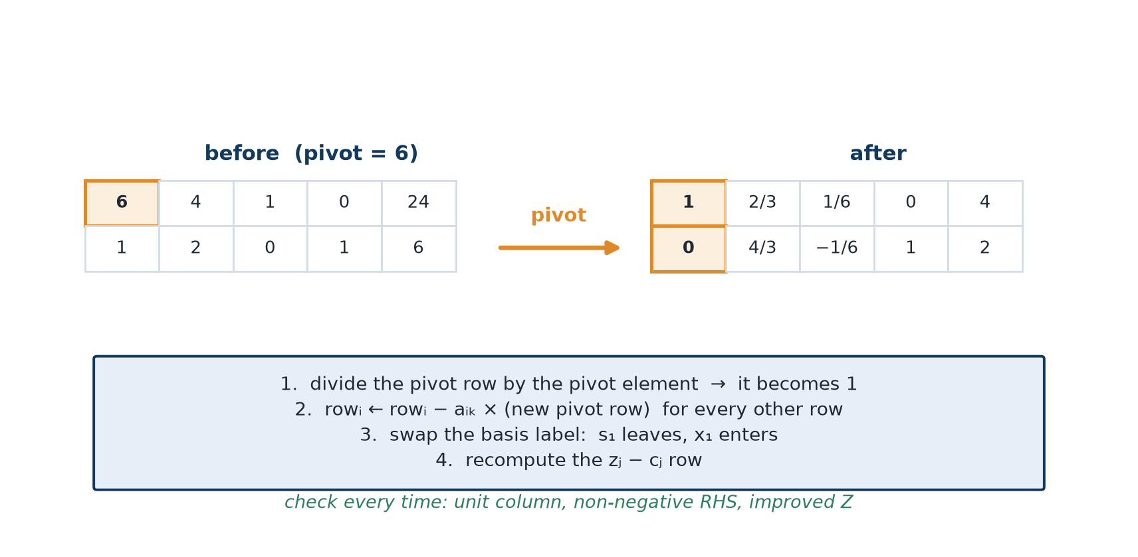
The pivot operation, step by step
• New pivot row = old pivot row ÷ p; then row i ← row i − (its pivot-column entry) × (new pivot row).
• Relabel the basis: the entering variable xₖ takes the pivot row, cB takes cₖ; then recompute zⱼ − cⱼ.
• Check every time: pivot column is a unit column, all RHS ≥ 0, and Z improved (or held, under degeneracy).
• Work in fractions, not decimals - rounding corrupts the zⱼ − cⱼ signs and causes wrong termination.
Pivot on p: divide the pivot row by p, then clear the rest of that column.
OM-L05 · The Simplex Method II: The Tableau Algorithm
Nikhil Rajput
115
Notes:
A pivot is Gauss-Jordan elimination applied to one column. Choose an entering column k and a leaving row r; their intersection is the pivot element p. Divide row r by p so that entry becomes 1, then for every other row i subtract aᵢₖ times the new pivot row, driving the rest of column k to zero. Column k is now a unit column, which is exactly what it means for xₖ to be basic: its value is read straight off the RHS. Relabel that row with xₖ, set its cB to cₖ, and recompute zⱼ − cⱼ. All the judgment lies in choosing the column and the row; the arithmetic afterwards is forced. The three checks catch nearly every slip, and each failure names its cause: a broken unit column means a wrong multiple, a negative RHS means the wrong row was taken. Decimals are the real danger, because rounding corrupts a zⱼ − cⱼ sign and stops the method early with nothing in the output to warn you.

Slide 116
Worked example - the LP and its standard form
max Z = 5x₁ + 4x₂
s.t. 6x₁ + 4x₂ ≤ 24, x₁ + 2x₂ ≤ 6, x₁, x₂ ≥ 0
6x₁ + 4x₂ + s₁ = 24, x₁ + 2x₂ + s₂ = 6
max Z = 5x₁ + 4x₂ + 0s₁ + 0s₂
Solved graphically in L03: the optimum is (3, 1.5) with Z = 21. The tableau must reproduce it.
OM-L05 · The Simplex Method II: The Tableau Algorithm
Nikhil Rajput
116
Notes:
Standard form is the shape simplex requires: every constraint an equality with a non-negative right-hand side. A slack variable does that, sᵢ measuring the unused amount of resource i, so 6x₁ + 4x₂ ≤ 24 becomes 6x₁ + 4x₂ + s₁ = 24 with s₁ ≥ 0. Slack earns nothing, so it enters the objective with coefficient zero and Z is untouched: max Z = 5x₁ + 4x₂ + 0s₁ + 0s₂. The choice of problem is deliberate. It was solved graphically earlier, so the destination (3, 1.5) with Z = 21 is known in advance and every intermediate tableau can be checked against a picture. Notice the shape of what follows: four variables and two equations mean each basis holds two variables while the other two sit at zero, and the slack columns already form an identity matrix, so the starting basis costs no work. That free start exists only because both constraints were ≤ with positive right-hand sides.

Slide 117
Iteration 0 - the origin
Basis | x₁ x₂ s₁ s₂ | RHS | Ratio
s₁ | 6 4 1 0 | 24 | 24/6 = 4 ←
s₂ | 1 2 0 1 | 6 | 6/1 = 6
zⱼ − cⱼ | −5 −4 0 0 | 0 | —
cB = (0, 0), so every zⱼ = 0 and zⱼ − cⱼ = −cⱼ. Basis {s₁, s₂} means x₁ = x₂ = 0, Z = 0. Entering x₁, leaving s₁, pivot 6.
OM-L05 · The Simplex Method II: The Tableau Algorithm
Nikhil Rajput
117
Notes:
Nothing has been pivoted, so these rows are the standard-form equations verbatim and the s₁, s₂ columns are the identity matrix. That identity is what makes {s₁, s₂} the basis: x₁ and x₂ are non-basic and therefore zero, s₁ = 24 and s₂ = 6 are read straight from the RHS, and the point represented is the origin with Z = 0 — make nothing, waste everything. Because cB = (0, 0), every zⱼ = Σ cBᵢ aᵢⱼ is zero, so the score row is simply −cⱼ, namely −5 and −4. x₁ enters because −5 is the most negative, promising the largest gain per unit made. The ratio test then divides each RHS by that row's x₁ entry, using strictly positive entries only: 24/6 = 4 against 6/1 = 6. Row 1 runs out first, so s₁ leaves and the pivot element is 6. Zero or negative entries are excluded because those rows never become binding as x₁ grows.

Slide 118
Iteration 1 - the corner (4, 0)
Basis | x₁ x₂ s₁ s₂ | RHS | Ratio
x₁ | 1 2/3 1/6 0 | 4 | 4 ÷ 2/3 = 6
s₂ | 0 4/3 −1/6 1 | 2 | 2 ÷ 4/3 = 3/2 ←
zⱼ − cⱼ | 0 −2/3 5/6 0 | 20 | —
cB = (5, 0). x₁ = 4, s₂ = 2, Z = 20. Check z₂ = 5(2/3) + 0(4/3) = 10/3, so z₂ − c₂ = 10/3 − 4 = −2/3. Entering x₂, leaving s₂, pivot 4/3.
OM-L05 · The Simplex Method II: The Tableau Algorithm
Nikhil Rajput
118
Notes:
This tableau represents the corner (4, 0), reached by one pivot on the 6. Row 1 was divided by 6, giving (1, 2/3, 1/6, 0) with RHS 4; row 2 held a 1 in the x₁ column, so row 2 ← row 2 − 1(new row 1) turned 2 into 4/3, 0 into −1/6 and 6 into 2. The basis label changed from s₁ to x₁ and its cB from 0 to 5, so the score row had to be rebuilt from the new entries: z₂ = 5(2/3) + 0(4/3) = 10/3, hence z₂ − c₂ = 10/3 − 4 = −2/3. Read the basic values off the RHS: x₁ = 4 and s₂ = 2, with x₂ and s₁ at zero, and Z has risen from 0 to 20. One negative entry remains, so the walk is not finished: x₂ enters, and ratios 4 ÷ 2/3 = 6 against 2 ÷ 4/3 = 3/2 send s₂ out on a pivot of 4/3.

Slide 119
Iteration 2 - optimal
Basis | x₁ x₂ s₁ s₂ | RHS | Ratio
x₁ | 1 0 1/4 −1/2 | 3 | —
x₂ | 0 1 −1/8 3/4 | 3/2 | —
zⱼ − cⱼ | 0 0 3/4 1/2 | 21 | —
cB = (5, 4). All zⱼ − cⱼ ≥ 0 ⟹ OPTIMAL: x₁* = 3, x₂* = 3/2, Z* = 21 - exactly the graphical answer of L03.
OM-L05 · The Simplex Method II: The Tableau Algorithm
Nikhil Rajput
119
Notes:
Row 2 was divided by 4/3, that is multiplied by 3/4, giving (0, 1, −1/8, 3/4) with RHS 3/2. Row 1 carried 2/3 in the x₂ column, so row 1 ← row 1 − (2/3)(new row 2): s₁ became 1/6 + 1/12 = 1/4, s₂ became 0 − (2/3)(3/4) = −1/2, and the RHS became 4 − 1 = 3. Both structural variables are now basic, so this tableau represents the corner x₁ = 3, x₂ = 3/2, with both slacks non-basic and hence zero, and Z = 21. With cB = (5, 4) the slack columns score 5(1/4) + 4(−1/8) = 3/4 and 5(−1/2) + 4(3/4) = 1/2. Both are non-negative, so no column can raise Z and the algorithm stops; that is the stopping rule, not a guess. It matches the graphical answer, which is the independent check. Strictly positive scores also mean this optimum is unique.

Slide 120
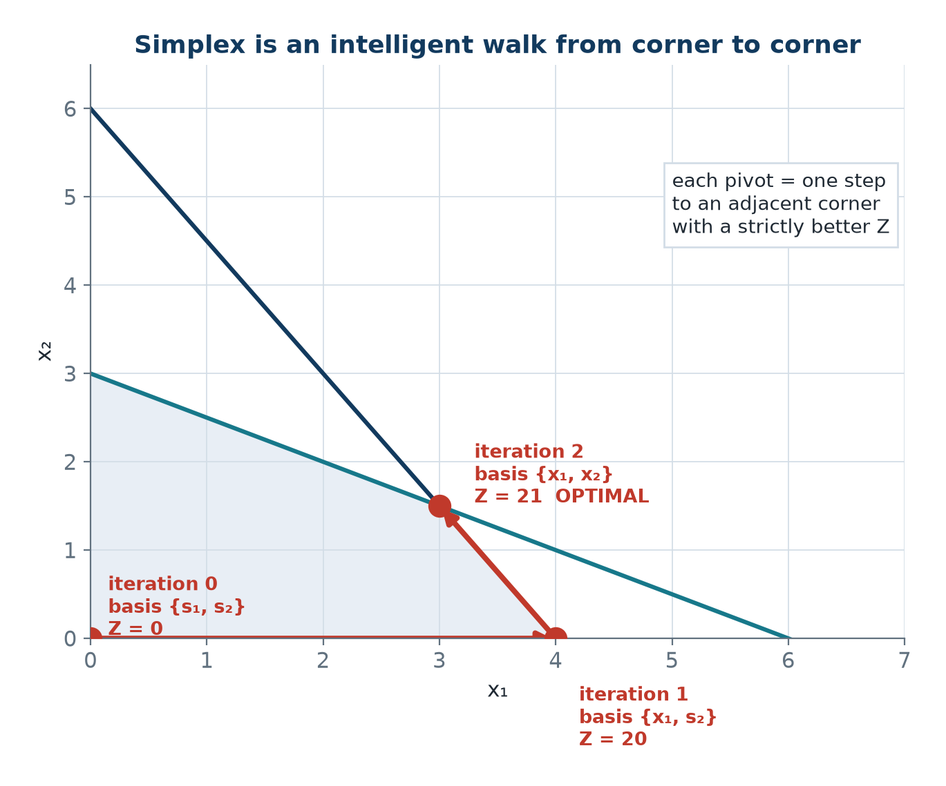
The corner walk the tableau performed
• Each pivot slides the solution along one edge to an adjacent corner.
• Z climbs 0 → 20 → 21 and then stops: no negative zⱼ − cⱼ remains.
• Two pivots for two constraints - the 2m to 3m rule of L04 in action.
Iterations 0, 1 and 2 are the corners (0, 0), (4, 0) and (3, 1.5).
OM-L05 · The Simplex Method II: The Tableau Algorithm
Nikhil Rajput
120
Notes:
Follow the path rather than the numbers. The algorithm visited (0, 0), then (4, 0), then (3, 1.5), and each pivot slid it along one edge of the feasible region to an adjacent corner. That is the geometric content of an algebraic basis change: two bases sharing all but one variable are two corners joined by an edge, so swapping one variable in and one out lands you on a neighbour. Z climbed 0 → 20 → 21 and then halted, because no negative zⱼ − cⱼ remained to promise a further gain, and for a linear objective over a convex feasible set a corner no better than all its neighbours is best overall. That is why simplex never inspects the interior or distant corners. Two pivots for two constraints sits inside the usual expectation of roughly 2m to 3m iterations for m constraints. The picture is two-dimensional only for drawing; the same walk happens unseen in n dimensions.

Slide 121
Reading the final tableau
it contains far more than the answer
• Basic variables take their RHS values; non-basic variables are zero.
  – x₁ = 3, x₂ = 3/2, s₁ = 0, s₂ = 0.
  – Both slacks zero ⟹ both constraints binding, so both resources are fully consumed.
• Shadow price of constraint i = the zⱼ − cⱼ entry in the column of slack sᵢ.
• A non-basic variable with zⱼ − cⱼ = 0 at optimality ⟹ alternate optima.
  – Here s₁ and s₂ carry 3/4 and 1/2, both strictly positive, so this optimum is unique.
  – That agrees with the slope analysis of L03.
OM-L05 · The Simplex Method II: The Tableau Algorithm
Nikhil Rajput
121
Notes:
Each reading has a fixed address in the table, which is why interpreting a finished tableau takes seconds. A basic variable takes the RHS value of its own row; anything absent from the Basis column is non-basic and equals zero, so here x₁ = 3, x₂ = 3/2, s₁ = 0, s₂ = 0. A zero slack means its constraint holds with equality, so that resource is exhausted and the constraint is binding. The shadow price of constraint i is the zⱼ − cⱼ entry in the column of slack sᵢ: raising bᵢ by one unit is the same as letting sᵢ absorb one unit less, and that column's score is precisely the rate at which Z responds. The alternate-optima test applies to non-basic columns alone: a zero score there means a different corner ties the optimum. Here s₁ and s₂ carry 3/4 and 1/2, both strictly positive, so this optimum is unique. A basic column always scores zero, and that zero carries no information.

Slide 122
Shadow prices and the duality check
y₁ = 3/4 = 0.75, y₂ = 1/2 = 0.50
b₁ = 24 → 25: x₁ = 13/4, x₂ = 11/8
Z = 65/4 + 11/2 = 16.25 + 5.5 = 21.75 = 21 + 0.75 ✓
bᵀy = 24(0.75) + 6(0.5) = 18 + 3 = 21 = Z* ✓
The shadow price is exact. (y₁, y₂) is the optimal dual solution of L07, and bᵀy = Z* is strong duality, verified numerically.
OM-L05 · The Simplex Method II: The Tableau Algorithm
Nikhil Rajput
122
Notes:
A shadow price yᵢ is the rate at which the optimal value Z* changes when the right-hand side bᵢ rises by one unit, read from the slack column of constraint i; here y₁ = 3/4 and y₂ = 1/2. The middle lines prove the rate is exact rather than an estimate. Raise b₁ from 24 to 25, keep both constraints binding, and the new intersection of 6x₁ + 4x₂ = 25 with x₁ + 2x₂ = 6 is x₁ = 13/4, x₂ = 11/8, giving Z = 65/4 + 11/2 = 21.75, which is 21 plus y₁ precisely. A shadow price is a slope, not an approximation to one. The last line multiplies each original right-hand side by its own price: 24(0.75) + 6(0.5) = 21 = Z*. That equality is strong duality, and (y₁, y₂) is the optimal dual solution. Run the check on every problem you solve; if bᵀy ≠ Z*, a pivot contains a slip. It holds only at optimality.

Slide 123
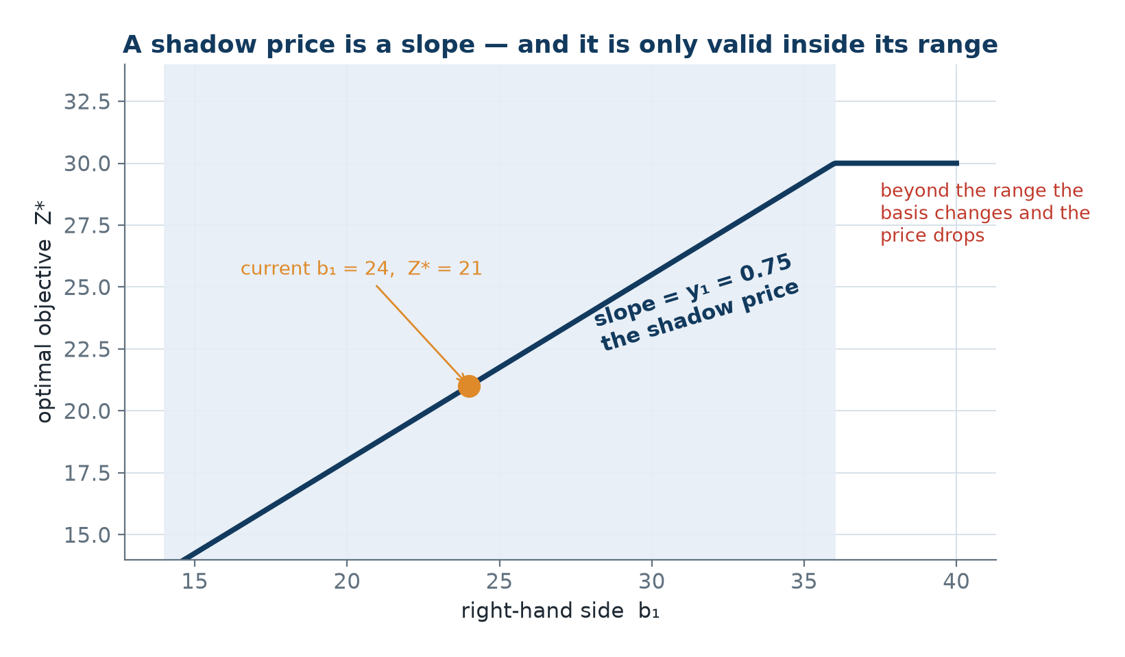
What one more unit is worth
• y₁ = 0.75 means raising b₁ from 24 to 25 raises Z* from 21 to 21.75.
• The slope is constant only while the same basis stays optimal.
• Beyond that range the basis changes and the slope drops.
• This is the maximum management should ever pay for one extra unit.
Z* as a piecewise-linear function of b₁: the slope is the shadow price.
OM-L05 · The Simplex Method II: The Tableau Algorithm
Nikhil Rajput
123
Notes:
The graph plots Z*, the optimal profit, against b₁, the right-hand side of the first constraint. What to notice is that it is a straight line, not a curve: Z* gains exactly 0.75 for each unit b₁ gains, which is what makes a shadow price a slope. The reason is that while the same two constraints stay binding, the optimal corner slides along a fixed pair of lines and Z rises at a constant rate. It is only piecewise straight, though. As b₁ grows the basic values shift, here x₁ rising and x₂ falling, and once one of them would turn negative the basis must change, a different constraint binds, and the slope drops to something smaller. Quoting 0.75 is therefore safe only inside that range. The number matters because it is a ceiling on price: pay less than 0.75 for an extra unit and you gain, pay more and you lose money on the deal.

Slide 124
Solved Problem 1 - Full simplex on the furniture problem (1 of 2)
Solve max Z = 450x₁ + 300x₂ subject to 5x₁ + 3x₂ ≤ 120, 2x₁ + 4x₂ ≤ 90, x₁, x₂ ≥ 0 by simplex, and extract the shadow prices.
Step 1 - Standard form
5x₁ + 3x₂ + s₁ = 120
2x₁ + 4x₂ + s₂ = 90
Initial basis {s₁, s₂}: x₁ = x₂ = 0, Z = 0.
Step 2 - First pivot
Entering x₁ (zⱼ − cⱼ = −450, most negative).
Ratios 120/5 = 24 and 90/2 = 45; leaving s₁, pivot 5.
Row 1 ÷ 5, then row 2 ← row 2 − 2(new row 1).
Step 3 - Second pivot
Entering x₂ (zⱼ − cⱼ = −30).
Ratios 24 ÷ 3/5 = 40 and 42 ÷ 14/5 = 15; leaving s₂, pivot 14/5.
Row 2 ÷ 14/5 gives (0, 1, −1/7, 5/14) with RHS 15.
Row 1 ← row 1 − 3/5(new row 2).
The three tableaus follow on the next slides.
OM-L05 · The Simplex Method II: The Tableau Algorithm
Nikhil Rajput
124
Notes:
The technique is exactly the trace just worked; only the numbers are larger. Standard form adds s₁ and s₂ so that 5x₁ + 3x₂ ≤ 120 and 2x₁ + 4x₂ ≤ 90 become equations, and {s₁, s₂} gives the starting basis with x₁ = x₂ = 0 and Z = 0. x₁ enters on zⱼ − cⱼ = −450, the most negative score, because a table earns ₹450 against a chair's ₹300 while nothing has yet been given up. The ratio test compares 120/5 = 24 against 90/2 = 45 and takes row 1: carpentry runs out after 24 tables while finishing would allow 45, so carpentry binds first, s₁ leaves and the pivot is 5. The second pivot repeats the logic on the recomputed score row, where −30 under x₂ is the only negative left and 15 beats 40 in the ratios. Fractions like 3/5, 14/5 and 5/14 appear at once, which is why decimals are a false economy.

Slide 125
Furniture problem - Iteration 0
Basis | x₁ x₂ s₁ s₂ | RHS | Ratio
s₁ | 5 3 1 0 | 120 | 120/5 = 24 ←
s₂ | 2 4 0 1 | 90 | 90/2 = 45
zⱼ − cⱼ | −450 −300 0 0 | 0 | —
cB = (0, 0) with c = (450, 300, 0, 0). Entering x₁, leaving s₁, pivot 5.
OM-L05 · The Simplex Method II: The Tableau Algorithm
Nikhil Rajput
125
Notes:
Nothing has been pivoted, so these rows are the standard-form equations and the s₁, s₂ columns are the identity matrix. That identity makes {s₁, s₂} the basis: x₁ and x₂ are non-basic and zero, s₁ = 120 and s₂ = 90 are read from the RHS, and the point is the origin where nothing is made and Z = 0. With cB = (0, 0) against c = (450, 300, 0, 0), every zⱼ = Σ cBᵢ aᵢⱼ is zero, so the score row is simply the negated objective, (−450, −300, 0, 0). x₁ enters on −450, the most negative entry and so the steepest gain per unit. Ratios use the x₁ column over positive entries only: 120/5 = 24 against 90/2 = 45. In words, 24 tables exhaust carpentry but 45 would be needed to exhaust finishing, so carpentry binds first, s₁ leaves and the pivot is 5. Most negative is a heuristic, not a guarantee of the fewest pivots.

Slide 126
Furniture problem - Iteration 1, the corner (24, 0)
Basis | x₁ x₂ s₁ s₂ | RHS | Ratio
x₁ | 1 3/5 1/5 0 | 24 | 24 ÷ 3/5 = 40
s₂ | 0 14/5 −2/5 1 | 42 | 42 ÷ 14/5 = 15 ←
zⱼ − cⱼ | 0 −30 90 0 | 10 800 | —
cB = (450, 0). Check z₂ = 450(3/5) = 270, so z₂ − c₂ = 270 − 300 = −30. Entering x₂, leaving s₂, pivot 14/5.
OM-L05 · The Simplex Method II: The Tableau Algorithm
Nikhil Rajput
126
Notes:
This tableau represents the corner (24, 0): 24 tables, no chairs. Row 1 was divided by 5, giving (1, 3/5, 1/5, 0) with RHS 24; row 2 held a 2 in the x₁ column, so row 2 ← row 2 − 2(new row 1) turned 4 into 14/5, 0 into −2/5 and 90 into 42. The basis label became x₁ with cB = 450, which forces the score row to be rebuilt: z₂ = 450(3/5) = 270, so z₂ − c₂ = 270 − 300 = −30. Read that as a chair costing ₹270 of forgone table production while earning ₹300, so ₹30 net per chair is still available. Z jumped from 0 to 10,800, and s₂ = 42 says 42 finishing hours remain unused. A negative score remains, so x₂ enters; ratios 24 ÷ 3/5 = 40 against 42 ÷ 14/5 = 15 send s₂ out on a pivot of 14/5. Forgetting to update cB would corrupt every entry in that score row.

Slide 127
Furniture problem - Iteration 2, optimal
Basis | x₁ x₂ s₁ s₂ | RHS | Ratio
x₁ | 1 0 2/7 −3/14 | 15 | —
x₂ | 0 1 −1/7 5/14 | 15 | —
zⱼ − cⱼ | 0 0 600/7 75/7 | 11 250 | —
cB = (450, 300). All zⱼ − cⱼ ≥ 0 ⟹ OPTIMAL: 15 tables, 15 chairs, Z* = ₹11,250.
OM-L05 · The Simplex Method II: The Tableau Algorithm
Nikhil Rajput
127
Notes:
Row 2 was divided by 14/5, giving (0, 1, −1/7, 5/14) with RHS 15. Row 1 carried 3/5 in the x₂ column, so row 1 ← row 1 − (3/5)(new row 2): s₁ became 1/5 + 3/35 = 2/7, s₂ became −3/14, and the RHS became 24 − 9 = 15. Both structural variables are now basic, so the tableau represents the plan of 15 tables and 15 chairs, with both slacks non-basic and therefore zero, meaning both resources are consumed to the last unit. With cB = (450, 300) the slack columns score 600/7 and 75/7, both strictly positive, so no activity can improve on 11,250 and the walk stops. Those two numbers are not waste; they are the shadow prices, the profit one further carpentry or finishing hour would add. Positive scores in every non-basic column also mean the optimum is unique. Check the unit columns and the non-negative RHS before trusting any of it.

Slide 128
Solved Problem 1 - Reading the furniture tableau (2 of 2)
Step 4 - The optimal plan
x₁* = 15 tables, x₂* = 15 chairs, Z* = ₹11,250.
s₁ = 0 and s₂ = 0: both resources fully used.
Step 5 - Shadow prices
y₁ = 600/7 = ₹85.71 per carpentry hour
y₂ = 75/7 = ₹10.71 per finishing hour
Carpentry is worth 8× finishing at the margin.
Step 6 - Duality check
120(600/7) + 90(75/7) = (72 000 + 6 750)/7
= 78 750/7 = 11 250 = Z* ✓
Step 7 - Iteration count
2 pivots for a 2-constraint problem,
consistent with the 2m to 3m rule of L04.
x₁* = 15, x₂* = 15, Z* = ₹11,250; y₁ = ₹85.71, y₂ = ₹10.71
Management rule: buy overtime carpentry below ₹85.71 an hour; refuse finishing overtime above ₹10.71.
OM-L05 · The Simplex Method II: The Tableau Algorithm
Nikhil Rajput
128
Notes:
This is where the tableau earns its keep. The plan itself, 15 tables and 15 chairs for ₹11,250, is only the first line of the answer, and both slacks being zero says both resources are fully used, so both constraints are binding. The commercially useful output is the pair of shadow prices sitting in the slack columns: y₁ = 600/7 = ₹85.71 per carpentry hour and y₂ = 75/7 = ₹10.71 per finishing hour, each the extra profit one more unit of that resource would unlock, and each computed for free during the pivots. Carpentry is worth about eight times finishing at the margin, which tells management where extra capacity is worth buying and where it is not. The duality check multiplies each original right-hand side by its own price: 120(600/7) + 90(75/7) = 78,750/7 = 11,250 = Z*, confirming the arithmetic independently. Two pivots for two constraints is the expected count. Both prices are ceilings, and valid only within a range.

Slide 129
Solved Problem 3 - Recognising alternate optima
A final tableau shows zⱼ − cⱼ = (0, 0, 0, 5/2, 0), where columns 1 and 2 are basic and columns 3, 4, 5 are non-basic. What do you conclude, and how do you find the second optimum?
Step 1 - Diagnosis
Columns 3 and 5 are non-basic yet have zⱼ − cⱼ = 0.
ALTERNATE OPTIMA exist.
Step 2 - Why
Bringing x₃ (or x₅) in changes Z by −(zⱼ − cⱼ)·θ = 0.
The objective is unchanged, so a different corner ties.
Step 3 - Finding the second optimum
Apply the minimum-ratio test to column 3 for the leaving variable.
Pivot as usual.
Same Z, different basic solution - the second optimal corner.
Step 4 - All optima, and one caution
Every x(λ) = λ x(1) + (1 − λ) x(2), λ ∈ [0, 1], is optimal.
If column 3 has no positive entries, the optimal set is an unbounded ray.
Z is still bounded; only the optimal set is infinite in extent.
Always report alternate optima: they give the decision-maker free choice over criteria the model omitted, at zero cost.
OM-L05 · The Simplex Method II: The Tableau Algorithm
Nikhil Rajput
129
Notes:
Alternate optima means more than one point attains the same optimal Z. The diagnosis rests on one identity: bringing a non-basic column into the basis at level θ changes Z by −(zⱼ − cⱼ)θ, so a zero score makes the move free whatever θ turns out to be. Here zⱼ − cⱼ = (0, 0, 0, 5/2, 0) with columns 1 and 2 basic, so columns 3 and 5 are non-basic and yet score zero: a different corner ties the optimum, and one ordinary pivot on either column produces it. Apply the minimum-ratio test to that column, pivot as usual, and read off a new basic solution with the same Z. Everything on the segment joining the two corners, x(λ) = λx⁽¹⁾ + (1 − λ)x⁽²⁾ for λ in [0, 1], is optimal too, by linearity. Report them, since they give free choice over criteria the model omitted. The caution: with no positive entry in the entering column, nothing bounds θ and the optimal set is an unbounded ray, though Z stays bounded.

Slide 130
Solved Problem 4 - Degeneracy in action
Solve max Z = 3x₁ + 9x₂ subject to x₁ + 4x₂ ≤ 8, x₁ + 2x₂ ≤ 4, x₁, x₂ ≥ 0, noting the degeneracy.
Step 1 - Iteration 0
Basis {s₁, s₂}, zⱼ − cⱼ = (−3, −9, 0, 0), Z = 0.
Entering x₂; ratios 8/4 = 2 and 4/2 = 2.
A TIE in the minimum ratio ⟹ degeneracy will occur.
Take row 1 arbitrarily: s₁ leaves, pivot 4.
Step 2 - Iteration 1
Row 1 ÷ 4 gives (1/4, 1, 1/4, 0) with RHS 2.
Row 2 − 2(new row 1) gives (1/2, 0, −1/2, 1) with RHS 0.
s₂ = 0 while basic ⟹ DEGENERATE BFS; Z = 18.
zⱼ − cⱼ = (−3/4, 0, 9/4, 0): not optimal. Entering x₁.
Step 3 - Iteration 2
Ratios 2 ÷ 1/4 = 8 and 0 ÷ 1/2 = 0 ← ; s₂ leaves, pivot 1/2.
Row 2 ÷ 1/2 = (1, 0, −1, 2) with RHS 0.
Row 1 − 1/4(new row 2) = (0, 1, 1/2, −1/2) with RHS 2.
zⱼ − cⱼ = (0, 0, 3/2, 3/2) ⟹ OPTIMAL, Z = 18 unchanged.
OM-L05 · The Simplex Method II: The Tableau Algorithm
Nikhil Rajput
130

Slide 131
Solved Problem 4 - Degeneracy in action (continued)
Step 4 - What happened, geometrically
θ = 0, so the basis changed but the point did not move.
Three lines meet at (0, 2): x₁ + 4x₂ = 8, x₁ + 2x₂ = 4, x₁ = 0.
An over-determined corner corresponds to multiple bases.
Common and harmless; Bland's rule (L04) rules out cycling.
x₁* = 0, x₂* = 2, Z* = 18
Z was already 18 at iteration 1 - the second pivot was a stalling step.
OM-L05 · The Simplex Method II: The Tableau Algorithm
Nikhil Rajput
131
Notes:
Degeneracy means a basic variable equal to zero, and the warning sign appears at iteration 0: the ratio test ties at 8/4 = 2 and 4/2 = 2. A tie means both rows run out together, so whichever you choose, the other basic variable lands at zero. Take row 1: s₁ leaves on pivot 4, row 1 ÷ 4 gives (1/4, 1, 1/4, 0) with RHS 2, and row 2 − 2(new row 1) gives (1/2, 0, −1/2, 1) with RHS 0. So s₂ stays in the basis carrying the value zero, a degenerate basic feasible solution, at the point (0, 2) with Z = 18. The next pivot then has ratio 0 ÷ (1/2) = 0, so x₁ enters at value zero: the basis changes and the point does not move, and Z stands still at 18. Geometrically three lines meet at (0, 2), one more than the plane requires, so a single corner carries several bases. Common and harmless; only cycling is a theoretical risk.

Slide 132
Solved Problem 5 - Shadow prices for a business decision
From the furniture tableau, y₁ = ₹85.71 per carpentry hour and y₂ = ₹10.71 per finishing hour. A supplier offers 10 extra carpentry hours for ₹700 total, and 20 extra finishing hours for ₹150. Accept?
Step 1 - Offer 1, carpentry
Value gained = 10 × ₹85.71 = ₹857.14
Cost = ₹700 ⟹ net gain = ₹157.14 ⟹ ACCEPT
Step 2 - Range check on b₁
The s₁ column is (2/7, −1/7)ᵀ, so x₁ = 15 + (2/7)Δ, x₂ = 15 − (1/7)Δ.
x₂ ≥ 0 ⟹ Δ ≤ 105, and Δ = 10 is well inside.
Confirm: x₁ = 17.857, x₂ = 13.571,
Z = 8035.7 + 4071.4 = ₹12,107.1 = 11,250 + 857.14 ✓
Step 3 - Offer 2, finishing
Value gained = 20 × ₹10.71 = ₹214.29; cost ₹150 ⟹ net gain ₹64.29.
The s₂ column is (−3/14, 5/14)ᵀ, so x₁ = 15 − (3/14)Δ ≥ 0 ⟹ Δ ≤ 70.
Δ = 20 is within range ✓ ⟹ ACCEPT
Step 4 - Both together: the 100 % rule
Shadow prices are marginal rates valid one change at a time.
10/105 + 20/70 = 0.095 + 0.286 = 0.381 ≤ 1
The fractions sum below 1, so the basis stays optimal
and both shadow prices remain valid.
Accept both. Combined net gain ₹157.14 + ₹64.29 = ₹221.43, verified by the 100 % rule.
A concrete, defensible recommendation that comes entirely from the final tableau at no extra computational cost.
OM-L05 · The Simplex Method II: The Tableau Algorithm
Nikhil Rajput
132
Notes:
Each offer is judged by comparing the value the shadow price predicts against the price asked. Ten carpentry hours are worth 10 × ₹85.71 = ₹857.14 and cost ₹700, a net gain of ₹157.14; twenty finishing hours are worth 20 × ₹10.71 = ₹214.29 against ₹150, a gain of ₹64.29. But that comparison is legitimate only while the current basis stays optimal, and the slack columns give the range directly. The s₁ column is (2/7, −1/7)ᵀ, so raising b₁ by Δ moves x₁ to 15 + (2/7)Δ and x₂ to 15 − (1/7)Δ; feasibility fails when x₂ reaches zero at Δ = 105, and 10 is well inside. The s₂ column is (−3/14, 5/14)ᵀ, giving Δ ≤ 70, and 20 is inside. Taking both together needs more, because each change eats the room the other has: the 100 % rule adds the fractions used, 10/105 + 20/70 = 0.381, and only a total at or below 1 keeps both prices valid.

Slide 133
Where reading the final tableau pays
Buying overtime and subcontract hours
The tableau sets the ceiling price for bought-in machine hours: buy carpentry below ₹85.71 an hour, refuse finishing above ₹10.71.
Refinery and feed blending
Dual values on crude and octane constraints are quoted to traders daily as the marginal worth of one more barrel of each feedstock.
Electricity market clearing
The wholesale price at each grid node is literally the shadow price of that node's power-balance constraint in the market LP.
Hospital theatre and roster planning
Alternate optima let managers pick the roster staff actually prefer, at exactly zero cost to the objective.
Every spreadsheet solver
Excel Solver's sensitivity report is this final tableau rewritten: final values, shadow prices and allowable ranges.
OM-L05 · The Simplex Method II: The Tableau Algorithm
Nikhil Rajput
133
Notes:
The common thread is that every one of these uses the dual values rather than the plan. A shadow price is the marginal worth of one more unit of a constrained resource, and unlike a production schedule it does not go stale the moment demand shifts. A refinery's schedule is obsolete by morning, but the dual value on a crude or octane constraint is what the trading desk acts on when pricing one more barrel of feedstock. Nodal electricity pricing is not an analogy: the wholesale price at a grid node is literally the shadow price of that node's power-balance constraint in the market-clearing model. Alternate optima are worth reporting because they let a hospital manager pick the roster staff actually prefer at zero cost to the objective. And a spreadsheet solver's sensitivity report is this final tableau relabelled, with final values, shadow prices and allowable ranges, so anyone who can read a tableau can read a solver output. Ranges still bind: a dual value quoted outside its range is wrong.

Slide 134
The intuition - what a shadow price really is
A shadow price is what you would pay the workshop next door for one more hour on their saw - and not one rupee more.
• ₹85.71 an hour for carpentry is not the wage; it is the extra profit one more hour would unlock.
• It is a rate, not a promise: it holds while the plan keeps its shape - here for up to 105 extra hours.
• Buy 200 extra carpentry hours and the bottleneck moves elsewhere, so the rate stops applying.
• Two changes at once need the 100 % rule: add the fractions of each range used and keep the total at or below 1.
• 10/105 + 20/70 = 0.381, comfortably under 1, so both prices still hold together.
OM-L05 · The Simplex Method II: The Tableau Algorithm
Nikhil Rajput
134
Notes:
The point of the analogy is that a shadow price is a ceiling, not a wage. ₹85.71 is not what a carpenter costs; it is the extra profit one more machine hour of carpentry would unlock given the plan you are already running, so anything paid below it is a gain and anything above it a loss. It is a rate rather than a promise because it comes from a slope: while the same constraints stay binding, each extra carpentry hour moves the optimum along a fixed edge, adding ₹85.71 every time. That holds here for up to 105 extra carpentry hours, since x₂ = 15 − (1/7)Δ reaches zero at Δ = 105; beyond that the bottleneck moves and a different constraint starts to bind, so 200 extra hours are not worth 200 times ₹85.71. Two changes at once compete for the same room, which is why their fractions of the allowable ranges are added, 10/105 + 20/70 = 0.381, and kept at or below 1.

Slide 135
Common mistakes to avoid
• Working in decimals instead of fractions; rounding accumulates and corrupts the zⱼ − cⱼ signs.
  – The result is wrong termination - an answer reported as optimal that is not.
• Forgetting to relabel the basis and update cB after a pivot, so the next zⱼ − cⱼ row is wrong.
• Taking a ratio against a zero or negative pivot-column entry; ratios use positive entries only.
• Stopping while a negative zⱼ − cⱼ remains, or pivoting on after all of them are ≥ 0.
• Reading a shadow price from the wrong column - it is the zⱼ − cⱼ entry of that constraint's slack.
• Quoting a shadow price outside its range, or adding two of them without the 100 % rule.
OM-L05 · The Simplex Method II: The Tableau Algorithm
Nikhil Rajput
135
Notes:
Most of these are process failures rather than conceptual ones, and each has its own symptom. Decimals are the worst because the failure is silent: values like 2/3 and 5/14 do not terminate, rounding accumulates, and once a zⱼ − cⱼ entry that should be slightly negative rounds to zero, the method halts at a tableau that looks optimal and is not. Forgetting to relabel the basis and update cB matters because zⱼ = Σ cBᵢ aᵢⱼ is built from those coefficients, so a stale cB corrupts the whole next score row and the entering choice becomes meaningless. Ratios must be taken over strictly positive entries only: a zero or negative entry means that row's basic variable never falls to zero as the entering variable grows, so it can impose no limit. And a price read from the wrong column, quoted outside its range, or added to another without the 100 % rule, yields a confident recommendation that is simply false.

Slide 136
Summary
• Build the tableau from standard form with the slacks as the initial basis; work in fractions.
• Pivot: divide the pivot row by the pivot element, clear that column elsewhere, then check the unit column, RHS ≥ 0 and Z.
• Read the final tableau: optimal values in the basic RHS, and a zero slack means a binding constraint.
• Shadow price = marginal value of one extra unit of a resource; it is exactly the dual variable.
• Strong duality: bᵀy = Z*, seen as 24(0.75) + 6(0.5) = 21 and 120(600/7) + 90(75/7) = 11 250.
• A non-basic variable with zⱼ − cⱼ = 0 at optimality signals alternate optima - always report them.
• Degeneracy gives a θ = 0 stalling pivot; shadow prices hold only within a range, tested by the 100 % rule.
OM-L05 · The Simplex Method II: The Tableau Algorithm
Nikhil Rajput
136
Notes:
Two distinct skills are being summarised. The mechanical one: put the problem in standard form, take the slacks as the initial basis because their columns already form an identity, pivot by dividing the pivot row by the pivot element and clearing that column elsewhere, keep everything in fractions, and run the three checks after each pivot. The interpretive one separates solving a problem from advising on one, because the same finished table carries the plan in the basic RHS values, the binding constraints wherever a slack is zero, the marginal value of each resource in the slack columns' scores, and flags for alternate optima and degeneracy. Shadow prices are exactly the dual variables, which is why bᵀy = Z*: 24(0.75) + 6(0.5) = 21, and 120(600/7) + 90(75/7) = 11,250. That check costs ten seconds and catches slips anywhere in the pivots. The caveat runs throughout: a shadow price is valid only inside its range, and two together only under the 100 % rule.

Slide 137
Practice problems
answers given where the source supplies them
• Solve by simplex: max 4x₁ + 3x₂ s.t. 2x₁ + x₂ ≤ 10, x₁ + 3x₂ ≤ 15. Ans: x₁ = 3, x₂ = 4, Z = 24.
• From this lesson's final tableau, what is the shadow price of constraint 2? Ans: 1/2.
• Perform one pivot with pivot element 3 in row 2, column 1, where row 2 = (3, 6, 1, 0) with RHS 9.
• A final tableau has zⱼ − cⱼ = (0, 0, 4, 0) with column 4 non-basic. Interpret it.
• Verify the duality check bᵀy = Z* for Problem 1 of Section 5.
• Solve max 2x₁ + 3x₂ s.t. x₁ + x₂ ≤ 4, x₁ + 3x₂ ≤ 6 and identify any degeneracy.
• If a shadow price is 0, what does that tell you about the constraint?
OM-L05 · The Simplex Method II: The Tableau Algorithm
Nikhil Rajput
137
Notes:
Work these with pencil and fractions rather than software, because the aim is fluency in the arithmetic and confidence about where each answer lives in the grid. Questions 1 and 6 are full solves and will each take two pivots: build standard form, take the most negative score, run the ratio test, pivot, and repeat until no score is negative. Question 6 asks you to look for degeneracy; neither ratio test ties there, so its optimum (3, 1) with Z = 9 is not degenerate, and a tie is the signature to watch for. Question 3 is one pivot in isolation: divide row 2 by 3 to get (1, 2, 1/3, 0) with RHS 3, then clear column 1 from every other row. Questions 2, 4 and 7 are pure reading, asking you to name a cell rather than compute one. Question 4 is the alternate optima test read the other way, since a non-basic column scoring 4 rather than 0 means the optimum is unique. Question 7 is worth thinking through: a zero price means the resource is not scarce, so its slack is basic.

Slide 138
OPTIMIZATION METHODS · LESSON 06
Big-M, Two-Phase Methods and Special Cases
Linear Programming - Lesson 6
Nikhil Rajput
Notes:
A basic feasible solution is a corner of the feasible region: choose as many variables as there are constraint rows, set the rest to zero, and read the chosen ones off the rows. Simplex needs one before it can start, because every step moves from a corner it already occupies to an adjacent, better one. When every constraint is ≤ with a non-negative right-hand side the slacks supply that corner free: set all real variables to zero and each slack equals its own right-hand side, so the origin is legal. A ≥ or = row destroys the gift, and what follows builds a replacement. Artificial variables manufacture a starting corner that does not belong to the real problem; Big-M and two-phase are two ways of paying for it; and the four special cases turn a finished tableau into a diagnosis. The pivot arithmetic never changes. Only getting in, and reading the exit correctly, become harder.

Slide 139
Learning Outcomes
by the end of this lesson you will be able to
• Explain why ≥ and = constraints need artificial variables.
• Apply the Big-M method and interpret its tableaus.
• Apply the two-phase method and know when to prefer it.
• Detect infeasibility, unboundedness, alternate optima and degeneracy from a tableau.
• Diagnose and repair a failing model.
OM-L06 · Big-M, Two-Phase Methods and Special Cases
Nikhil Rajput
139
Notes:
The five outcomes trace one argument. The first asks why a starting corner can be missing, and the answer is arithmetic: a ≥ row contributes a variable with coefficient −1, an = row contributes none, so neither can hand simplex a non-negative basic variable at the origin. The second and third are the two repairs. Big-M keeps a single objective and fines the fictitious variables by a huge constant M; two-phase runs a first optimisation whose only goal is to drive those fictions to zero. The fourth treats the tableau as an instrument, since infeasible, unbounded, alternate optima and degenerate each leave a distinct fingerprint in the columns. The fifth turns a fingerprint into advice, because a verdict has a size as well as a name. Hold on to the fourth. Simplex does not crash on a broken model; it stops normally and leaves the evidence in place, so a wrong answer gets reported confidently unless someone reads it.

Slide 140
The big picture, in simple terms
Simplex can only improve a plan it is already standing on. With an 'at least' requirement, the obvious starting plan - do nothing - is already illegal, so there is nowhere to stand.
• 'At most' rules are easy: producing nothing obeys all of them, so that is where simplex starts.
• 'At least' rules break that: producing nothing already violates the promise you made.
• An artificial variable is a temporary fiction that pretends the shortfall is covered.
• Big-M fines the fiction heavily; two-phase first hunts for any legal plan, then for the best one.
• If the fiction cannot be dropped, no legal plan exists - the model, not the method, is at fault.
OM-L06 · Big-M, Two-Phase Methods and Special Cases
Nikhil Rajput
140
Notes:
Simplex is an improvement algorithm, not a search: it must already stand on a legal plan before it can look for a better neighbouring one. When every rule is a ceiling — use at most this much — the plan 'produce nothing' obeys them all, so that plan is always available as a starting point. A floor — deliver at least this much — is broken by producing nothing, so the obvious start is already illegal and there is nowhere to stand. An artificial variable is a temporary invented quantity added to the offending row, exactly large enough to make that row's arithmetic come out right while nothing real has been produced. It buys a place to stand at the price of describing a problem you were not asked. Big-M fines the fiction so heavily that any improvement removes it; two-phase spends a first pass hunting for any legal plan at all. If the fiction cannot be dropped, no legal plan exists, and the model rather than the method is at fault.

Slide 141
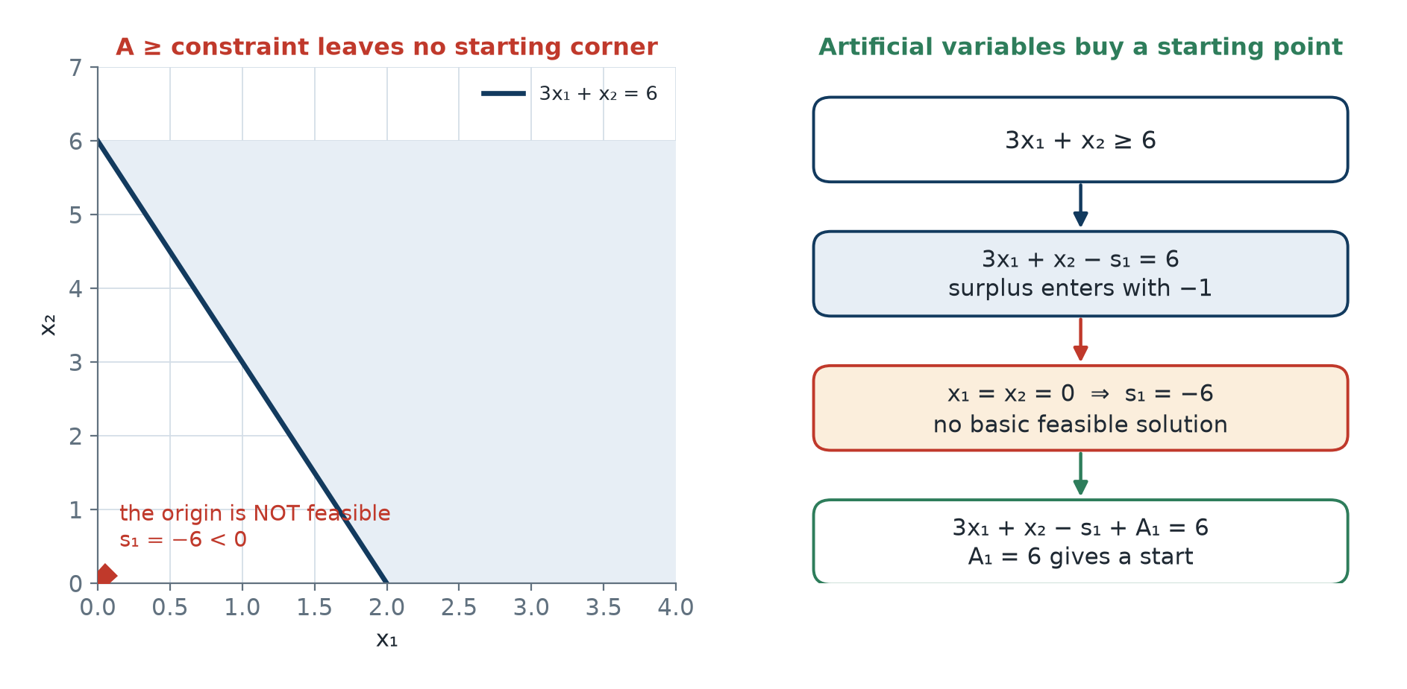
Why artificial variables are needed
• All constraints ≤ with bᵢ ≥ 0: set xⱼ = 0 and read sᵢ = bᵢ ≥ 0. The origin is feasible.
• But 3x₁ + x₂ − s₁ = 6 at x₁ = x₂ = 0 gives s₁ = −6 < 0. Surplus enters with coefficient −1.
• And 3x₁ + x₂ = 3 has no slack at all, so that row has no basic variable.
• Fix: add Aᵢ ≥ 0 with coefficient +1. Then A₁ = 6 and A₂ = 3 form a starting basis.
Artificial variables buy a starting point at the price of having to expel them.
OM-L06 · Big-M, Two-Phase Methods and Special Cases
Nikhil Rajput
141
Notes:
Every constraint becomes an equation by adding one variable, and the sign that variable carries decides whether the origin survives. A slack on a ≤ row enters with +1 and appears in no other row, so setting the real variables to zero gives sᵢ = bᵢ ≥ 0 and the origin is a legal corner. A ≥ row instead needs its excess removed: 3x₁ + x₂ − s₁ = 6, and at x₁ = x₂ = 0 that forces s₁ = −6, breaking the non-negativity every variable must obey. An equality such as 3x₁ + x₂ = 3 adds nothing at all, so its row owns no basic variable. The size of the numbers is irrelevant; the sign is the entire fault. An artificial Aᵢ ≥ 0 with coefficient +1 supplies precisely what the row refused, giving A₁ = 6 and A₂ = 3 as a starting basis. It also changes the problem being solved, which is why expelling it later is compulsory rather than optional.

Slide 142
The Big-M method and its three outcomes
At optimality | Conclusion
All Aᵢ = 0 | optimal for the original problem
Some Aᵢ > 0 | the original problem is INFEASIBLE
Z unbounded, all Aᵢ = 0 | the original problem is UNBOUNDED
Penalty form: max Z = Σ cⱼxⱼ − M Σ Aᵢ, min Z = Σ cⱼxⱼ + M Σ Aᵢ, with M above any number that can arise. This lesson uses M = 1000.
OM-L06 · Big-M, Two-Phase Methods and Special Cases
Nikhil Rajput
142
Notes:
Big-M attaches the penalty inside the objective itself: max Z = Σ cⱼxⱼ − M Σ Aᵢ, or min Z = Σ cⱼxⱼ + M Σ Aᵢ, where M is one constant chosen larger than any number the problem can otherwise produce. Because M dominates, a basis holding a positive artificial scores worse than any basis without one, so simplex expels the artificials in pursuit of its own objective and needs no separate instruction. That is why the three rows read as they do. All Aᵢ = 0 means the fiction is repaid and the answer belongs to the original problem. The middle row is the one that bites: an infeasible model does not crash the algorithm, it terminates normally with an artificial still basic at a positive value. The third row is genuine unboundedness, since nothing artificial is propping the solution up. Choose M too small and the penalty stops dominating, which is why M = 1000 is used here, safely above every coefficient present.

Slide 143
Worked Big-M example: model and standard form
min Z = 4x₁ + x₂ s.t. 3x₁ + x₂ = 3, 4x₁ + 3x₂ ≥ 6, x₁ + 2x₂ ≤ 4
x₁, x₂ ≥ 0
3x₁ + x₂ + A₁ = 3
4x₁ + 3x₂ − s₂ + A₂ = 6
x₁ + 2x₂ + s₃ = 4
max Z' = −4x₁ − x₂ + 0s₂ + 0s₃ − MA₁ − MA₂
The minimisation is converted to maximisation of Z' = −Z. Two artificials are needed: one for the equality, one for the ≥ row.
OM-L06 · Big-M, Two-Phase Methods and Special Cases
Nikhil Rajput
143
Notes:
The model is min Z = 4x₁ + x₂ subject to 3x₁ + x₂ = 3, 4x₁ + 3x₂ ≥ 6 and x₁ + 2x₂ ≤ 4. Standard form gives every row an equation and every row a basic variable. The equality gets one artificial, A₁. The ≥ row gets two additions: a surplus s₂ entering with −1 to absorb whatever the left side has above 6, and an artificial A₂ with +1 to supply the basic variable the surplus cannot be. The ≤ row already carries its own slack s₃. Minimising Z is identical to maximising Z' = −Z, and the conversion is worth making so that one optimality test, all zⱼ−cⱼ ≥ 0, applies throughout; the artificials then carry −M. Geometrically the equality is a line rather than a half-plane, and the two inequalities trim that line to a short segment nowhere near the origin. That is precisely why no starting corner could simply be read off the rows.

Slide 144
Iteration 0 - the starting tableau (1 of 2)
Basis | x₁ | x₂ | s₂
A₁ (cB = −M) | 3 | 1 | 0
A₂ (cB = −M) | 4 | 3 | −1
s₃ (cB = 0) | 1 | 2 | 0
zⱼ−cⱼ | −7M+4 | −4M+1 | M
Eight columns will not fit one slide, so this tableau is split: A₁, A₂, s₃ and RHS follow on the next slide. With M = 1000 these entries are −6996, −3999, 1000.
OM-L06 · Big-M, Two-Phase Methods and Special Cases
Nikhil Rajput
144
Notes:
The starting basis {A₁, A₂, s₃} is read off the three +1 columns, and cB collects those variables' objective coefficients: −M, −M and 0. The quantity zⱼ−cⱼ prices a column: zⱼ is what the current basis already earns from the resources one unit of xⱼ would consume, cⱼ is what that unit pays, so a negative entry means bringing the variable in improves Z'. Under x₁ the two artificials contribute −M(3) − M(4) = −7M, and subtracting c₁ = −4 leaves −7M + 4, which is −6996 at M = 1000. The same arithmetic gives −4M + 1 under x₂ and M under s₂. Every comparison here is settled by the coefficient of M alone; the constants 4 and 1 matter only if two coefficients tie. x₁ carries the most negative entry, so x₁ enters. Splitting the tableau across two slides is a matter of width, not of arithmetic.

Slide 145
Iteration 0 - the starting tableau (2 of 2)
Basis | A₁ | A₂ / s₃ | RHS
A₁ | 1 | 0 / 0 | 3
A₂ | 0 | 1 / 0 | 6
s₃ | 0 | 0 / 1 | 4
zⱼ−cⱼ | 0 | 0 / 0 | −9M
Second half of the iteration 0 tableau. Z' = −9M = −9000. Ratios 1, 3/2, 4: entering x₁, leaving A₁, pivot 3.
OM-L06 · Big-M, Two-Phase Methods and Special Cases
Nikhil Rajput
145
Notes:
These are the remaining columns of the same tableau. The artificial columns form the identity block that makes the basis readable: A₁ = 3, A₂ = 6 and s₃ = 4 come straight off the right-hand side, and a basic variable always prices at zero, hence the three zeros in the objective row. Z' = −9M = −9000 is almost entirely penalty, which is the point: at this corner the objective measures the debt, not the real costs. The minimum-ratio test now decides which variable leaves. Divide each row's right-hand side by its entry in the entering x₁ column, ignoring non-positive entries, because that quotient is how far x₁ can rise before that row's basic variable hits zero. Here 3/3 = 1, 6/4 = 3/2 and 4/1 = 4. The smallest belongs to the A₁ row, so A₁ leaves and 3 is the pivot. One artificial is gone on the very first pivot.

Slide 146
Iteration 1 - A₁ has left the basis
Basis | (x₁, x₂, s₂) | (A₁, A₂, s₃) | RHS
x₁ (cB = −4) | 1, 1/3, 0 | 1/3, 0, 0 | 1
A₂ (cB = −M) | 0, 5/3, −1 | −4/3, 1, 0 | 2
s₃ (cB = 0) | 0, 5/3, 0 | −1/3, 0, 1 | 3
zⱼ−cⱼ | 0, −1667, 1000 | 2332, 0, 0 | −2004
Row 1 was divided by 3, then eliminated. Ratios 3, 6/5, 9/5: entering x₂, leaving A₂, pivot 5/3. Symbolically z₂−c₂ = −(5/3)M − 1/3, which is −1667 at M = 1000.
OM-L06 · Big-M, Two-Phase Methods and Special Cases
Nikhil Rajput
146
Notes:
A pivot is ordinary row reduction: divide the pivot row by the pivot element so the entering column reads 1 there, then subtract multiples of that row from every other row so the column is zero elsewhere. Here the A₁ row was divided by 3 to become the new x₁ row, and multiples were subtracted from the other two rows and from the objective row. A₁ has left the basis, one down and one to go, and its column now prices positive, so it will never be selected to return. The most negative entry is now under x₂, symbolically −(5/3)M − 1/3 and shown as −1667 at M = 1000, so x₂ enters. Ratios 1 ÷ (1/3) = 3, 2 ÷ (5/3) = 6/5 and 3 ÷ (5/3) = 9/5 select the A₂ row, so A₂ leaves on a pivot of 5/3. The point is now x₁ = 1 with Z' = −2004, still dominated by penalty.

Slide 147
Iteration 2 - both artificials are out, but not yet optimal
Basis | (x₁, x₂, s₂) | (A₁, A₂, s₃) | RHS
x₁ (cB = −4) | 1, 0, 1/5 | 3/5, −1/5, 0 | 3/5
x₂ (cB = −1) | 0, 1, −3/5 | −4/5, 3/5, 0 | 6/5
s₃ (cB = 0) | 0, 0, 1 | 1, −1, 1 | 1
zⱼ−cⱼ | 0, 0, −1/5 | 4992/5, 5001/5, 0 | −18/5
Z' = −18/5, so Z = 3.6 at (0.6, 1.2) - feasible but not optimal, since the s₂ column has zⱼ−cⱼ = −1/5 < 0. Entering s₂, leaving s₃, pivot 1.
OM-L06 · Big-M, Two-Phase Methods and Special Cases
Nikhil Rajput
147
Notes:
Dividing the A₂ row by 5/3 makes the new x₂ row, and clearing the x₂ column from the other rows completes the pivot. Both artificials are now non-basic and therefore zero, so every original constraint holds at x₁ = 3/5 and x₂ = 6/5, where Z = 3.6. This looks like a finished answer and is not, which is the classic mistake. Feasibility and optimality are separate tests: expelling the artificials only earns the right to ask whether this corner is the best one, and the objective row answers no, because the s₂ column has zⱼ−cⱼ = −1/5 < 0 and a negative entry means raising that variable still improves Z'. So s₂ enters. Only the s₃ row has a positive entry in that column, so it supplies the sole ratio, 1 ÷ 1 = 1, and s₃ leaves on a pivot of 1. Raising the surplus slides the point along the equality line until the ≤ row binds.

Slide 148
Iteration 3 - the optimal tableau (1 of 2)
Basis | x₁ | x₂ | s₂
x₁ (cB = −4) | 1 | 0 | 0
x₂ (cB = −1) | 0 | 1 | 0
s₂ (cB = 0) | 0 | 0 | 1
zⱼ−cⱼ | 0 | 0 | 0
Again more than four columns, so the tableau is split: the A₁, A₂, s₃ and RHS columns are on the next slide.
OM-L06 · Big-M, Two-Phase Methods and Special Cases
Nikhil Rajput
148
Notes:
This is the real-variable half of the final tableau. x₁, x₂ and s₂ are the basic variables, so their columns form an identity block and their zⱼ−cⱼ entries are zero automatically: a basic variable's own contribution to zⱼ equals its cost exactly, so the difference vanishes, and a variable already in the basis can never be the entering column. Those three zeros therefore carry no information about optimality, and the decision rests entirely on the non-basic columns shown on the next slide. The pivot that produced this tableau used the s₃ row's s₂ entry of 1, so that row re-entered the basis labelled s₂, and multiples of it cleared the s₂ column from the rows above. Reading a basic zero as a signal of anything, alternate optima in particular, is a recurring error; only a non-basic column priced at zero says something.

Slide 149
Iteration 3 - the optimal tableau (2 of 2)
Basis | A₁ | A₂ / s₃ | RHS
x₁ | 2/5 | 0 / −1/5 | 2/5
x₂ | −1/5 | 0 / 3/5 | 9/5
s₂ | 1 | −1 / 1 | 1
zⱼ−cⱼ | 4993/5 | 1000 / 1/5 | −17/5
Second half of the final tableau. All zⱼ−cⱼ ≥ 0, so OPTIMAL: x₁* = 2/5 = 0.4, x₂* = 9/5 = 1.8, min Z = 17/5 = 3.4.
OM-L06 · Big-M, Two-Phase Methods and Special Cases
Nikhil Rajput
149
Notes:
Optimality here has two conditions and both are met. First, every zⱼ−cⱼ is non-negative — 4993/5 under A₁, 1000 under A₂ and 1/5 under s₃ — so no column can raise Z' and the algorithm stops. Second, both artificials are non-basic and therefore zero, so the augmented system and the original problem now describe the same point. The answer is read off the right-hand side of the basic rows: x₁ = 2/5 = 0.4, x₂ = 9/5 = 1.8, and Z' = −17/5 converts back through Z = −Z' to a minimum Z of 3.4, genuinely better than the 3.6 reached two pivots earlier. The second condition is the one people skip. Had either artificial remained basic at a positive value, this identical non-negative objective row would be reporting infeasibility rather than an optimum, and the right-hand side would mean nothing.

Slide 150
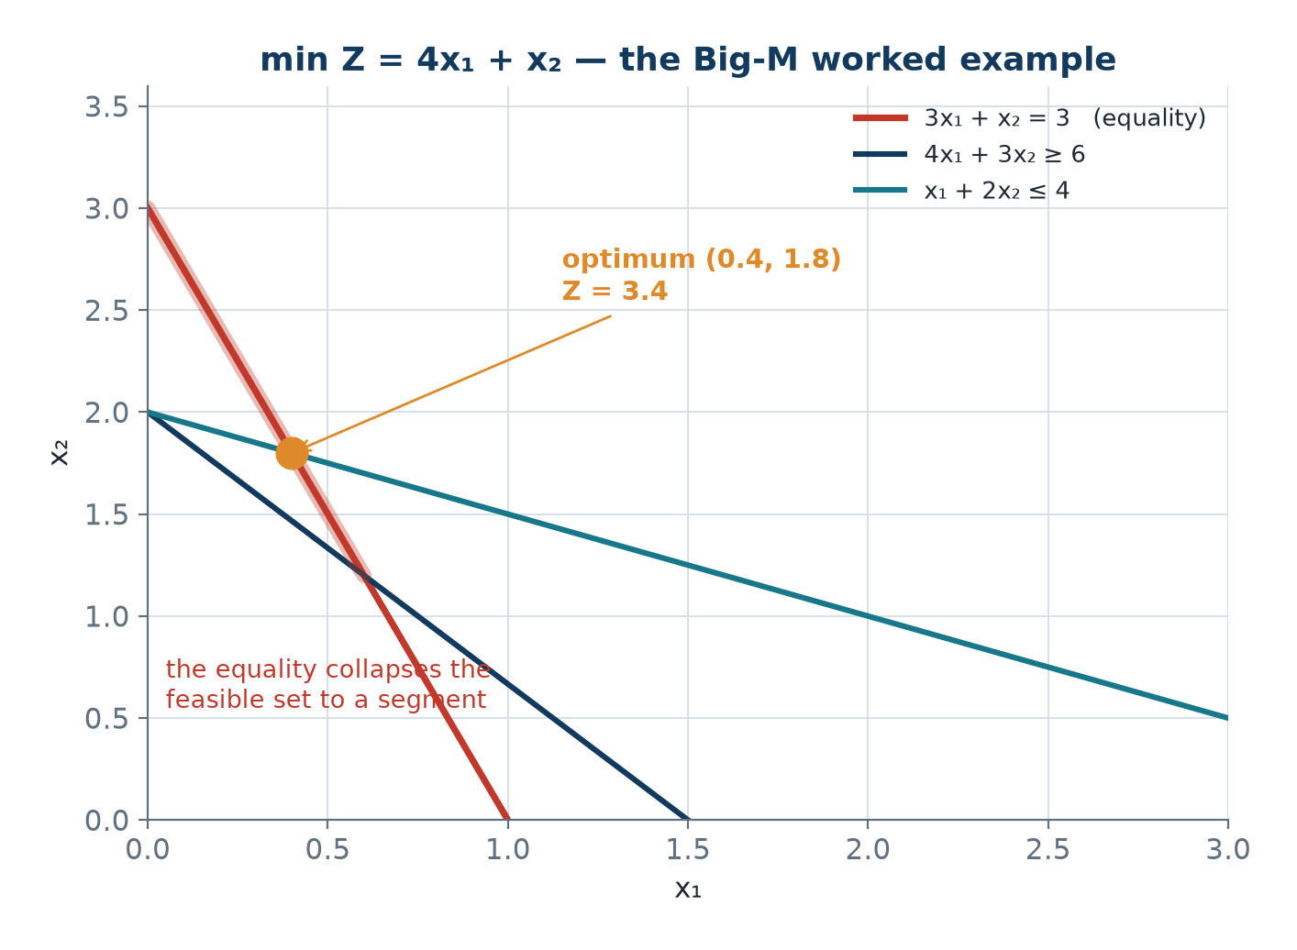
The Big-M optimum, checked against the original problem
• 3(0.4) + 1.8 = 1.2 + 1.8 = 3 ✓ the equality holds.
• 4(0.4) + 3(1.8) = 1.6 + 5.4 = 7.0 ≥ 6 ✓ with surplus s₂ = 1.
• 0.4 + 2(1.8) = 0.4 + 3.6 = 4.0 ≤ 4 ✓ binding, so s₃ = 0.
• Z = 4(0.4) + 1.8 = 3.4 ✓. Both artificials are zero, so the answer is valid.
The optimum x₁* = 0.4, x₂* = 1.8 with min Z = 3.4, and both artificials zero.
OM-L06 · Big-M, Two-Phase Methods and Special Cases
Nikhil Rajput
150
Notes:
Substituting the answer back is not a formality; it confirms three different things and gives each basic variable a geometric meaning. The equality gives 3(0.4) + 1.8 = 3 exactly, so the point sits on that line. The ≥ row gives 4(0.4) + 3(1.8) = 7.0, which exceeds 6 by one unit, and that one unit is precisely the basic surplus s₂ = 1, since a surplus variable measures how far a ≥ constraint is over-satisfied. The ≤ row gives 0.4 + 2(1.8) = 4.0 exactly, so it is binding and its slack is zero, which is why s₃ left the basis. The objective recomputes as 4(0.4) + 1.8 = 3.4. The final line carries the most weight: both artificials are zero, so these numbers answer the problem that was asked rather than the fiction used to get started.

Slide 151
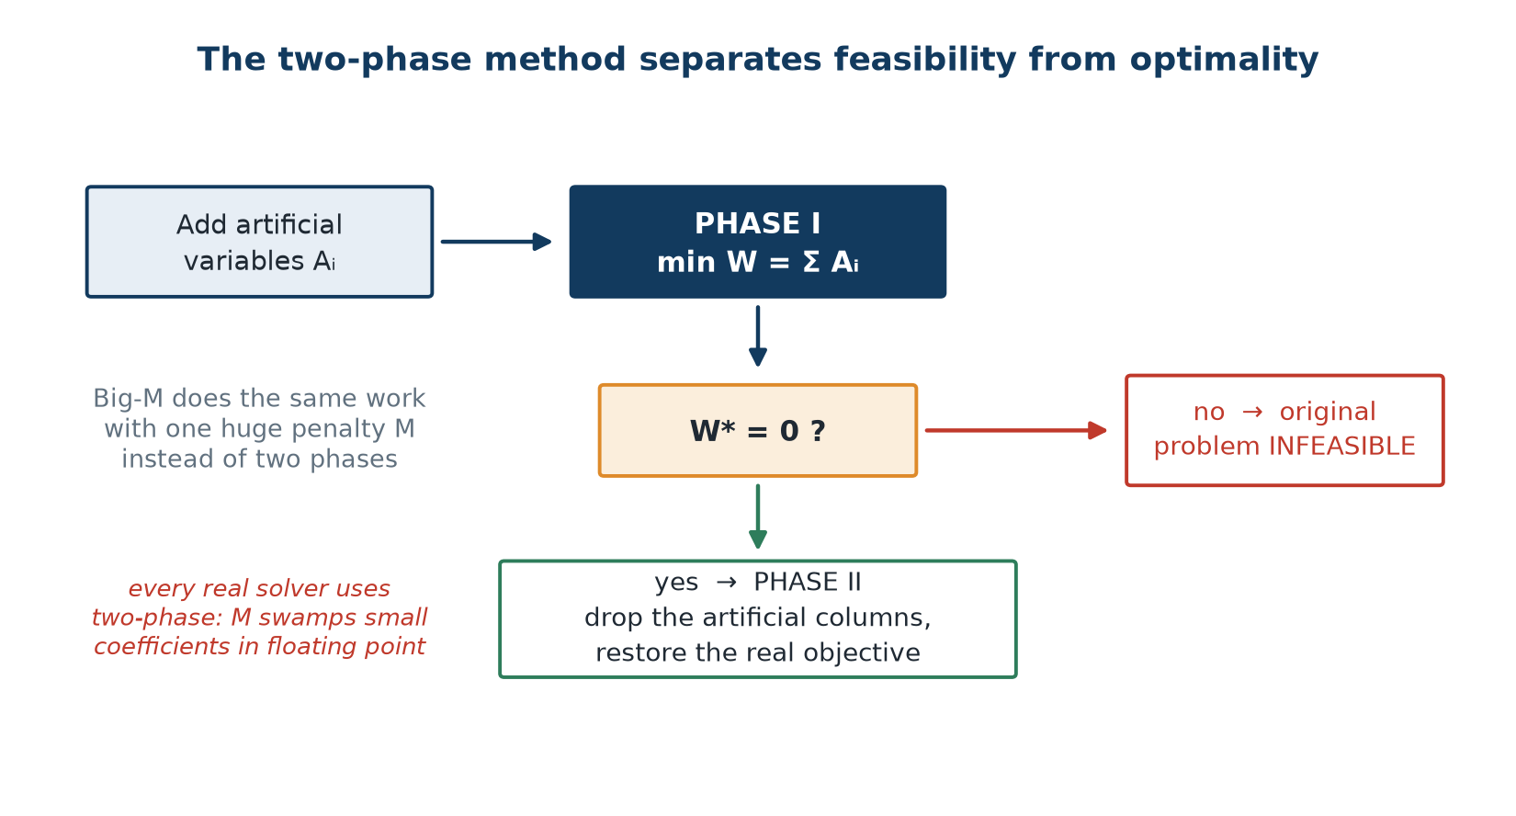
The two-phase method
• Phase I: replace the objective by min W = Σ Aᵢ, equivalently max −Σ Aᵢ, over the same constraints.
• W* > 0 ⟹ the original problem is INFEASIBLE. Stop.
• W* = 0 ⟹ a BFS of the original problem has been found. Proceed.
• Phase II: drop the artificial columns, restore the original objective, recompute zⱼ−cⱼ, continue.
Phase I finds feasibility; Phase II finds optimality. No M anywhere.
OM-L06 · Big-M, Two-Phase Methods and Special Cases
Nikhil Rajput
151
Notes:
Two-phase separates the two questions instead of mixing them. Phase I throws the real objective away and minimises W = Σ Aᵢ, the total size of the artificials, over the same constraints; equivalently it maximises −Σ Aᵢ. Since each Aᵢ is non-negative, W is zero exactly when every artificial has been driven out, so W measures directly how far the model sits from feasible, in the units of the violated constraint. If W* > 0 they cannot all be removed, no point satisfies every constraint, and you stop before spending any effort on optimisation. If W* = 0 the final Phase I tableau already describes a genuine basic feasible solution of the original problem. Phase II then drops the artificial columns, restores the real objective and continues. One step is easily forgotten: the inherited zⱼ−cⱼ row prices columns against W, not Z, so it must be recomputed before the next pivot.

Slide 152
Big-M versus two-phase
Big-M
Two-phase
• Number of tableaus: fewer.
• Arithmetic mixes M with ordinary numbers.
• Numerical stability poor - a huge M swamps small coefficients in floating point.
• Infeasibility detected only at the very end.
• Fine by hand; avoided in computer implementation.
• With M = 10⁶ and a real coefficient of 10⁻³, 16-digit double precision cannot hold the sum.
• Number of tableaus: more.
• Clean numbers throughout.
• Numerical stability good.
• Infeasibility detected at the end of Phase I - earlier.
• Fine by hand; used in practice by every real solver.
• On the worked example Phase I takes the same pivots and ends at iteration 2 with W* = 0 at (0.6, 1.2).
OM-L06 · Big-M, Two-Phase Methods and Special Cases
Nikhil Rajput
152
Notes:
The two methods do the same work and differ in what the numbers look like while they do it. On this example they take identical pivots, for a structural reason: Phase I's objective is the sum of the artificials, which is exactly the M-part of Big-M's objective, so every comparison M dominated was already a Phase I comparison. Big-M pays for its smaller tableau count in arithmetic hygiene. Storing −7M + 4 as a single floating-point number loses the small half: with a double carries about sixteen significant digits, so once M is big enough to dominate every coefficient the genuine part sits at the far end of them, and successive row operations grind it away until the signs in the zⱼ−cⱼ row are round-off rather than arithmetic, and the method halts at a wrong basis while reporting success. Two-phase never forms such a sum, and it reports infeasibility at the end of Phase I rather than at the very end. That silent failure, not the tableau count, keeps Big-M out of solvers.

Slide 153
The four special cases in the tableau
Case | Tableau signature | Action
Infeasible | some Aᵢ > 0 at optimality, or W* > 0 | relax a constraint
Unbounded | entering column has no positive entry | add the missing constraint
Alternate optima | a non-basic variable has zⱼ−cⱼ = 0 | pivot to the second optimum
Degenerate | a basic variable equals 0 | continue; watch for stalling
Only non-basic zeros signal alternate optima; a basic variable with zⱼ−cⱼ = 0 signals nothing.
OM-L06 · Big-M, Two-Phase Methods and Special Cases
Nikhil Rajput
153
Notes:
Nothing raises an alarm; each abnormal outcome leaves a fingerprint in the finished tableau instead, and there are exactly four to learn. Infeasible means no point satisfies every constraint, and it appears as some Aᵢ > 0 at optimality, or W* > 0 in Phase I; the repair is to relax a constraint. Unbounded means the objective improves forever, and it appears when the entering column has no positive entry, so the minimum-ratio test has no candidate and nothing limits how far that variable can rise; the repair is to add the missing constraint. The other two are statements about geometry rather than errors: a non-basic column priced at zero means a tied edge with a second optimum along it, and a basic variable equal to zero means more constraints meet at that corner than the dimension requires. Degeneracy is not a failure, though it risks stalling — pivots that change the basis without moving the point.

Slide 154
Solved Problem 1 - Detecting infeasibility with Big-M
Solve max Z = 3x₁ + 2x₂ subject to x₁ + x₂ ≤ 4, x₁ + x₂ ≥ 8, x₁, x₂ ≥ 0.
Step 1 - Standard form
x₁ + x₂ + s₁ = 4
x₁ + x₂ − s₂ + A₁ = 8
max Z = 3x₁ + 2x₂ − MA₁
Step 2 - Iteration 0
Basis {s₁, A₁}, Z = −8M
zⱼ−cⱼ = (−M−3, −M−2, 0, M, 0)
Entering x₁; ratios 4/1 = 4 and 8/1 = 8
Leaving s₁, pivot 1
Step 3 - Iteration 1
x₁ row (cB = 3): (1, 1, 1, 0, 0 | 4)
A₁ row (cB = −M): (0, 0, −1, −1, 1 | 4)
zⱼ−cⱼ = (0, 1, M+3, M, 0), Z = 12 − 4M
All zⱼ−cⱼ ≥ 0 since M is large, so simplex STOPS
OM-L06 · Big-M, Two-Phase Methods and Special Cases
Nikhil Rajput
154

Slide 155
Solved Problem 1 - Detecting infeasibility with Big-M (continued)
Step 4 - Verdict
But A₁ = 4 > 0, so the answer is INFEASIBLE
x₁+x₂ ≤ 4 and x₁+x₂ ≥ 8 cannot both hold, since 4 < 8
The −4M term in Z = 12 − 4M prices the violation at 4 units
Solvers report exactly this minimum total constraint violation
INFEASIBLE - minimum total constraint violation 4 units
Either the capacity 4 is wrong or the requirement 8 is. The 4 units tell management how much extra capacity, or demand reduction, is needed.
OM-L06 · Big-M, Two-Phase Methods and Special Cases
Nikhil Rajput
155
Notes:
The technique is Big-M carried to its normal termination and then read, not abandoned early. Standard form gives x₁ + x₂ + s₁ = 4 and x₁ + x₂ − s₂ + A₁ = 8 with max Z = 3x₁ + 2x₂ − MA₁, so the starting basis {s₁, A₁} sits at Z = −8M. One pivot brings x₁ in and sends s₁ out, and iteration 1 stops because the remaining entries M+3 and M are large positive numbers, so every zⱼ−cⱼ passes. That is a perfectly ordinary stop, which is exactly the danger: the tableau looks finished. The verdict comes from the basis instead, where A₁ still sits at 4, and a positive artificial means infeasible. The −4M term in Z = 12 − 4M prices that violation at four units, and 4 < 8 confirms it directly, since x₁ + x₂ cannot be at most 4 and at least 8 at once. Solvers report this same minimum total violation.

Slide 156
Solved Problem 2 - The two-phase method, complete
Solve by two-phase: min Z = 2x₁ + 3x₂ subject to x₁ + x₂ ≥ 5, x₁ + 2x₂ ≥ 6, x₁, x₂ ≥ 0.
Step 1 - Standard form and Phase I, iteration 0
x₁ + x₂ − s₁ + A₁ = 5, x₁ + 2x₂ − s₂ + A₂ = 6
Phase I: min W = A₁ + A₂, i.e. max −A₁ − A₂
Basis {A₁, A₂}, W = 5 + 6 = 11, zⱼ−cⱼ = (−2, −3, 1, 1)
Entering x₂; ratios 5 and 3; leaving A₂; pivot 2
Step 2 - Phase I, iteration 1
A₁ row: (1/2, 0, −1, 1/2, 1 | 2), ratio 4 ←
x₂ row: (1/2, 1, 0, −1/2, 0 | 3), ratio 6
zⱼ−cⱼ = (−1/2, 0, 1, −1/2), W = 2
Entering x₁; leaving A₁; pivot 1/2
Step 3 - Phase I, iteration 2
x₁ row: (1, 0, −2, 1 | 4)
x₂ row: (0, 1, 1, −1 | 1)
zⱼ−cⱼ = (0, 0, 0, 0) and W* = 0 ⟹ FEASIBLE
Both artificials have left; BFS (x₁, x₂) = (4, 1)
OM-L06 · Big-M, Two-Phase Methods and Special Cases
Nikhil Rajput
156

Slide 157
Solved Problem 2 - The two-phase method, complete (continued)
Step 4 - Phase II
Drop the artificial columns, restore min Z = 2x₁ + 3x₂, cB = (2, 3)
z(s₁)−c(s₁) = 2(−2) + 3(1) = −1
z(s₂)−c(s₂) = 2(1) + 3(−1) = −1
Minimisation in this form needs zⱼ−cⱼ ≤ 0: both are −1 ✓ OPTIMAL
x₁* = 4, x₂* = 1, min Z = 2(4) + 3(1) = 11
Both constraints are binding: 4 + 1 = 5 and 4 + 2(1) = 6. Graphical cross-check: (6, 0) gives 12, (4, 1) gives 11, (0, 5) gives 15.
OM-L06 · Big-M, Two-Phase Methods and Special Cases
Nikhil Rajput
157
Notes:
Both constraints are ≥, so neither row owns a usable variable and each needs an artificial, giving x₁ + x₂ − s₁ + A₁ = 5 and x₁ + 2x₂ − s₂ + A₂ = 6. Phase I minimises W = A₁ + A₂ and therefore starts at W = 5 + 6 = 11, the current size of the two artificials. Its objective row is built by summing the artificial rows and negating the real-variable entries, giving (−2, −3, 1, 1). x₂ is most negative, so it enters; ratios 5 and 3 send A₂ out on pivot 2. Then x₁ enters and A₁ leaves on pivot 1/2, reaching W* = 0 with both artificials gone and the basic feasible solution (4, 1). Phase II drops those columns and recomputes the row against cB = (2, 3), giving −1 under each surplus. Written this way for a minimisation, optimality needs zⱼ−cⱼ ≤ 0, the opposite sign convention to the earlier example.

Slide 158
Solved Problem 3 - Detecting unboundedness and naming the ray
Solve max Z = 2x₁ + x₂ subject to x₁ − x₂ ≤ 10, 2x₁ − x₂ ≤ 40, x₁, x₂ ≥ 0.
Step 1 - Iteration 0
s₁ row: (1, −1, 1, 0 | 10), ratio 10 ←
s₂ row: (2, −1, 0, 1 | 40), ratio 20
zⱼ−cⱼ = (−2, −1, 0, 0), Z = 0
Entering x₁; leaving s₁; pivot 1
Step 2 - Iteration 1
x₁ row (cB = 2): (1, −1, 1, 0 | 10)
s₂ row (cB = 0): (0, 1, −2, 1 | 20)
zⱼ−cⱼ = (0, −3, 2, 0), Z = 20
Entering x₂; ratio 20/1 = 20; leaving s₂
Step 3 - Iteration 2
x₁ row (cB = 2): (1, 0, −1, 1 | 30)
x₂ row (cB = 1): (0, 1, −2, 1 | 20)
zⱼ−cⱼ = (0, 0, −4, 3), Z = 80
Entering s₁; its column is (−1, −2) - BOTH NEGATIVE
OM-L06 · Big-M, Two-Phase Methods and Special Cases
Nikhil Rajput
158

Slide 159
Solved Problem 3 - Detecting unboundedness and naming the ray (continued)
Step 4 - The ray of unboundedness
No positive entry in the pivot column ⟹ UNBOUNDED
Raising s₁ by t: x₁ = 30 + t, x₂ = 20 + 2t, Z = 80 + 4t → ∞
x₁ − x₂ = 10 − t ≤ 10 ✓ and 2x₁ − x₂ = 40 ✓ for every t ≥ 0
Both constraints hold along the whole ray - genuinely unbounded
UNBOUNDED along x₁ = 30 + t, x₂ = 20 + 2t, Z = 80 + 4t
Both constraints read (something) − x₂ ≤ constant, so raising x₂ loosens both. Every LP with unbounded profit has a missing constraint, and the ray names it.
OM-L06 · Big-M, Two-Phase Methods and Special Cases
Nikhil Rajput
159
Notes:
Two ordinary pivots reach x₁ = 30, x₂ = 20 and Z = 80, and then the ratio test fails in a new way. The column s₁ prices at zⱼ−cⱼ = −4, so it should enter, but its column reads (−1, −2) with no positive entry. The minimum-ratio test accepts only positive entries, because a negative entry means that row's basic variable grows rather than shrinks as the entering variable rises, so no row ever forces a stop. With no candidate row, nothing bounds the increase, and that absence is the whole signature of unboundedness. The ray makes it concrete: raising s₁ by t gives x₁ = 30 + t, x₂ = 20 + 2t and Z = 80 + 4t, while x₁ − x₂ = 10 − t ≤ 10 and 2x₁ − x₂ = 40 hold for every t ≥ 0. So the model is genuinely unbounded rather than the victim of an arithmetic slip, and the ray names the missing constraint.

Slide 160
Solved Problem 4 - Diagnosing and repairing a failing model (1 of 2)
A production LP returns 'infeasible'. It has 2x₁ + 3x₂ ≤ 100 machine hours, x₁ ≥ 30 and x₂ ≥ 25 by contract. Diagnose it and propose three repairs, quantifying each.
Step 1 - Diagnosis
The two contracts consume at least 2(30) + 3(25) = 60 + 75 = 135 hours
Only 100 machine hours are available
Infeasible by 35 machine hours
Phase I terminates with W* = 35, in units of the violated constraint
Step 2 - What the solver reports
In Big-M form an artificial variable remains at a positive value
Commercial solvers also report the Irreducible Infeasible Subsystem
Here it is exactly these three constraints
Removing any one of them restores feasibility
Step 3 - Repair 1, buy capacity
Raise machine hours to at least 135: extra needed = 35 hours
At ₹200 per overtime hour the cost is ₹7,000
Feasible if the contract penalties exceed ₹7,000
Step 4 - Repair 2, renegotiate a contract
Relax x₂ ≥ 25 to x₂ ≥ q: 2(30) + 3q ≤ 100 ⟹ q ≤ 13.33, so q = 13
That is a 48% reduction in the product-2 commitment
Relax x₁ ≥ 30 to x₁ ≥ p: 2p + 75 ≤ 100 ⟹ p ≤ 12.5, so p = 12
A 60% reduction - relaxing product 2 is the cheaper repair
Continued on the next slide with Repair 3, goal programming, and the costed comparison of all three.
OM-L06 · Big-M, Two-Phase Methods and Special Cases
Nikhil Rajput
160
Notes:
Diagnosis needs no tableau here, only the arithmetic of the contracts. x₁ ≥ 30 and x₂ ≥ 25 must both hold, and the machine-hour row charges 2 hours per unit of product 1 and 3 per unit of product 2, so the cheapest legal plan already consumes 2(30) + 3(25) = 60 + 75 = 135 hours against the 100 available. The model is short by 35. That figure is not an aside: it is exactly what Phase I returns as W*, expressed in the units of the violated constraint, which is why an infeasible report is a measurement rather than a failure. Solvers add the irreducible infeasible subsystem, the smallest set of rules that clash, which here is these three constraints, since dropping any one restores feasibility. The repairs then price the gap: 35 overtime hours at ₹200 cost ₹7,000, while relaxing the product-2 commitment to 13 units is a 48% cut against 60% for product 1.

Slide 161
Solved Problem 4 - Diagnosing and repairing a failing model (2 of 2)
Step 1 - Repair 3, soften the constraints
x₁ + d₁⁻ − d₁⁺ = 30, x₂ + d₂⁻ − d₂⁺ = 25
min Z = p₁d₁⁻ + p₂d₂⁻ subject to 2x₁ + 3x₂ ≤ 100
This goal-programming model is always feasible
It finds the least-cost way to break the promises
Step 2 - Pricing the shortfalls
Penalties p₁ = ₹500 and p₂ = ₹300 per unit short
Product 1 uses 2 hours/unit: 500/2 = ₹250 per hour saved
Product 2 uses 3 hours/unit: 300/3 = ₹100 per hour saved
Cut product 2 - it is the cheaper promise per hour saved
Step 3 - The solution
Units of x₂ to cut = 35/3 = 11.67, so x₂ = 25 − 11.67 = 13.33
x₁ = 30, x₂ = 13.33, d₂⁻ = 11.67
Check: 2(30) + 3(13.33) = 60 + 40 = 100 ✓
Minimum penalty = 11.67 × ₹300 = ₹3,500
Step 4 - The three repairs compared
Buy 35 overtime hours: ₹7,000 - keeps both contracts intact
Goal programming, cut product 2: ₹3,500 - cheapest
Cut product 1 instead: (35/2) × 500 = ₹8,750 - worst option
Buy overtime only if the reputational cost exceeds ₹7,000
Cheapest repair ₹3,500: keep x₁ = 30 and cut x₂ to 13.33
'Infeasible' is not a failure of the algorithm - it is information. Phase I quantifies the violation; goal programming prices the trade-off.
OM-L06 · Big-M, Two-Phase Methods and Special Cases
Nikhil Rajput
161
Notes:
Goal programming turns a hard constraint into a target plus deviation variables: x₁ + d₁⁻ − d₁⁺ = 30, where d₁⁻ measures the shortfall below the target and d₁⁺ the excess above it. Minimising the penalised shortfalls subject only to the machine-hour limit gives a model that is always solvable, so the question shifts from whether the promises can be kept to which one to break. The ranking must be per machine hour saved, not per unit, because hours are the scarce resource: ₹500 spread over the 2 hours a unit of product 1 releases is ₹250, while ₹300 over 3 hours is only ₹100. So cut product 2. Saving 35 hours needs 35/3 = 11.67 units, leaving x₂ = 13.33 with x₁ = 30, and 2(30) + 3(13.33) = 100 exactly. The penalty is 11.67 × ₹300 = ₹3,500, half the overtime bill and far below the ₹8,750 of cutting product 1.

Slide 162
Where this is used
Airline and railway crew rostering
Every flight needs at least one qualified crew, so every row is a ≥ constraint and a Phase I start is unavoidable.
Feed, petrol and cement blending
Minimum nutrient or octane levels are ≥ constraints. An infeasible run says the specification cannot be met from the stocks on hand.
Half-hourly power dispatch
Demand must be met exactly, so the balance rows are equalities. The Phase I value reports the megawatt shortfall, not just 'model failed'.
Hospital nurse staffing
Minimum nurses per shift are ≥ constraints. Phase I measures how many shifts are short before anyone argues about overtime cost.
Solver diagnostics in industry
Commercial solvers run a Phase I equivalent and return an irreducible infeasible subsystem - the smallest set of rules that clash.
OM-L06 · Big-M, Two-Phase Methods and Special Cases
Nikhil Rajput
162
Notes:
These are all models whose rows are floors or exact balances rather than ceilings, which is the normal case outside a textbook: every flight needs at least one qualified crew, every blend must meet a minimum nutrient or octane specification, every shift needs a minimum number of nurses, and every half-hour of power demand must be matched exactly. Each such row is a ≥ or = constraint, so producing nothing is already illegal and there is no origin to start from. A Phase I start is forced by the structure of these problems, not chosen for style. The second thread is what an infeasible run is worth here. It does not say the model failed; Phase I returns a number in the units of the violated row — megawatts short, shifts unstaffed — and commercial solvers add the irreducible infeasible subsystem, the smallest set of rules that contradict one another, pointing the modeller at the clash.

Slide 163
The intuition: feasible is not the same as optimal
Driving the artificial variables out is like finally finding a legal parking space. You are allowed to be there - but it is not yet the space nearest the door.
• At iteration 2 of the worked example both artificials had gone and Z = 3.6 looked like an answer.
• It was not. One column still had zⱼ−cⱼ = −1/5, and one more pivot brought Z down to 3.4.
• Expelling the artificials buys feasibility. Only the zⱼ−cⱼ test buys optimality.
• If they refuse to leave, the honest report is not 'the method failed' but 'your rules contradict each other'.
• And Phase I says by how much: 35 machine hours here, 4 units of unmet demand there.
OM-L06 · Big-M, Two-Phase Methods and Special Cases
Nikhil Rajput
163
Notes:
Feasible means every constraint holds; optimal means no better feasible point exists. They are separate tests answering separate questions, and confusing them is the single most common misreading of this method. The artificials settle only the first: while one sits in the basis at a positive value the tableau describes a point that breaks a constraint, and driving them all out means the point is finally legal. Whether it is the best legal point is decided by something else entirely, the zⱼ−cⱼ row, which prices each non-basic column and reports whether any of them still improves the objective. The worked example makes the gap concrete. At iteration 2 both artificials had gone and (0.6, 1.2) with Z = 3.6 looked like an answer, but one column still priced at −1/5 and a further pivot brought Z down to 3.4. When they refuse to leave, the honest report names the model and measures the damage.

Slide 164
Common mistakes to avoid
• Stopping the moment the artificials leave the basis - feasibility is not optimality.
• Forgetting that a surplus enters with coefficient −1, so it cannot be a starting basic variable.
• Reading a positive artificial at optimality as an answer. Any Aᵢ > 0 means INFEASIBLE.
• Choosing M too small: it must dominate every other number that can arise in the tableau.
• Using Big-M in floating-point code: M = 10⁶ against a coefficient of 10⁻³ corrupts the zⱼ−cⱼ signs.
• Calling a basic variable with zⱼ−cⱼ = 0 an alternate optimum. Only non-basic zeros count.
• Treating an infeasible report as a bug rather than as a measured statement about the model.
OM-L06 · Big-M, Two-Phase Methods and Special Cases
Nikhil Rajput
164
Notes:
Each entry names a specific failure with a specific consequence rather than offering general advice. Stopping the moment the artificials leave, and reading a positive artificial at optimality as an answer, are opposite halves of the same confusion between feasibility and optimality, and both produce a number that looks like a solution and is not — worse than any error message, since nothing signals it. Forgetting that a surplus enters with coefficient −1 is the set-up version of the same error: a variable at −1 goes negative at the origin, so it cannot start basic. Too small an M fails silently, because the penalty works only while M dominates every real coefficient that can arise in the objective row. The floating-point item is why this method never reached production code. The last is a reading error: a basic variable prices at zero automatically, so only a non-basic zero signals a second optimum.

Slide 165
Summary
• ≥ and = constraints leave no starting BFS: artificial variables buy a start and must then be expelled.
• Big-M: all Aᵢ = 0 at optimality ⟹ valid answer; any Aᵢ > 0 ⟹ INFEASIBLE.
• Expelling the artificials gives feasibility, not optimality - continue until the zⱼ−cⱼ test passes.
• Two-phase: Phase I minimises Σ Aᵢ, W* > 0 means infeasible, then Phase II restores the real objective.
• Two-phase is numerically far safer and is what real solvers use; Big-M is a teaching device.
• Signatures: Aᵢ > 0 infeasible; no positive column entry unbounded; non-basic zero alternate optima; basic zero degenerate.
• Infeasibility is information: Phase I measures the violation and goal programming prices the trade-off.
OM-L06 · Big-M, Two-Phase Methods and Special Cases
Nikhil Rajput
165
Notes:
Read these as one chain rather than seven separate facts. A ≥ row contributes a variable with coefficient −1 and an = row contributes none, so neither leaves a starting basic feasible solution; an artificial with coefficient +1 manufactures one; the manufactured start describes a different problem, so the artificials must be driven to zero; Big-M and two-phase are two ways of forcing that, one by penalising them inside the objective and one by minimising their sum first; and whether they actually went, together with the zⱼ−cⱼ test, decides what the final tableau means. The four signatures are the reading rules for that last step. The two load-bearing lines are the highlighted ones: any Aᵢ > 0 at termination is a verdict of infeasible rather than a small numerical annoyance, and expelling every artificial delivers feasibility only, with optimality still to be proved.

Slide 166
Practice problems
answers given where the source supplies them
• 1. Set up the Big-M tableau for min 3x₁ + 5x₂ s.t. x₁ + x₂ ≥ 4, 2x₁ + x₂ = 6.
• 2. Solve Problem 2 above by Big-M and confirm the same answer, x₁ = 4, x₂ = 1, Z = 11.
• 3. A Phase I ends with W* = 3. What do you conclude?
• 4. The pivot column entries are (0, −2, −5). Diagnose. [Ans: unbounded]
• 5. Why is Big-M numerically dangerous on a computer? State the optimality condition for a minimisation tableau.
• 6. A final tableau has a basic variable equal to 0 and all zⱼ−cⱼ > 0. Is it optimal? [Ans: yes - optimal and degenerate]
OM-L06 · Big-M, Two-Phase Methods and Special Cases
Nikhil Rajput
166
Notes:
These test the two separate skills a tableau demands: building one correctly and reading a finished one. Problems 1 and 2 are construction. Count the artificials before writing anything — one per ≥ row and one per = row, so the first needs two — and keep the surplus distinct from the artificial that follows it, since the surplus enters with −1 and the artificial with +1. Problems 3, 4 and 6 are diagnosis, each matching one signature exactly: a positive Phase I value means no feasible point exists, a pivot column with no positive entry means the objective improves without limit, and a basic variable at zero alongside a passing optimality test means optimal and merely degenerate, not stuck. Problem 5 asks for the reason behind a rule rather than the rule: a huge M and a tiny coefficient cannot share sixteen digits.

Slide 167
OPTIMIZATION METHODS · LESSON 07
Duality and Sensitivity Analysis
Linear Programming - Lesson 7
Nikhil Rajput
Notes:
An optimisation problem written down once can be read two ways. The version you write, called the primal, allocates scarce resources to activities and asks what to make. Hidden inside it is a second problem, the dual, carrying one variable for every constraint of the first; those variables are prices, and they ask what the resources themselves are worth. Both are built from the same data: the dual's coefficient matrix is the primal's transposed, its objective coefficients are the primal's right-hand sides, and its right-hand sides are the primal's profits. Because one set of numbers generates both, solving either solves both, and the prices emerge as a by-product of the simplex run you have already performed. That is why the pair is worth studying: the plan tells a manager what to do, the prices tell them what to pay. The caveat, and the whole second half of this material, is that a price of this kind holds only over a limited range of the data.

Slide 168
Learning Outcomes
by the end of this lesson you will be able to
• Construct the dual of any LP.
• State and apply weak duality, strong duality and complementary slackness.
• Interpret dual variables as shadow prices and use them for economic decisions.
• Compute ranging on objective coefficients and right-hand sides.
• Apply the 100 % rule for simultaneous changes.
OM-L07 · Duality and Sensitivity Analysis
Nikhil Rajput
168
Notes:
These five outcomes form one chain rather than a checklist. Constructing the dual is mechanical - count the constraints, transpose the matrix, swap the objective coefficients with the right-hand sides - but the construction means nothing until three theorems say what the new variables are. Weak duality shows any dual-feasible price vector bounds the primal optimum; strong duality shows the two optima are equal; complementary slackness settles which prices are zero, forcing an unused resource to be worth nothing extra. Only then do dual variables become shadow prices, numbers a manager can use to decide what to buy, what to charge internally, and which product to launch. Ranging supplies the interval of data over which each of those decisions stays correct, and the 100 % rule extends the guarantee to several changes at once. Remove the ranging and the economics is still arithmetic, but arithmetic quoted outside the region where it is true, which is how sound analysis produces wasted purchases.

Slide 169
The big picture, in simple terms
Solving an LP tells you what to make. The dual tells you what your factory's hours, space and materials are actually worth - the numbers you need before you negotiate.
• Every plan has a bottleneck. Duality puts a price tag on each one.
• The prices come free: they are already sitting in the final simplex tableau.
• A resource you never run out of is worth nothing extra, whatever it cost to buy.
• Sensitivity analysis asks how much the world can change before your plan is wrong.
• Managers rarely want only the answer. They want to know how fragile it is.
OM-L07 · Duality and Sensitivity Analysis
Nikhil Rajput
169
Notes:
The idea here is that a solved production plan quietly contains a price list. When simplex finishes it has not only found the best mix of products; it has also worked out, for each constraint, how much the objective would rise if that constraint's limit were relaxed by one unit. That number is the resource's marginal value, and it is exactly the corresponding dual variable. The mechanism is that the final tableau's zⱼ − cⱼ row already carries these figures in the slack columns, so no second optimisation is ever needed. Two consequences follow. A bottleneck - a resource you have genuinely run out of - carries a positive price, and that price is the most you may pay for one more unit and still come out ahead. A resource with capacity to spare carries a price of zero, whatever it cost to buy, because more of it changes nothing you can do. The catch is that such values are marginal and local, never permanent.

Slide 170
The dual problem - the construction
Primal (canonical maximisation):
max Z = Σⱼ cⱼxⱼ s.t. Σⱼ aᵢⱼxⱼ ≤ bᵢ (i = 1..m), xⱼ ≥ 0
Dual:
min W = Σᵢ bᵢyᵢ s.t. Σᵢ aᵢⱼyᵢ ≥ cⱼ (j = 1..n), yᵢ ≥ 0
The primal allocates resources to activities; the dual prices those resources.
OM-L07 · Duality and Sensitivity Analysis
Nikhil Rajput
170
Notes:
Read the two blocks as one economic argument rather than a transposition. In the primal, xⱼ is the level of activity j, cⱼ its profit per unit, aᵢⱼ the amount of resource i that one unit of j consumes, and bᵢ the stock of resource i available. The dual introduces one variable yᵢ for each of those m constraints, and yᵢ is a price: what you would pay for one more unit of bᵢ. The objective min W = Σᵢ bᵢyᵢ values your entire stock at your own prices and hunts for the smallest valuation you can defend. Each dual constraint Σᵢ aᵢⱼyᵢ ≥ cⱼ is what stops those prices collapsing to zero: the bundle of resources consumed by one unit of activity j must be worth at least the cⱼ that unit earns, or profit would appear from nothing. So the pair is not a formal trick but the same situation priced instead of scheduled. Note the direction reverses - the primal maximises, the dual minimises.

Slide 171
In words - transpose everything
Primal | Dual
max | min
m constraints | m variables
n variables | n constraints
objective coefficients c | right-hand sides c
right-hand sides b | objective coefficients b
constraint matrix A | Aᵀ
≤ constraints | ≥ constraints
Theorem. The dual of the dual is the primal.
OM-L07 · Duality and Sensitivity Analysis
Nikhil Rajput
171
Notes:
Every row of this table is a consequence of one operation: the data of the primal is transposed. The count of constraints, m, becomes the count of dual variables, because each constraint contributes one price; the count of variables, n, becomes the count of dual constraints, because each activity contributes one break-even test. The vector c, which was profit per unit in the objective, becomes the right-hand sides those prices must cover, while b, which was the stock available, becomes what the dual objective values. The matrix A becomes Aᵀ, so a dual constraint is read down a primal column rather than across a primal row. Direction flips too: maximise becomes minimise, and ≤ becomes ≥. The practical payoff is that a problem with many rows and few columns has a dual with few rows and many columns, so a solver may attack whichever side is cheaper. Because transposing twice restores the original, the dual of the dual is the primal, and this table may equally be read right to left.

Slide 172
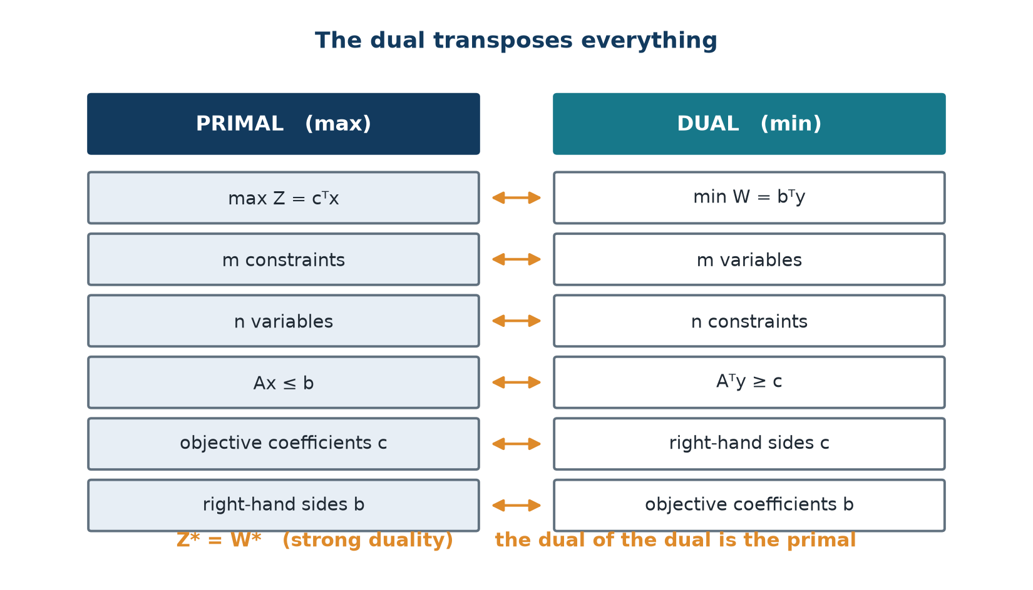
Primal and dual, side by side
• Each primal constraint contributes one dual variable yᵢ.
• Each primal variable contributes one dual constraint.
• The b vector and the c vector swap roles entirely.
• Dualising twice returns you to the problem you started with.
Transposition: m constraints become m variables, and A becomes Aᵀ.
OM-L07 · Duality and Sensitivity Analysis
Nikhil Rajput
172
Notes:
The picture to hold is a crossing, not a copy. Look at the middle two bands: each primal constraint sends an arrow to one dual variable yᵢ, and each primal variable sends an arrow to one dual constraint. That crossing is the structural fact everything else rests on - the dual is not the same unknowns rearranged but a problem about entirely different unknowns. Follow a primal row across and you arrive at the price of the resource that row limits; follow a primal column across and you arrive at the test Σᵢ aᵢⱼyᵢ ≥ cⱼ an activity must pass before it is worth running. The b and c vectors swap jobs on the way: what was a limit becomes something to value, and what was a profit becomes something to cover. Because the map is symmetric, applying it twice returns you to the start. The trap is reading it as bookkeeping; the arrows carry the meaning, and losing that meaning is how shadow prices later get misused.

Slide 173
The full correspondence rules
for a maximisation primal
Primal (max) | Dual (min)
constraint ≤ | variable ≥ 0
constraint ≥ | variable ≤ 0
constraint = | variable unrestricted
variable ≥ 0 | constraint ≥
variable ≤ 0 | constraint ≤
variable unrestricted | constraint =
A constraint's type fixes a dual variable's sign; a variable's sign fixes a dual constraint's type.
OM-L07 · Duality and Sensitivity Analysis
Nikhil Rajput
173
Notes:
These rules extend the canonical case to constraints and variables of any type, and a single idea sits behind all six. A dual variable's sign records the direction in which relaxing its constraint helps. Raising the right-hand side of a ≤ ceiling can only enlarge the feasible region, so its price is non-negative; raising the right-hand side of a ≥ floor tightens the problem and can only hurt, so its multiplier is non-positive; an equality can be pushed either way, so its variable is unrestricted. The last three rows run in the opposite direction. A variable held at xⱼ ≥ 0 need only satisfy its break-even test as an inequality, because raising xⱼ is optional; a free variable can move either way, so its dual constraint must hold with equality. This matters the moment a model mixes constraint types, which real ones always do. The reliable slip is a ≥ row inside a maximisation: its dual variable is yᵢ ≤ 0, not yᵢ ≥ 0.

Slide 174
Weak duality, with its proof
If x is primal-feasible and y is dual-feasible, then cᵀx ≤ bᵀy
Proof: cᵀx ≤ (Aᵀy)ᵀx = yᵀAx ≤ yᵀb
first ≤ uses the dual constraints Aᵀy ≥ c with x ≥ 0
second ≤ uses the primal constraints Ax ≤ b with y ≥ 0
Any dual-feasible y is an upper bound on the primal optimum; if the primal is unbounded the dual is infeasible.
OM-L07 · Duality and Sensitivity Analysis
Nikhil Rajput
174
Notes:
Weak duality says that if x satisfies the primal constraints and y satisfies the dual constraints, then cᵀx ≤ bᵀy: every feasible plan's profit is at most every feasible valuation of the stock. The proof is two substitutions. Because the dual requires Aᵀy ≥ c and x ≥ 0, replacing c by Aᵀy can only raise the left side, giving cᵀx ≤ (Aᵀy)ᵀx = yᵀAx. Because the primal requires Ax ≤ b and y ≥ 0, replacing Ax by b raises it again, giving yᵀAx ≤ yᵀb. Each inequality spends one side's feasibility, which is why both are needed. The consequence is practical: any dual-feasible y at all, optimal or not, caps the primal optimum from above, so a plan worth 34 alongside a valuation worth 36 traps the true optimum between them - that difference is the duality gap a solver quotes when it stops early. And if the primal is unbounded no finite cap can exist, so the dual must be infeasible.

Slide 175
Strong duality - the four possible outcome pairs
Primal | Dual | Possible?
finite optimum | finite optimum | yes - the usual case
unbounded | infeasible | yes
infeasible | unbounded | yes
infeasible | infeasible | yes - rare but possible
finite | infeasible or unbounded | impossible
If either problem has a finite optimum, so does the other, and Z* = W*.
OM-L07 · Duality and Sensitivity Analysis
Nikhil Rajput
175
Notes:
Weak duality only bounds the two problems apart; strong duality closes the gap. It states that if either problem has a finite optimum then so does the other, and their optimal values are equal, Z* = W*. That equality is what lets a dual solution certify a primal one: exhibit a feasible x and a feasible y whose values match and, by weak duality, neither can be improved, so both are optimal and no further search is needed. The table catalogues what else the pair can do. Unbounded on one side forces infeasible on the other, since an unbounded primal admits no finite upper bound at all. Row four is the one people forget: both problems can be infeasible together, so an infeasible dual does not by itself prove the primal unbounded - you must still test primal feasibility. Only the final row is genuinely impossible. The boundary is that this is a theorem about linear programmes; integer and nonlinear problems can leave a real gap.

Slide 176
Complementary slackness
x* and y* are optimal for their problems if and only if
yᵢ*(bᵢ − Σⱼ aᵢⱼxⱼ*) = 0 for all i
xⱼ*(Σᵢ aᵢⱼyᵢ* − cⱼ) = 0 for all j
Rule 1: slackᵢ > 0 ⟹ yᵢ* = 0
Rule 2: yᵢ* > 0 ⟹ constraint i is binding
Every slack multiplied by its price, and every variable multiplied by its dual surplus, must vanish.
OM-L07 · Duality and Sensitivity Analysis
Nikhil Rajput
176
Notes:
Complementary slackness concerns the products yᵢ*(bᵢ − Σⱼ aᵢⱼxⱼ*), each a price multiplied by its own slack, where the slack is the unused part of resource i. The theorem says an optimal pair is exactly one for which every such product vanishes, and likewise every xⱼ*(Σᵢ aᵢⱼyᵢ* − cⱼ), an activity level multiplied by its dual surplus. The argument is short. Both factors of each product are non-negative: the slack because x is primal-feasible, the price because y is dual-feasible. A product of two non-negative numbers is zero only when at least one factor is zero, so each pair must contain a zero, and that is the entire content. Out of it fall the two working rules - spare capacity forces a zero price, a positive price forces a binding constraint. Notice the statement is if and only if, so these conditions do not merely follow from optimality, they certify it.

Slide 177
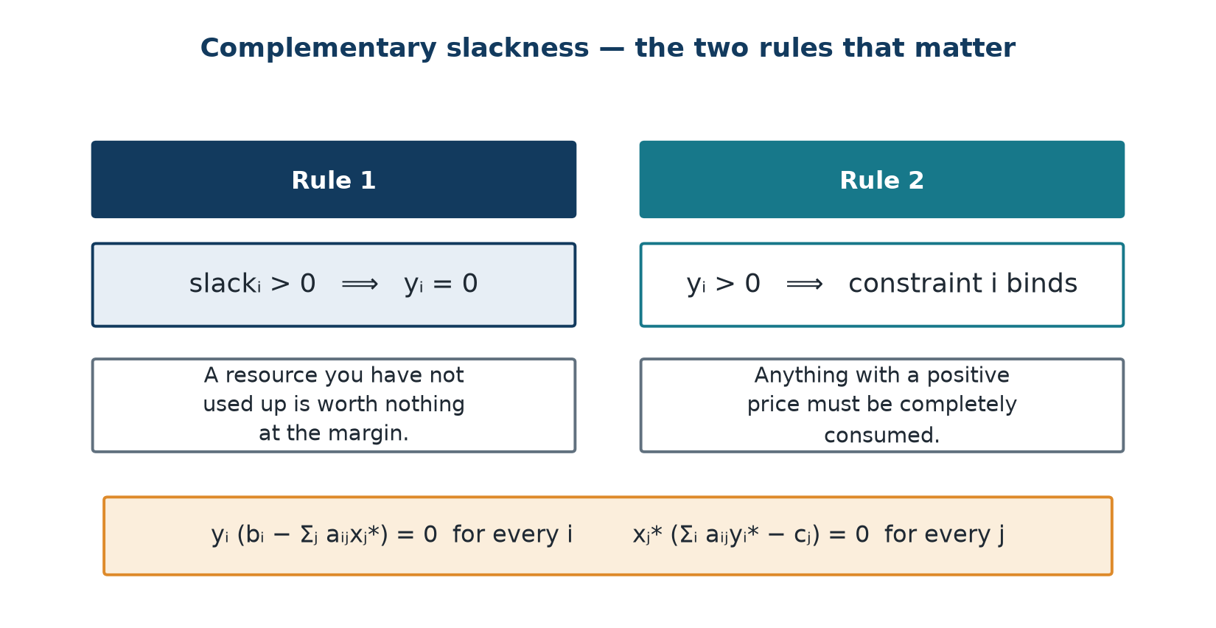
What the two rules mean in money
• A resource that is not fully used has zero marginal value.
• If you have idle machine hours, an extra machine hour is worth nothing.
• Symmetrically, an activity actually used (xⱼ > 0) must exactly break even at the shadow prices.
• Its dual constraint then holds with equality.
Slack > 0 forces the price to zero; a positive price forces the constraint to bind.
OM-L07 · Duality and Sensitivity Analysis
Nikhil Rajput
177
Notes:
The two rules partition the constraints: every constraint satisfies exactly one of them. Rule 1 says slackᵢ > 0 implies yᵢ* = 0. If a resource is not fully consumed by the current plan, one further unit of it changes nothing you are able to do, so the derivative of the optimum with respect to its stock is zero - its marginal value is zero however much the stock cost to acquire. Rule 2 is the contrapositive: only a resource you have genuinely exhausted can carry a positive price. Idle machine hours are the standard illustration; one more machine hour added to hours you are already not using is worth nothing. The symmetric statement concerns activities: anything you actually produce, xⱼ > 0, must break even exactly at these prices, so its dual constraint holds with equality rather than slack. The caution is that a zero price means zero marginal value, not zero importance - the resource may still be essential to the plan you run.

Slide 178
Shadow prices
definition, where to read them, and four uses
• yᵢ* = ∂Z*/∂bᵢ - the marginal value of one extra unit of resource i.
• Where to read them: in the final simplex tableau, yᵢ = (zⱼ − cⱼ) in the column of slack sᵢ.
  – Purchasing. Buy an extra unit if its market price is below yᵢ.
  – Pricing. yᵢ is the internal transfer price of the resource.
  – Priorities. The largest yᵢ identifies the tightest bottleneck.
  – Product costing. A new product pays only if its revenue exceeds Σᵢ aᵢ,new·yᵢ, its imputed resource cost.
OM-L07 · Duality and Sensitivity Analysis
Nikhil Rajput
178
Notes:
A shadow price is defined as a derivative: yᵢ* = ∂Z*/∂bᵢ, the rate at which the optimal objective rises as the stock of resource i rises. Being a derivative, it prices the next unit - not the average unit you already hold, and not the unit you originally bought. Reading it costs nothing extra. The slack variable sᵢ measures the unused part of resource i, so its zⱼ − cⱼ entry in the final tableau measures exactly what leaving one more unit idle would forgo, which is that unit's marginal value. The four uses are one number read four ways: pay anything below yᵢ for another unit; charge yᵢ internally when one division takes the resource from another; rank bottlenecks by the size of yᵢ; and judge a new product by whether its revenue beats Σᵢ aᵢ,new·yᵢ, its imputed resource cost. Every one of those readings is valid only while the same set of constraints stays binding.

Slide 179
Sensitivity analysis - ranging
Objective coefficient cⱼ
Right-hand side bᵢ
• Non-basic xⱼ: it stays non-basic, so the plan is unchanged, while cⱼ ≤ zⱼ.
  – Equivalently cⱼ ≤ cⱼ(current) + (zⱼ − cⱼ).
• Basic xⱼ: changing cⱼ alters the whole zₖ − cₖ row.
• The basis stays optimal while zₖ − cₖ + Δcⱼ·αⱼₖ ≥ 0 for every non-basic k.
  – αⱼₖ is the entry in row xⱼ, column k of the final tableau.
• max over αⱼₖ < 0 of −(zₖ−cₖ)/αⱼₖ ≤ Δcⱼ ≤ min over αⱼₖ > 0 of −(zₖ−cₖ)/αⱼₖ
• Changing bᵢ by Δ moves the basics to xB(new) = xB + Δ·(B⁻¹)·ᵢ.
  – (B⁻¹)·ᵢ is simply the sᵢ column of the final tableau.
• Feasibility requires xB(new) ≥ 0.
• max over βₖᵢ > 0 of −xBₖ/βₖᵢ ≤ Δ ≤ min over βₖᵢ < 0 of −xBₖ/βₖᵢ
• Within this range the shadow price yᵢ is constant.
  – Outside it the basis changes and a new shadow price applies.
OM-L07 · Duality and Sensitivity Analysis
Nikhil Rajput
179
Notes:
Ranging asks how far a single number in the data may move before the current solution stops being the right one, and the two columns test different things. Changing a profit coefficient cⱼ moves no wall of the feasible region, so every plan that was available still is; what can change is which corner pays most. A cⱼ range is therefore a test of optimality, enforced by keeping every zₖ − cₖ non-negative as the row shifts by Δcⱼ·αⱼₖ, where αⱼₖ is the final-tableau entry in row xⱼ and column k. Changing a right-hand side bᵢ does move a wall, so the corner itself slides - by Δ along the sᵢ column of the final tableau - and a basic variable can be driven negative. A bᵢ range is therefore a test of feasibility, requiring xB + Δ(B⁻¹)·ᵢ ≥ 0. Both are read from one tableau you already have. Inside the bᵢ range yᵢ is constant; outside it the basis changes and a different price applies.

Slide 180
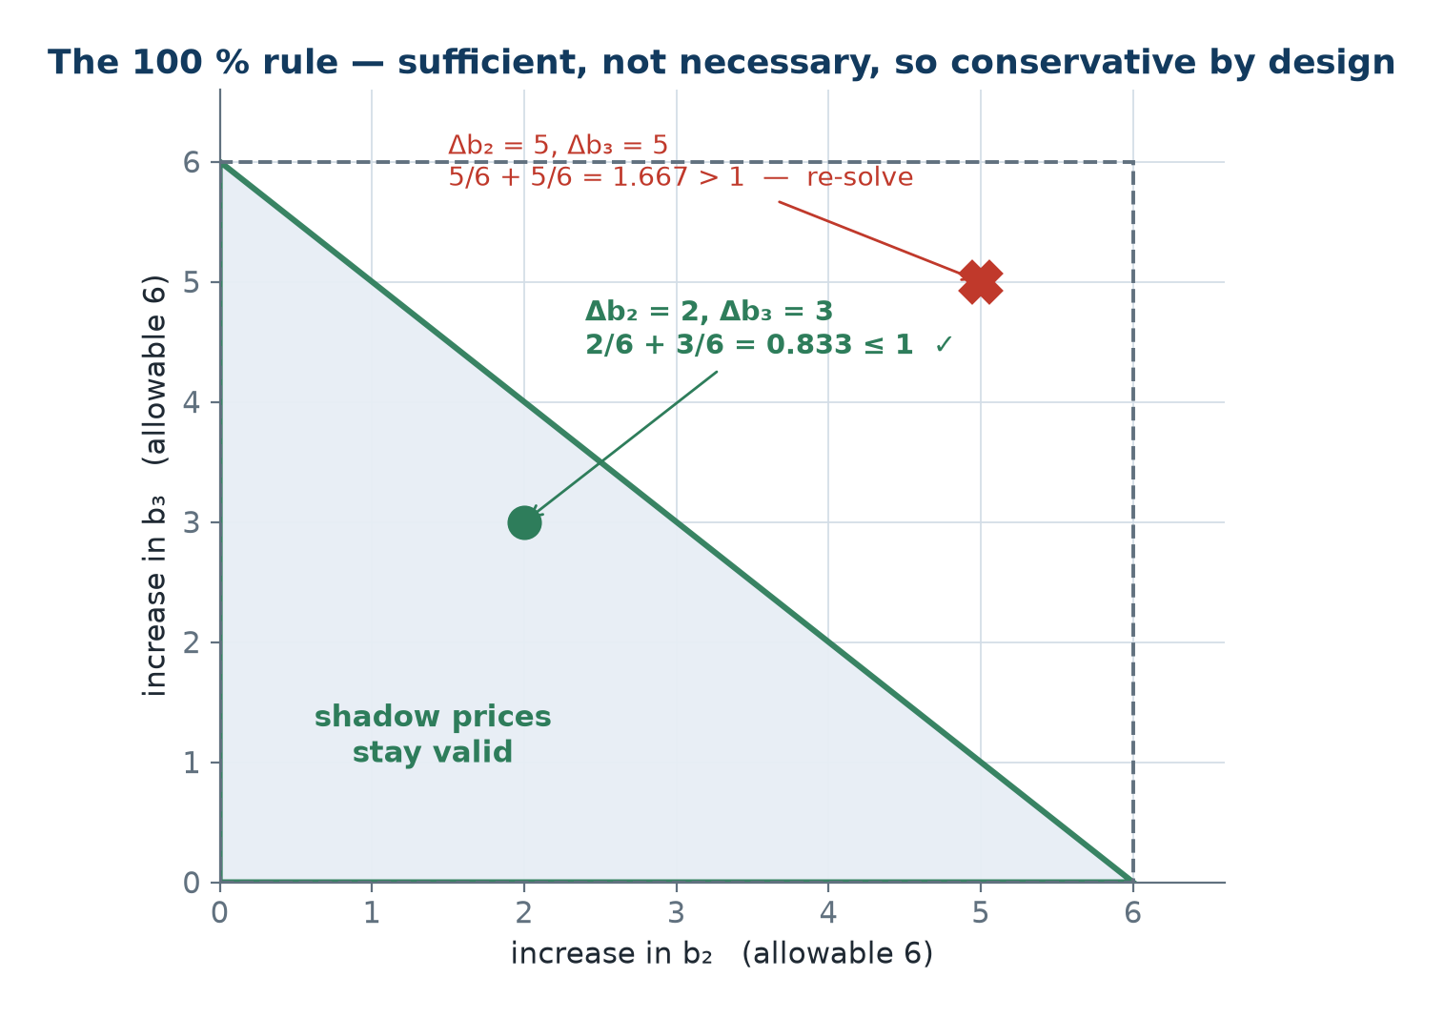
The 100 % rule for simultaneous changes
• Express each change as a fraction of its allowable range in the direction of change.
• If Σᵢ |Δᵢ| / allowable rangeᵢ ≤ 1, the basis and all shadow prices remain valid.
• If the sum exceeds 1, re-solve - the rule gives no conclusion either way.
• Sufficient but not necessary: exceeding 100 % does not prove the basis changed.
The region of simultaneous changes for which the basis is guaranteed to survive.
OM-L07 · Duality and Sensitivity Analysis
Nikhil Rajput
180
Notes:
Each individual range assumes the rest of the data holds still, so the ranges cannot settle what happens when two numbers move together - the changes interact, and one may consume the room the other needed. The 100 % rule is a cheap sufficient test for exactly that case. Express each change as a fraction of its own allowable range in the direction it actually moves, |Δᵢ| divided by that allowable range, and add the fractions. If the total is at most 1, the basis survives and every shadow price stays valid, so the new optimum can be predicted rather than recomputed. Geometrically the fractions describe a simple region of safe combinations sitting inside the true region of stability. That is why the caveat matters: the condition is sufficient, not necessary. A sum above 1 means the cheap test has run out of guarantee, not that anything has broken, and the honest response is to re-solve and find out.

Slide 181
Solved Problem 1 - Constructing and verifying a dual (1 of 2)
Form the dual of max Z = 3x₁ + 5x₂ s.t. x₁ ≤ 4, 2x₂ ≤ 12, 3x₁ + 2x₂ ≤ 18, x₁, x₂ ≥ 0. Solve both and verify strong duality.
Step 1 - Count the transposition
Three primal constraints ⟹ three dual variables y₁, y₂, y₃ ≥ 0.
Two primal variables ⟹ two dual constraints.
Step 2 - Write the dual
min W = 4y₁ + 12y₂ + 18y₃
y₁ + 3y₃ ≥ 3 (from the x₁ column)
2y₂ + 2y₃ ≥ 5 (from the x₂ column)
y₁, y₂, y₃ ≥ 0
Step 3 - Final primal tableau, columns (x₁, x₂, s₁, s₂, s₃ | RHS)
s₁: (0, 0, 1, 1/3, −1/3 | 2)
x₂: (0, 1, 0, 1/2, 0 | 6)
x₁: (1, 0, 0, −1/3, 1/3 | 2)
zⱼ − cⱼ: (0, 0, 0, 3/2, 1 | 36)
Step 4 - The primal optimum
x₁* = 2, x₂* = 6
Z* = 3(2) + 5(6) = 36
OM-L07 · Duality and Sensitivity Analysis
Nikhil Rajput
181
Notes:
Construction begins by counting, because the counts are fixed by transposition: three primal constraints give three prices y₁, y₂, y₃, and two primal variables give two dual constraints. Each dual constraint is then read down a primal column rather than across a row - the x₁ column holds coefficients 1, 0 and 3, so the first dual constraint is y₁ + 3y₃ ≥ 3, matching the profit 3 that x₁ earns, while the x₂ column gives 2y₂ + 2y₃ ≥ 5. The dual objective min W = 4y₁ + 12y₂ + 18y₃ takes its coefficients from the primal stocks 4, 12 and 18. Only the primal is then solved, by simplex, and its final tableau does double duty: the right-hand column gives the plan x₁* = 2, x₂* = 6 with Z* = 3(2) + 5(6) = 36, while the zⱼ − cⱼ row is about to hand over the dual solution. The dual itself is never solved separately, which is the whole economy of the method.

Slide 182
Solved Problem 1 - Constructing and verifying a dual (2 of 2)
Step 5 - Read the dual off the slack columns
y₁* = 0, y₂* = 3/2 = 1.5, y₃* = 1
Step 6 - Check dual feasibility
y₁ + 3y₃ = 0 + 3 = 3 ≥ 3 - equality
2y₂ + 2y₃ = 3 + 2 = 5 ≥ 5 - equality
Step 7 - Verify strong duality
W = 4(0) + 12(1.5) + 18(1) = 0 + 18 + 18 = 36
Z* = W* = 36
Step 8 - Verify complementary slackness
x₁ ≤ 4: LHS 2, slack 2, y₁ = 0 ⟹ product 0
2x₂ ≤ 12: LHS 12, slack 0, y₂ = 3/2 ⟹ product 0
3x₁ + 2x₂ ≤ 18: LHS 18, slack 0, y₃ = 1 ⟹ product 0
x₁* = 2, x₂* = 6, Z* = W* = 36, y* = (0, 1.5, 1)
Constraint 1 has slack 2 and its shadow price is exactly 0 - Rule 1 confirmed. Resource 1 is not scarce, so an extra unit of it is worthless.
OM-L07 · Duality and Sensitivity Analysis
Nikhil Rajput
182
Notes:
These four steps are the verification any claimed dual solution should be put through. The prices are read from the zⱼ − cⱼ row in the slack columns, giving y₁* = 0, y₂* = 3/2 and y₃* = 1 at no computational cost. Step 6 checks dual feasibility: y₁ + 3y₃ = 0 + 3 = 3 and 2y₂ + 2y₃ = 3 + 2 = 5, both holding with equality, which is precisely what complementary slackness demands of activities actually produced - x₁ and x₂ are both positive, so their dual constraints must be tight. Step 7 evaluates W = 4(0) + 12(1.5) + 18(1) = 36, matching Z* = 36, so strong duality is confirmed on a concrete case rather than merely quoted. Step 8 carries the pattern worth keeping: constraint x₁ ≤ 4 has left-hand side 2 and slack 2, and its price is exactly 0, because a resource you never exhaust earns nothing extra.

Slide 183
Solved Problem 2 - Economic decisions from shadow prices
Using Problem 1's shadow prices (0, 1.5, 1): (a) should the firm buy 3 more units of resource 2 at ₹1.20 each? (b) at ₹2.00 each? (c) a new product needs 1 unit of resource 1, 2 of resource 2 and 2 of resource 3, and sells for ₹6 - should it be introduced?
(a) Three units of resource 2 at ₹1.20
Marginal value ₹1.50 > price ₹1.20.
Net gain = 3 × (1.50 − 1.20) = ₹0.90.
BUY.
Range check on b₂
The s₂ column is (1/3, 1/2, −1/3)ᵀ against basic values (2, 6, 2).
s₁ = 2 + Δ/3 ≥ 0 always; x₂ = 6 + Δ/2 ≥ 0 always.
x₁ = 2 − Δ/3 ≥ 0 ⟹ Δ ≤ 6, and Δ = 3 ≤ 6.
The ₹1.50 rate therefore applies in full.
(b) Three units at ₹2.00
₹2.00 > ₹1.50 ⟹ net loss of 3 × 0.50 = ₹1.50.
DO NOT BUY.
General rule: buy resource i if and only if its market price is below yᵢ.
OM-L07 · Duality and Sensitivity Analysis
Nikhil Rajput
183

Slide 184
Solved Problem 2 - Economic decisions from shadow prices (continued)
(c) The new product column
Imputed resource cost = 1(0) + 2(1.5) + 2(1) = 0 + 3 + 2 = ₹5.
Revenue is ₹6, so the reduced cost is 6 − 5 = +₹1 > 0.
INTRODUCE IT - it earns ₹1 more than the resources it consumes are worth.
(a) buy, net gain ₹0.90 (b) do not buy, net loss ₹1.50 (c) introduce, reduced cost +₹1
This is exactly the simplex entering-variable test applied to a column that was never in the original problem - column generation, the engine behind large-scale LP. Had the product sold for ₹4, the reduced cost would be 4 − 5 = −1 and it should not be produced.
OM-L07 · Duality and Sensitivity Analysis
Nikhil Rajput
184
Notes:
Each part applies one test - what a unit is worth to you against what it costs in the market - using the prices (0, 1.5, 1) already computed. In (a), resource 2 has a marginal value of ₹1.50 while the seller asks ₹1.20, so each unit adds ₹0.30 and three add 3 × (1.50 − 1.20) = ₹0.90; buy. In (b) the asking price is ₹2.00, above ₹1.50, so the same three units lose 3 × 0.50 = ₹1.50; do not buy. The range check between them is not decoration: the ₹1.50 rate holds only while Δ ≤ 6, since x₁ = 2 − Δ/3 must stay non-negative, and buying 3 sits safely inside. Part (c) prices a column that was never in the model: its resources are worth 1(0) + 2(1.5) + 2(1) = ₹5 at these prices while it sells for ₹6, a reduced cost of +₹1, so it pays. Had it sold for ₹4 the reduced cost would be −1 and it should not be produced.

Slide 185
Solved Problem 3 - Ranging a right-hand side (1 of 2)
For Problem 1, find the range over which b₃ = 18 may vary with the shadow price y₃ = 1 still valid, and compute Z* at the endpoints.
Step 1 - The s₃ column
The s₃ column of the final tableau is (−1/3, 0, 1/3)ᵀ.
It acts on basic values (s₁, x₂, x₁) = (2, 6, 2).
Step 2 - Change b₃ by Δ
s₁ = 2 − Δ/3, x₂ = 6 + 0 = 6, x₁ = 2 + Δ/3
Step 3 - Feasibility conditions
s₁ ≥ 0: 2 − Δ/3 ≥ 0 ⟹ Δ ≤ 6
x₁ ≥ 0: 2 + Δ/3 ≥ 0 ⟹ Δ ≥ −6
−6 ≤ Δ ≤ 6 ⟺ 12 ≤ b₃ ≤ 24
Step 4 - Objective at the endpoints
b₃ = 24 (Δ = +6): x₁ = 4, x₂ = 6, s₁ = 0, Z = 12 + 30 = 42 = 36 + 6(1)
b₃ = 12 (Δ = −6): x₁ = 0, x₂ = 6, s₁ = 4, Z = 0 + 30 = 30 = 36 − 6(1)
Both confirm y₃ = 1 exactly.
OM-L07 · Duality and Sensitivity Analysis
Nikhil Rajput
185
Notes:
Ranging a right-hand side means pushing bᵢ and watching which basic variable reaches zero first, because that is the moment the current basis stops being feasible. The mechanism is that the sᵢ column of the final tableau is precisely the direction in which the basic solution slides per unit of change, so nothing new has to be computed. Here the s₃ column is (−1/3, 0, 1/3)ᵀ acting on basic values (s₁, x₂, x₁) = (2, 6, 2), so changing b₃ by Δ gives s₁ = 2 − Δ/3, x₂ = 6 unchanged, and x₁ = 2 + Δ/3. Requiring both moving variables to stay non-negative yields Δ ≤ 6 from s₁ and Δ ≥ −6 from x₁, that is 12 ≤ b₃ ≤ 24. Step 4 earns its place by testing the endpoints: Z = 42 at b₃ = 24 and Z = 30 at b₃ = 12, exactly 36 ± 6(1), so y₃ = 1 is measured across the interval rather than asserted.

Slide 186
Solved Problem 3 - Ranging a right-hand side (2 of 2)
Step 5 - What happens beyond the range
At b₃ = 24, s₁ hits zero - constraint 1 (x₁ ≤ 4) becomes binding.
Push further and the basis must change: x₁ can no longer grow.
The extra units of resource 3 become useless.
Step 6 - Check at b₃ = 30
x₁ = 4 and x₂ = 6 still, so Z = 42 - unchanged.
For b₃ > 24 the shadow price DROPS TO ZERO.
Step 7 - The management lesson
Resource 3 is worth ₹1 per unit only up to 24 units.
Beyond that, buying more of it is pointless.
12 ≤ b₃ ≤ 24 with y₃ = 1; Z* = 30 at b₃ = 12 and Z* = 42 at b₃ = 24
Never quote a shadow price without its range - this is the single most common error in applying LP results.
OM-L07 · Duality and Sensitivity Analysis
Nikhil Rajput
186
Notes:
This is the most important caution in the subject, and the mechanism behind it is visible here. A shadow price is a derivative, so it is a purely local statement: y₃ = 1 is not a fact about resource 3, it is a fact about resource 3 between 12 and 24 units. At b₃ = 24 the slack s₁ has fallen to zero, meaning the constraint x₁ ≤ 4 has become binding; x₁ can grow no further, so extra units of resource 3 have nothing left to be combined with. Checking at b₃ = 30 confirms it - x₁ = 4 and x₂ = 6 still, so Z = 42, unchanged from its value at 24, and the price has therefore dropped to zero. The practical consequence is blunt: resource 3 is worth ₹1 per unit only up to 24 units, and quoting a price without its range authorises purchases that return nothing at all. That omission is the commonest error in applying these results.

Slide 187
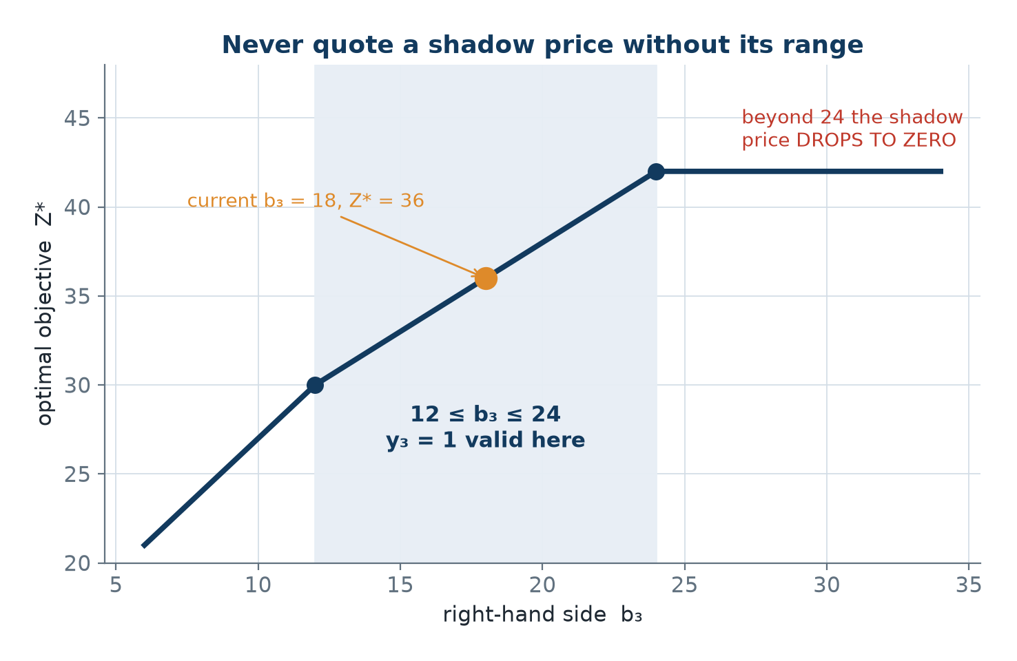
Z* as b₃ moves
• Inside 12 ≤ b₃ ≤ 24 the slope is exactly the shadow price y₃ = 1.
• Z* = 30 at b₃ = 12, 36 at b₃ = 18 and 42 at b₃ = 24.
• At b₃ = 24 the constraint x₁ ≤ 4 becomes binding and s₁ = 0.
• Beyond 24 the graph is flat: the shadow price has dropped to zero.
A straight line of slope 1 from b₃ = 12 to b₃ = 24, flat thereafter.
OM-L07 · Duality and Sensitivity Analysis
Nikhil Rajput
187
Notes:
The graph plots Z*, the best achievable objective, against the stock b₃, and the thing to look at is where it stops climbing. Between b₃ = 12 and b₃ = 24 the line is straight with slope exactly 1: raising the stock by one unit raises the optimum by 1, which is what it means for y₃ = 1 to be the derivative ∂Z*/∂b₃. That straightness is why a shadow price may legitimately be multiplied by the number of units bought, provided you stay inside the window - Z* runs from 30 at b₃ = 12 through 36 at b₃ = 18 to 42 at b₃ = 24. The kink at 24 appears because s₁ has reached zero and x₁ ≤ 4 has taken over as the binding constraint. Beyond it the line is flat, so the price there is zero and further purchases at any positive price are pure loss. The lesson is that the number quoted is a slope, and slopes change at corners.

Slide 188
Solved Problem 5 - The 100 % rule for simultaneous changes
For Problem 1, b₂ increases by 2 and b₃ increases by 3 simultaneously. Are the shadow prices still valid? Compute the new Z*.
Step 1 - The individual allowable ranges
b₂: column (1/3, 1/2, −1/3)ᵀ on basics (2, 6, 2) gives x₁ = 2 − Δ₂/3 ≥ 0.
So Δ₂ ≤ 6 - the allowable increase in b₂ is 6.
b₃: from Problem 3, the allowable increase is also 6.
Step 2 - The fractions
Δ₂/6 + Δ₃/6 = 2/6 + 3/6 = 0.333 + 0.500 = 0.833
0.833 ≤ 1, so the rule holds.
The basis and both shadow prices remain valid.
Step 3 - The new objective value
Z*(new) = 36 + 2(1.5) + 3(1) = 36 + 3 + 3 = 42
Step 4 - Direct verification with b₂ = 14, b₃ = 21
s₁ = 2 + 2/3 − 3/3 = 1.667, x₂ = 6 + 1 = 7, x₁ = 2 − 2/3 + 1 = 2.333
All non-negative, so the basis is indeed still feasible.
Z = 3(2.333) + 5(7) = 7.00 + 35 = 42
2x₂ = 14 ≤ 14 binding; 3(2.333) + 2(7) = 21 ≤ 21 binding.
Fractions sum to 0.833 ≤ 1 - the shadow prices hold, and Z*(new) = 42
Had the changes been Δ₂ = 5 and Δ₃ = 5, then 5/6 + 5/6 = 1.667 > 1 and the rule gives no guarantee. Checking directly, x₁ = 2 and s₁ = 2 stay non-negative, so the basis actually does survive. The rule is conservative by design.
OM-L07 · Duality and Sensitivity Analysis
Nikhil Rajput
188
Notes:
Here two right-hand sides move at once, b₂ up by 2 and b₃ up by 3, so no single range settles the question and the 100 % rule is the cheap test to reach for. Step 1 computes each allowable increase separately: for b₂ the column (1/3, 1/2, −1/3)ᵀ acting on basics (2, 6, 2) forces x₁ = 2 − Δ₂/3 ≥ 0, so Δ₂ ≤ 6, and the earlier ranging gave the same 6 for b₃. Step 2 turns the two changes into fractions of those ranges, 2/6 + 3/6 = 0.833, which is at most 1, so the basis and both prices survive. That lets the new optimum be predicted instead of recomputed: Z* = 36 + 2(1.5) + 3(1) = 42, confirmed in Step 4 by direct substitution with b₂ = 14 and b₃ = 21. The closing comment is the honest part - with increases of 5 and 5 the fractions reach 1.667, the rule declines to conclude, and yet a direct check shows the basis surviving anyway.

Slide 189
Where duality and shadow prices are used
Electricity market clearing
The locational marginal price a generator is paid is the dual variable of the power-balance constraint at that node.
Airline crew pairing
Billions of legal pairings exist; dual prices on flight-coverage rows decide which new column is even worth generating.
Paper and steel cutting stock
Shadow prices on order rows price each candidate cutting pattern, so only profitable patterns are ever built.
Hospital theatre capacity
The shadow price of theatre hours says what an extra evening list is worth before any staff or capital are committed.
Feed and fuel blending
Ranging on ingredient prices shows how far soy or naphtha can move before the least-cost recipe changes at all.
OM-L07 · Duality and Sensitivity Analysis
Nikhil Rajput
189
Notes:
Each of these is the same dual variable read in a different industry, which is worth seeing because the mathematics never changes. A locational marginal price is literally the dual variable of the power-balance constraint at a node, so an electricity market can be cleared by solving one optimisation and paying generators the prices it produces. Crew pairing and cutting stock share a different mechanism: the number of legal columns is far too large to write down, so dual prices on the coverage or order rows decide which candidate column is even worth generating - column generation, which is the new-product pricing test run automatically inside the solver. Theatre capacity uses the price directly as a decision aid, valuing an extra evening list before staff or capital are committed. Blending is the ranging side rather than the pricing side: how far an ingredient price may move before the least-cost recipe changes. In every case the price is only as good as the range that accompanies it.

Slide 190
The intuition - what a shadow price really is
A shadow price is what one more hour on your saw is worth to you tonight. Not what the saw cost, and not what the shop next door charges for one.
• It is only positive if the saw is the thing actually holding you back.
• If the hour is worth ₹1.50 to you, pay anything under ₹1.50 and you come out ahead.
• The price holds for a while and then stops. One more hour helps; a hundred more may not.
• So the range matters as much as the price. Here ₹1 per unit holds only up to 24 units.
• Quoting the price without the range is how sensible plans become wasted purchases.
OM-L07 · Duality and Sensitivity Analysis
Nikhil Rajput
190
Notes:
A shadow price is the marginal value of one more unit of a resource to you, given the plan you are already running, and the quickest way to grasp it is by contrast with the two numbers people reach for instead. It is not what the equipment cost, because money already spent cannot change what one further unit earns. It is not what a competitor charges, because that is a market price, not your valuation. It comes from your own optimisation: if the saw is what holds output back, one more hour on it lets the plan grow, and the amount the plan grows by is the price. So it is positive only for a resource you have genuinely run out of, and zero otherwise. If an hour is worth ₹1.50 to you, paying anything below ₹1.50 leaves you ahead. And it expires: here ₹1 per unit holds only up to 24 units, which is why the range must travel with the number every time it is quoted.

Slide 191
Common mistakes to avoid
• Quoting a shadow price without its range - beyond the range the price changes, often to zero.
• Assuming the same marginal value applies however much of a resource you buy.
• Giving a positive price to a constraint with slack; complementary slackness forces yᵢ* = 0.
• Expecting a finite primal optimum alongside an infeasible or unbounded dual - impossible.
• Reading a 100 % rule sum above 1 as proof the basis changed; it only means you cannot conclude.
• Failing to re-solve once the fractions of the allowable ranges exceed 1.
• Mis-transposing signs: a ≥ constraint in a max primal gives a dual variable yᵢ ≤ 0.
OM-L07 · Duality and Sensitivity Analysis
Nikhil Rajput
191
Notes:
These errors share one root: treating a local, conditional number as a global fact. A shadow price is the derivative of the optimum at the current data, valid only while the same constraints bind, so it cannot be multiplied by an arbitrary quantity, and past its range it very often falls to zero - as y₃ = 1 does beyond b₃ = 24. Complementary slackness forbids giving a positive price to a constraint that still has slack, since spare capacity means an extra unit changes nothing. Strong duality forbids a finite optimum on one side facing an infeasible or unbounded partner, so that pairing signals an arithmetic or modelling error rather than a discovery. The sign rule is the mechanical trap: a ≥ constraint in a maximisation gives yᵢ ≤ 0. And the 100 % error is subtlest of all - a fraction sum above 1 is an absence of proof, not a proof of change, and the only correct response is to re-solve.

Slide 192
Summary
• The dual transposes the primal: m constraints ↔ m variables, b ↔ c, A ↔ Aᵀ, ≤ ↔ ≥. The dual of the dual is the primal.
• Weak duality: any dual-feasible solution bounds the primal optimum. Strong duality: Z* = W*.
• Complementary slackness: slack > 0 ⟹ shadow price 0, and shadow price > 0 ⟹ constraint binding.
• Shadow prices yᵢ = ∂Z*/∂bᵢ are read from the slack columns' zⱼ − cⱼ entries.
• Use them for buying decisions, bottleneck priorities and product costing - the basis of column generation.
• Ranging: an RHS range keeps xB + Δ(B⁻¹)·ᵢ ≥ 0; a cⱼ range keeps every zₖ − cₖ ≥ 0.
• The 100 % rule validates simultaneous changes; it is sufficient but not necessary, conservative by design.
OM-L07 · Duality and Sensitivity Analysis
Nikhil Rajput
192
Notes:
Two threads tie all of this together. The first is that one simplex run answers two questions at once. It produces the plan, and it produces a price for every constraint - the dual variables yᵢ = ∂Z*/∂bᵢ, read straight from the zⱼ − cⱼ entries in the slack columns at no extra cost. Three theorems make those numbers trustworthy: weak duality bounds, strong duality gives Z* = W*, and complementary slackness fixes which prices are zero. The second thread is that every one of those prices is conditional. Each holds only while the same constraints bind, over an interval that ranging computes - from xB + Δ(B⁻¹)·ᵢ ≥ 0 for a right-hand side, and from keeping every zₖ − cₖ ≥ 0 for a profit coefficient - with the 100 % rule extending the guarantee to simultaneous changes. Duality is what makes the numbers mean something; sensitivity analysis is what makes them safe to quote to somebody who will act on them.

Slide 193
Practice problems
• Write the dual of min 4y₁ + 6y₂ s.t. y₁ + 2y₂ ≥ 3, 3y₁ + y₂ ≥ 5, y ≥ 0.
• If a primal is unbounded, what can you say about its dual? [Ans: infeasible]
• Given slack = 5 on constraint 2, what is y₂? [Ans: 0, by complementary slackness]
• A resource costs ₹8 per unit in the market and has shadow price ₹6. Buy or not? [Ans: do not buy]
• Changes use 40 %, 30 % and 20 % of their ranges. Is the basis still optimal? [Ans: 90 % ≤ 100 %, yes]
• A new product's imputed cost is ₹12 and it sells for ₹10. Introduce it? [Ans: no - reduced cost −2]
OM-L07 · Duality and Sensitivity Analysis
Nikhil Rajput
193
Notes:
These are meant to be worked without a tableau in front of you, because each isolates a single idea rather than a computation. The first asks whether a minimisation can be dualised, which the correspondence table settles when read from its right column to its left: the dual of a minimisation is a maximisation, and dualising twice returns the original. The second and third use the theorems as inference rules rather than as things to prove - unbounded on one side forces infeasible on the other by weak duality, and slack 5 on constraint 2 forces y₂ = 0 by complementary slackness. The fourth and the last are the two decision tests: market price against yᵢ, so ₹8 against a price of ₹6 means do not buy; and imputed resource cost against revenue, so ₹12 of resources earning ₹10 gives a reduced cost of −2 and a refusal. The remaining one is the reminder that 90 % passes, while anything above 100 % simply means re-solve.

